Slide 1
We Value Nature
Train-the-trainer on scoping a natural capital assessment
7 December 2020
Notes:
KB

Slide 2
We Value Nature – Who are we?
We Value Nature is a campaign supporting businesses and the natural capital community to make valuing nature the new normal for business across Europe, by:
Sharing research, resources & best practices;
Identifying barriers & opportunities for adopting a natural capital approach;
Providing practical support to help business improve their risk management, communication & stakeholder engagement;
Reinforcing & boosting the work of the Natural Capital Coalition.
Notes:
KB

Slide 3
Who is your support team for today?
Katia Bonga
Dr Stephanie Hime
Sabina Gordon
Caroline von Celsing
Notes:
Katia
Introductions for those who are presenting the session (virtual or in person)

Slide 4
A few “house rules”
Please change your username to your full name and (organization)
E.g. John Doe (WBCSD)
Please submit comments or questions in the chat function
We’ll also use Menti. Contribute and share your experiences
Ensure that you are on mute when not taking part in discussions
Make sure to be joining us through Zoom app or computer
We invite you to turn on your camera when speaking
This session is being recorded. Slides & recording will be shared afterwards.
Notes:
KB

Slide 5
Today’s objectives
Provide you with an overview of module 2, and explain how to deliver, adapt and contextualize the training material;
Aid different explanations of module 2 materials based on backgrounds, as well as suggesting answers to the main questions that arise;
Share practical tips on how to run the training virtually (using Zoom and Mentimeter) and in-person by going through the group exercise components of the material and how these can be used to engage the audience.
Notes:
KB

Slide 6
Agenda
Time (CET) | Session
15:00 | Welcome – Agenda, objectives, training material
15:10 – 15:20 | Introductions – Getting to know each other
15:20 – 15:30 | Brief presentation of We Value Nature’s capacity building work
15:30 – 16:05 | Go through 1st part of the training – Introduction, setting the scene, natural capital definition, the business case & natural capital impacts & dependencies
16:05 – 16:20 | Coffee break
16:20 – 17:10 | Go through 2nd part of the training – Scoping an assessment
17:10 – 17:40 | Go through 3rd part of the training – Introduction to monetary valuation & wrap-up
17:40 – 18:00 | Train the trainer course wrap-up – Key takeaways, next steps & engagement opportunities Group discussion on training material
18:00 | End of training
18:00 – 18:30 | Virtual Networking Drink (optional)
Notes:
KB

Slide 7
What is the Natural Capital Protocol & how does it work?
p. 2 & 6 in the NCP, p.21 in the workbook
The Natural Capital Protocol is a standardized framework for business to identify, measure and value its direct and indirect impacts and dependencies on natural capital
Notes:
KB
The Natural Capital Coalition is a collaborative space to harmonize approaches to natural capital
The network represents over 300 organizations across all parts of society and around the world
Purpose: To mainstream the inclusion of natural capital in decision making, harmonizing approaches and getting them to scale, quickly
The Protocol aims to support better decisions by taking into account how business interacts with natural capital in decision making. Until now, natural capital has for the most part and still is, being excluded from decisions.
So it is to be understood as a Framework that was really designed to help generate trusted, credible and actionable information that business managers need to inform decisions by identifying, measuring and valuing impacts and dependencies on natural capital.
The Protocol builds upon many approaches already used within business.
It acts as an overarching globally accepted framework to build and expand this information into robust natural capital assessments.
STRUCTURE of the Protocol:
4 overarching stages of frame (why), scope (what), measure and value (how) and apply (so what) and 09 logical steps. It should be easy to follow and should be suitable for any business across any sector or geography.
The stages and steps are iterative so expect that you may need to revisit a previous step.
Important to note that the NCP as an overarching framework, won’t give you actual results and need to therefore use the Nat Cap toolkit to get tools.
Highlight that while we will briefly cover tools and approaches for stages of ‘Measure & Value’ – the aim of the training will mainly focus on first two stages of the Protocol and that going into measurement and valuation technical details, requires a separate training.

Slide 8
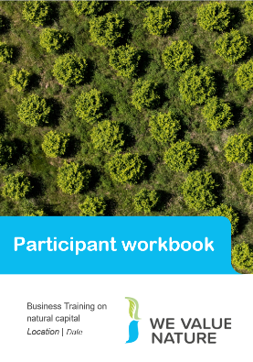
Train-the-trainer material
Take notes!
&
Write down any suggestion(s) in the chat
INCLUDE HERE THE T-T-T GUIDANCE
Full version
Executive summary
Notes:
KB

Slide 9
Legend
This legend will be used throughout the presentation to show where the training can be adapted
Edit the content depending on the timings
Deliver the content in a way that is suited for in-person training
Deliver the content in a way that is suited for virtual training
Edit the content based on the audience background (e.g. experience, knowledge, sector)
Provide further examples or explanation
Adapt the content and add further contextualization based on the relevant sector/region
Background knowledge required to deliver content (e.g. in environmental economics)
Very important slides – do not miss
Notes:
KB/SH

Slide 10
Legend
This legend will be used throughout the presentation to show where the training can be adapted
Edit the content depending on the timings
Deliver the content in a way that is suited for in-person training
Deliver the content in a way that is suited for virtual training
Edit the content based on the audience background (e.g. experience, knowledge, sector)
Provide further examples or explanation
Adapt the content and add further contextualization based on the relevant sector/region
Background knowledge required to deliver content (e.g. in environmental economics)
Very important slides – do not miss
Refer to the implementation guide
Notes:
KB/SH

Slide 11
Implementation Guide
To complement this training deck, an implementation guide has been created
This includes a summarized set of tips and suggestions for engaging with training participants when presenting the course in-person or virtually
This will be shared with you after the session and included on the We Value Nature website along with this deck
Look out for the compass symbol throughout the training deck – it will highlight where the implementation guide could be useful to refer to!

Slide 12
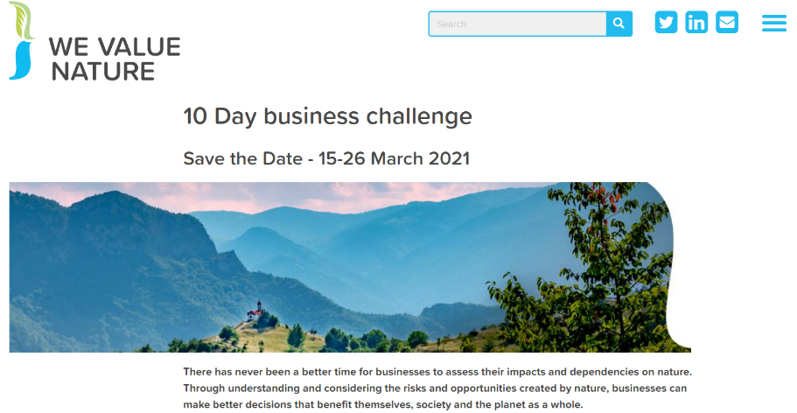
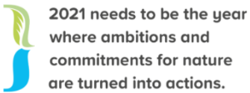
Opportunity to host a training in your language
Make sure to save the dates & pre-register to the event here!
March 2021
A “Call for proposals” will soon be launched.

Slide 13
Introductions
Notes:
KB

Slide 14
Introductions
Please tell us more about you by sharing your thoughts in the chat:
What are you hoping to get out from this train-the-trainer?
Any specific expectations?
Notes:
KB

Slide 15
We Value Nature training & resources
Notes:
KB

Slide 16
Module 2 training development – Acknowledging contributors
We Value Nature’s module 2 training is based on the Natural Capital Protocol and WBCSD’s BET training material.
Module 2 training content and material was developed in collaboration with Little Blue Research Ltd.
The training material has been reviewed by and tested with a group of 10 businesses from a variety of sectors as well as delivered as a test trial to nearly 90 participants representing businesses, NGOs, consultancies as part of WBCSD’s virtual event series.
Finally, 12 experts from the Advisory Board have provided their input into the training material.
Notes:
KB

Slide 17
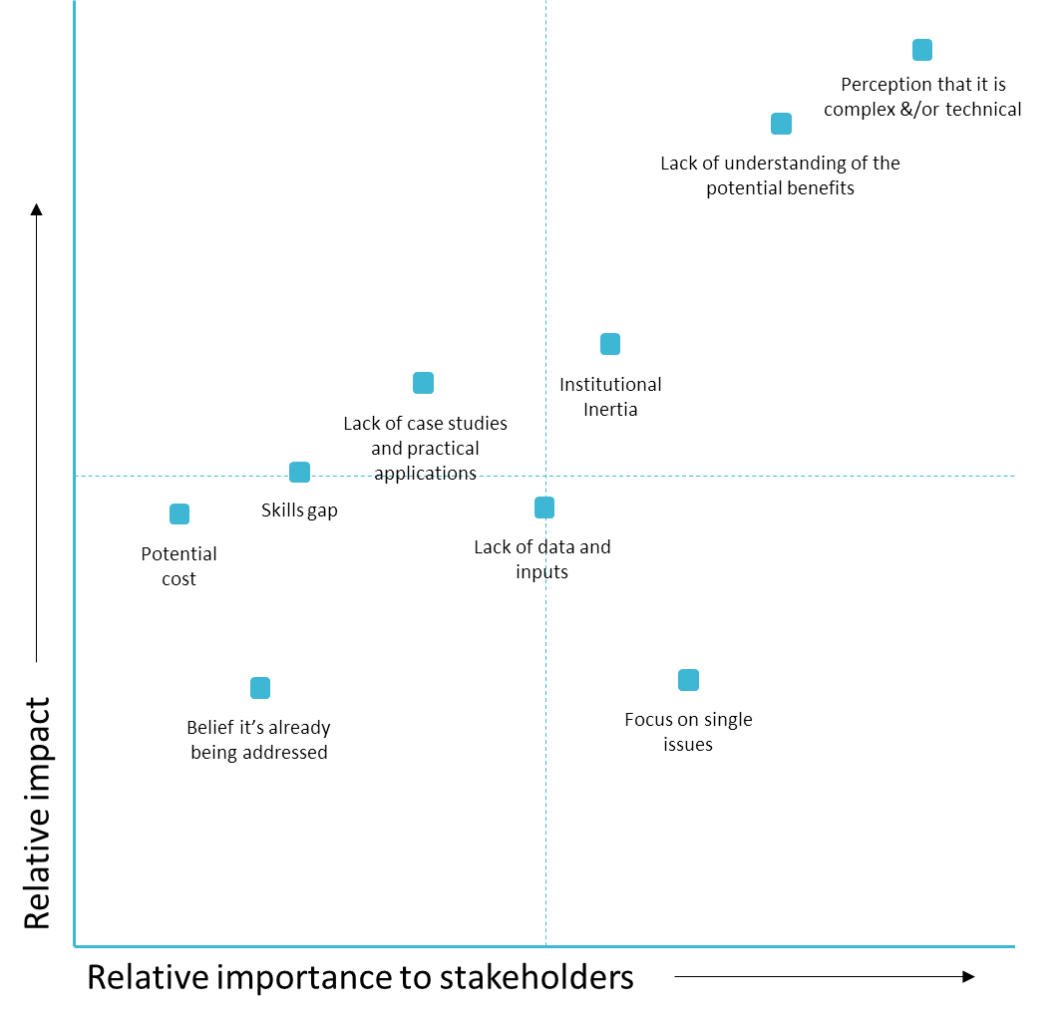
Identification of barriers and bottlenecks
New findings from We Value Nature Survey:
Perception that it is complex &/or technical
Lack of understanding of the potential benefits
Lack of regulatory frameworks
Institutional Inertia
Lack of standards (metrics, reporting etc.)
Lack of data and inputs
Focus on single issues
(In order of importance to stakeholders, 1 is highest)
Based on Coalition Annual review 2016 & 2017
Notes:
KB

Slide 18
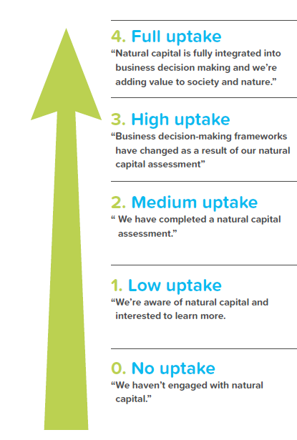
Typical barriers
Comprehensive
WVN actions
Lack of regulatory frameworks
Lack of standards (metrics, reporting etc.)
Focus on single issues
Case studies on public/private policy
Input into NBS standard
Maturing
are influenced by natural capital assessments.
Lack of data and inputs
Lack of case studies and practical applications
Institutional Inertia
“Testimonial” case studies
More detailed, specific training
Developing
Uptake levels of natural capital approaches
Perception that it is complex &/or technical
Lack of understanding of the potential benefits
Introductory training
Simplified, curated communications
First steps
Just starting
Notes:
KB

Slide 19
A modular approach to training
Module 1.
Understanding natural capital and the relationships with business decision-making & risk management
Module 2.
Understanding the tools & resources needed to approach a first natural capital assessment
Module 3.
A deep-dive into natural capital valuation methods
Module 4.
Integrating natural capital to support decision-making
Food & Beverage sector-specific training material
Soon available
Adapting module 1 & 2 for the Food & Beverage sector, as well as producing tailored communication material

Slide 20
We Value Nature training is open
You are free to:
Share — copy and redistribute the material in any medium or format
Adapt — remix, transform, and build upon the material for any purpose, even commercial
Under the following terms:
Attribution — You must give appropriate credit, link to the licence & indicate if changes were made (but not suggest endorsement).
No additional restrictions — You may not legally restrict others from doing anything the license permits.
CC BY 4.0 Creative Commons Attribution 4.0 International
If any images are more restricted this is noted on caption.

Slide 21
How to attribute We Value Nature training materials
If you’re just using one or two slides you can use our attribution block:
View here an example of two training slides on natural capital risks & opportunities that have been adapted to focus on realities in India.

Slide 22
Full attribution
For training courses based on We Value Nature materials:
Include these three slides.
Give them a couple of minutes… please don’t skip over them.
Ensure that participants understand that original We Value Nature materials are available under an open license.
View here our best practice on how to appropriately credit.

Slide 23
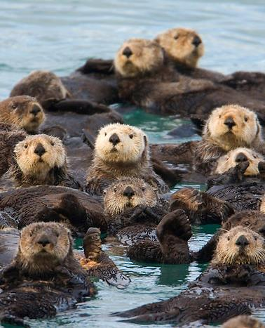
It’s good to share!
Let us know how you use the We Value Nature training materials.
How have you adapted them for your own training?
We will be pleased to share your news & resources with the We Value Nature community.
Share your remixed materials in our open media library
Training@wevaluenature.eu
@WeValueNature
smileycreek CC BY-NC-SA 2.0

Slide 24
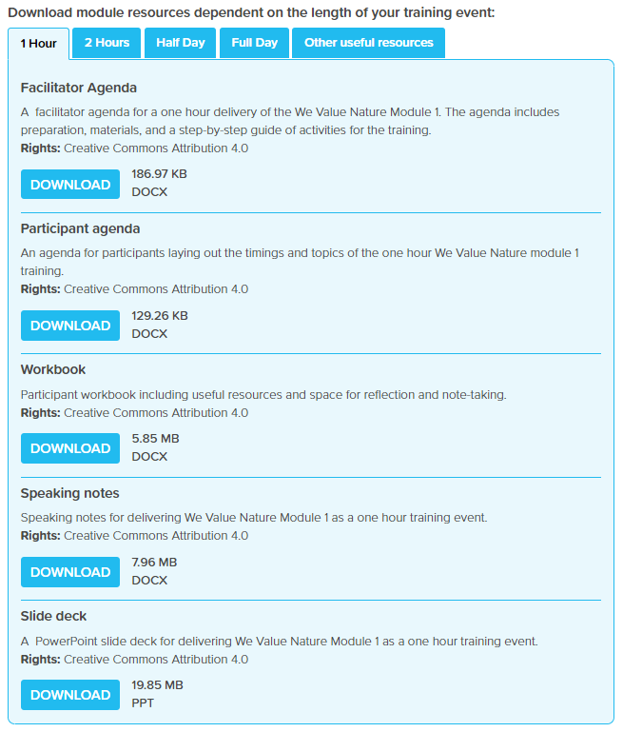
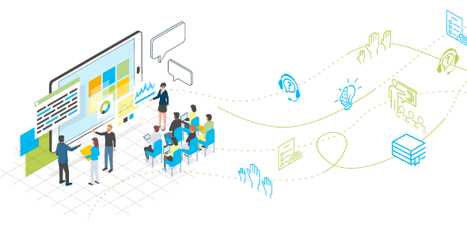
How can you adapt the length of the training?
You will find all the material adapted to different timing on We Value Nature’s training resources page!

Slide 25
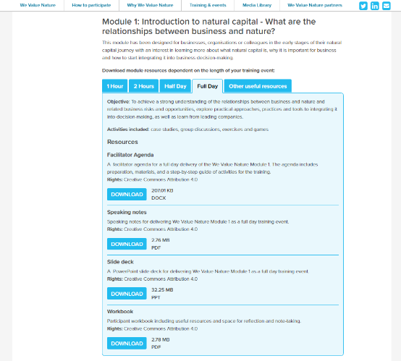
How can you adapt the length of the training?
You will find all the material adapted to different timing on We Value Nature’s training resources page!
The implementation guide provides useful information on what parts of the WVN training is most relevant for different audience groups
Notes:
KB

Slide 26
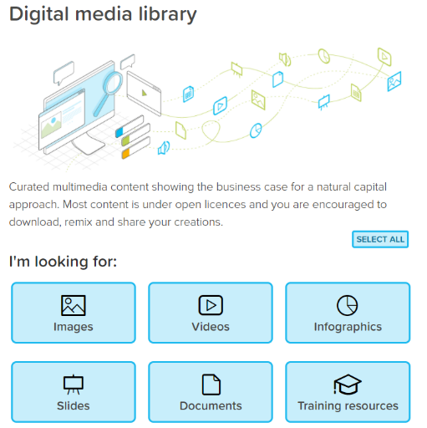
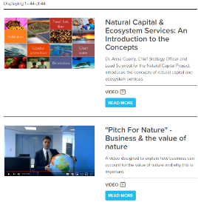
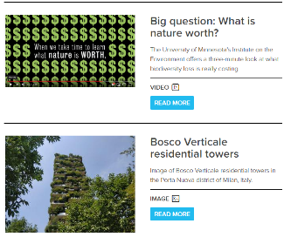
Supporting resources to the training material – Media library
We Value Nature’s open media library is a one stop shop to a variety of resources relating to nature in general and constitutes a valuable support to the open learning platform.

Slide 27
Business training on natural capital
Session overview: Module 2 covers how to scope a Natural Capital Assessment. It builds on an introductory module (Module 1).
Scoping a natural capital assessment
Three-hour training session
Notes:
SH - we are officially going to start walking you through our module 2 training material and will be showing you the 3h version of it for you to have the full spectrum of what can be done.

Slide 28
We Value Nature’s business training on natural capital – link to M1
Module 1
Understanding natural capital and the relationships with business decision-making & risk management
Module 2
Acquiring the resources & understanding needed to scope a first natural capital assessment
Today’s training
Understand the concept of natural capital and related risks & opportunities
Linkages with business decision-making & risk management
Introduction to a few key approaches
Identify and measure impact drivers and/or dependencies
Practical considerations
Introduction to valuation techniques
Trainer to discuss the different modules of training available to set expectations.
In order to commence with M2, it is important that the audience are familiar with a couple of key definitions from the M1 i.e. natural capital and ecosystem services

Slide 29
Learning objectives of module 2
The aim of We Value Nature’s module 2 training is:
To understand how to identify natural capital impacts and dependencies that are important to your business,
Acquire the necessary tools, resources and understanding to scope your own assessment,
To be introduced to the key practical considerations and steps to take when undertaking a first natural capital assessment as well as some tools to help undertake an assessment
To understand materiality assessments in the context of impacts and dependencies and how to undertake them
To introduce valuation following on from the brief overview provided in module one
Trainer to set out the relevant learning objectives for the training.

Slide 30
Agenda
The agenda can be modified depending on the time available. There are different options available for training duration i.e. 1-, 2- & 3- hours.
Note: there are more complex case studies & material in the 3-hour module for participants with more of a background in natural capital.
Time (XXX) | Session
10 | Introductions
15 | Setting the scene and a brief re-cap on natural capital
10 | The business case for assessing natural capital & common assessments
40 | Identifying your natural capital impacts & dependencies
15 | Coffee Break
25 | Scoping an assessment
20 | Materiality ADV
20 | Introduction to monetary valuation for scoping an assessment ADV
20 | Case study presentation
15 | Wrap-up & next steps

Slide 31
Agenda
Tips on modifying the agenda can be found in the implementation guide
The agenda can be modified depending on the time available. There are different options available for training duration i.e. 1-, 2- & 3- hours.
Note: there are more complex case studies & material in the 3-hour module for participants with more of a background in natural capital.
Time (XXX) | Session
10 | Introductions
15 | Setting the scene and a brief re-cap on natural capital
10 | The business case for assessing natural capital & common assessments
40 | Identifying your natural capital impacts & dependencies
15 | Coffee Break
25 | Scoping an assessment
20 | Materiality ADV
20 | Introduction to monetary valuation for scoping an assessment ADV
20 | Case study presentation
15 | Wrap-up & next steps

Slide 32
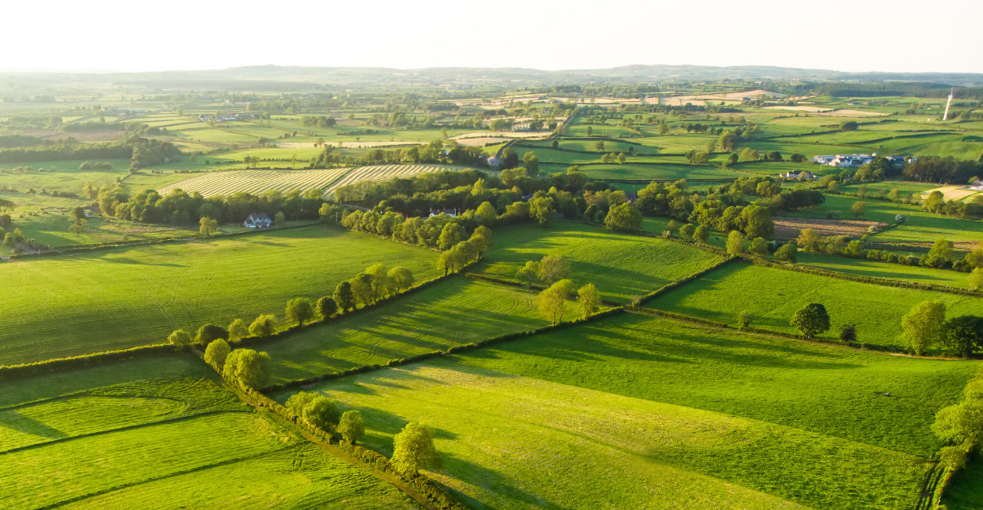
Setting the scene and a brief re-cap on natural capital
Session overview: This session re-caps on relevant definitions and provides the context for the training

Slide 33
Keeping up momentum during the COVID-19 crisis
Institutions urging a green recovery from covid-19
Christine Lagarde, President of ECB: "transition towards a greener economy is a crucial part of economic recovery”
Biden-Harris Transition Plan, USA “At this moment of profound crisis, we have the opportunity to build a more resilient, sustainable economy —one that will put the United States on an irreversible path to achieve net-zero emissions, economy-wide, by no later than 2050.”
"Business as usual" is vulnerable to a range of outside influences, not just market forces
The need for business to take into consideration all capitals
The crisis shows why understanding stakeholder values is important for decision making
Presenter can add further example quotes which are sector or region specific
Notes:
Speakers notes provide some additional back ground to the information in this slide
New WEF report on COVID and research section

Slide 34
Recent developments in the sustainability sector
TNFD – banks, companies & governments have set up a Task Force on Nature-related Financial Disclosures (to launch 2021)
Water guidance CDSB – framework for water-related disclosures supported by the LIFE programme/EU (to launch 2021)
Science Base Targets – targets to reduce GHG that are in line with science to meet the goals of the Paris Agreement (2020)
Merger of organisations – CDP, CDSB, GRI, SASB and IIRC have co-published a framework for comprehensive reporting (2020)
Integrated capitals – standardized natural capital accounting principles for businesses from the NCP and SHCP (2020)
IUCN’s Global Standard for Nature-based Solutions which provides clear parameters for defining NbS and a common framework to help benchmark progress
TEEBAgriFood operational guidelines for business which helps the food & beverage industry better understand their specific impact & dependencies not just on natural capital, but also social & human capital
More specific to biodiversity is IUCN’s biodiversity guidelines for planning and monitoring corporate biodiversity performance (incl. key biodiversity indicators)
The CBD post-2020 Global Biodiversity Framework – FYI Business for nature put together a helpful guide for businesses to help understand what is important for them
BSI 8632 Natural capital accounting for organisations – public consultation has been launched and is open until 4/02/2021

Slide 35
Keeping up momentum during the COVID-19 crisis
Institutions urging a green recovery from covid-19
Christine Lagarde, President of ECB: "transition towards a greener economy is a crucial part of economic recovery"
"Business as usual" is vulnerable to a range of outside influences, not just market forces
The need for business to take into consideration all capitals
The crisis shows why understanding stakeholder values is important for decision making
Presenter can add further example quotes which are sector or region specific
Notes:
Speakers notes provide some additional back ground to the information in this slide
New WEF report on COVID and research section

Slide 36
Video or concrete company example
Pitch for nature video – short clip explaining why business should invest in natural capital
Natural capital, a short film series, WBCSD – example of where pollution risks can cause a business issue
WBCSD video on business investing in nature – inspirational video about business and nature featuring contributions from businesses
Case-study – simple one
3 short & simple natural capital case studies available here
Different videos are available to help introduce the topic. Alternatively the trainer can present a case study example

Slide 37
Knowledge checks
The implementation guide also provides detailed tips on using Menti and Zoom
Interactive software like mentimeter can be used in-person or virtually! Alternatively, multiple choice options can be provided via a zoom poll.
Details of how to use Zoom and Menti are provided in the speaker notes for the module.
Possible answers are given in the speaker notes

Slide 38
Knowledge checks
Interactive software like mentimeter can be used in-person or virtually! Alternatively, multiple choice options can be provided via a zoom poll.
Details of how to use Zoom and Menti are provided in the speaker notes for the module.
Possible answers are given in the speaker notes

Slide 39
Mentimeter screen shots
Possible answers are given in the speaker notes
Alternative: use of an open question to produce a word cloud, or use of speech bubbles for answers
Notes:
Example answers are given in speaker notes for what is NOT a form on natural capital
Can Do an open ended question on Menti where participants write their definition of natural capital

Slide 40
Definitions and theory
Adaptations can be made, and more definitions added depending on the background of the audience.
Definitions from the Natural Capital Protocol have been used throughout the training as these are referenced throughout the process of scoping an assessment.
The Protocol was developed by a number of experts across different stakeholder groups and subject to an extensive consultation process before release.
Notes:
The speakers notes include further details on the definitions used in the deck. In addition the presenter should familiarise themselves with the NCP which provides more details

Slide 41
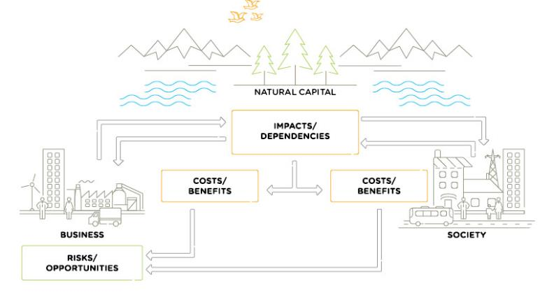
Business depends on & impacts natural capital
Refer to p.15 of the Natural Capital Protocol
Potential to go over in detail, by providing an example, depending on the audiences’ background.
1
2
All businesses impact and depend upon natural capital.
3
This relationship delivers costs and benefits back to themselves and to society.
These in turn lead to risks and opportunities to the business
Notes:
Emphasis on the connections between natural, social and economic issues are fundamentally interconnected and cannot be separated from one another

Slide 42
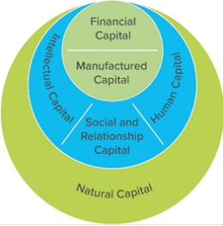
Integrating approaches and building links between protocols
Brundtland - Sustainable Development is development that meets the needs of the present without compromising the ability of future generations to meet their own needs.
Generally-accepted frameworks for business to identify, measure and value its impacts and dependencies on natural, social and human capital.
Full version
Full version
Executive summary
2016
2019
Depending on the familiarity of the audience with the protocols, potential to expand on their development and structure.
Notes:
Presenter recaps the definition to SD and provides some more information on the development of the different Protocols (further summary notes are provided in the speaker notes). Include information that Protocols build on existing guidance and don’t reinvent the wheel
Principles of integrated assessment that has just been released

Slide 43
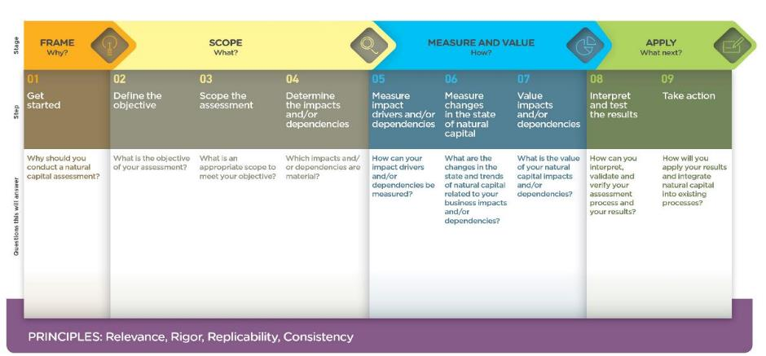
What parts of the Natural Capital Protocol will we cover?
Module 1
Module 2
Introduction in module 2
Edit the elements of the Protocol that are included depending on the background of the audience and the timings of the session.
Presenter to set out which steps will be included in their training session.

Slide 44
Summary tips: introduction and setting the scene
Adapt the structure of the introduction sessions depending on how the session is being delivered, consider:
What is the best way to engage with your audience given the way that they are watching?
Are the audience members fully equipped to participate in the training? Do they need to complete an exercise beforehand or asked to read through definitions?
Understand the objectives and background of your audience, think about:
Whether the audience all come from the same sector?
How experienced and knowledgeable are they with respect to natural capital?
Set the scene in relation to the context in which the training is being given, determine:
Whether the training being delivered in a region with a different relationship to natural capital e.g. is valuation considered acceptable?
Whether there is a sector-specific context that can be provided? Or an economic/environmental context.
Adapt the knowledge checks depending on the audience background, understand:
How familiar will the participants be with key definitions and terms used?
Make the training material as interactive and engaging as possible!
Use software like Mentimeter or Zoom to get feedback on the audiences’ ideas and check their understanding
Summaries of these tips by tip type can be found in the implementation guide

Slide 45
Summary tips: introduction and setting the scene
Adapt the structure of the introduction sessions depending on how the session is being delivered, consider:
What is the best way to engage with your audience given the way that they are watching?
Are the audience members fully equipped to participate in the training? Do they need to complete an exercise beforehand or asked to read through definitions?
Understand the objectives and background of your audience, think about:
Whether the audience all come from the same sector?
How experienced and knowledgeable are they with respect to natural capital?
Set the scene in relation to the context in which the training is being given, determine:
Whether the training being delivered in a region with a different relationship to natural capital e.g. is valuation considered acceptable?
Whether there is a sector-specific context that can be provided? Or an economic/environmental context.
Adapt the knowledge checks depending on the audience background, understand:
How familiar will the participants be with key definitions and terms used?
Make the training material as interactive and engaging as possible!
Use software like Mentimeter or Zoom to get feedback on the audiences’ ideas and check their understanding

Slide 46
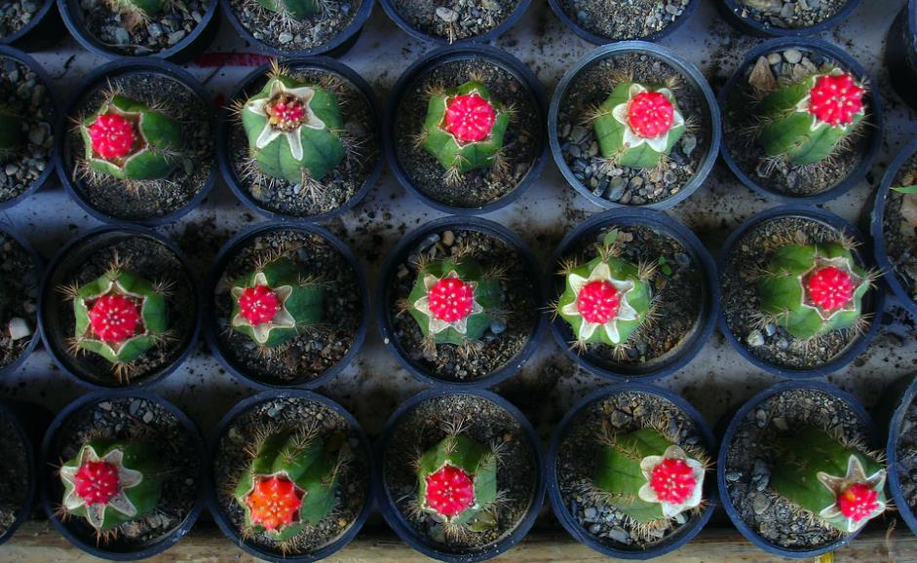
The business case for assessing natural capital & common assessments
Overview: This session sets out the business case for natural capital assessments and the definitions of natural capital impacts & dependencies

Slide 47
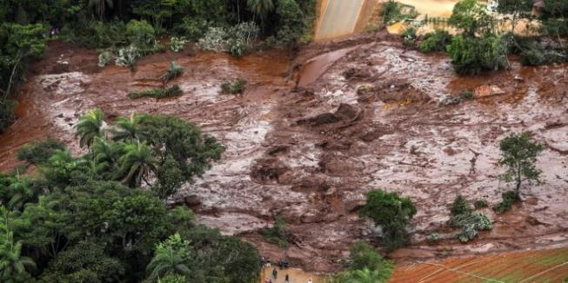
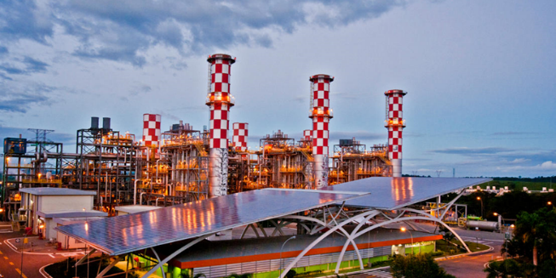
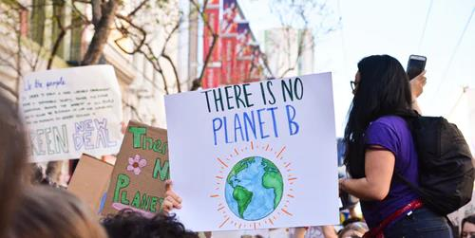
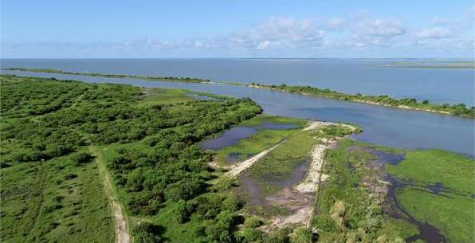
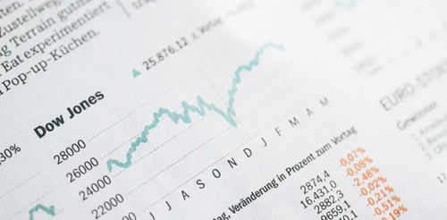
Reputational & Societal Opportunity
Operational Opportunity
Reputational & Societal Risk
Operational Risk
If relevant, highlight the types of risk which are more applicable to the audience – explain these using real-life examples to aid understanding. Include solutions to bring an encouraging message
The accompanying speakers notes provide examples of risk and opportunities to elaborate on but there is also potential to include your own examples
Legal Opportunity
Financial Risk
Legal Risk
Financial Opportunity
Risks for business
Opportunities for business
Notes:
Speaker notes:
Risk examples available for: Vale damn collapse (operational), Texas oil company, Anadarko Petroleum (legal risk), Canadian gold mining company, Infinito (financial)
Opportunity examples: EDF use of rain water harvesting (operational), ikea (reputation and market leading)
Remind trainers that slide is animated and that it is important to show risks and solutions to give an encouraging message

Slide 48
Reflections, risks and opportunities
Individually reflect on whether each of these ecosystem services pose more of a risk or opportunity?
Soil regulation:
Pollination
Water extraction
Note: reflection time is useful to help participants think about the different examples and concepts and how they may be applicable to their own situation
Is natural capital more of a risk or an opportunity?
Potential to skip this reflection or cut down the number of ecosystem services considered depending on the timing
Change the number and or types of ecosystem services. The trainer can make this sector specific or alter the difficulty level depending on the audience background. More details on each service are provided in the speaker notes.
Notes:
Speaker notes

Slide 49
Reflections, risks and opportunities
Note: reflection time is useful to help participants think about the different examples and concepts and how they may be applicable to their own situation
Individually reflect on whether each of these ecosystem services pose more of a risk or opportunity?
Soil regulation:
Pollination
Water extraction
Is natural capital more of a risk or an opportunity?
Potential to skip this reflection or cut down the number of ecosystem services considered depending on the timing
Change the number and or types of ecosystem services. The trainer can make this sector specific or alter the difficulty level depending on the audience background. More details on each service are provided in the speaker notes.
Notes:
Speaker notes

Slide 50
Why assess your impacts & dependencies? The business case…
Many natural capital risks and opportunities are becoming increasingly visible, and business needs a way to understand and manage these.
Understand relationships with nature in a structured way
Challenge your business model
Mitigate risks
Increased competitive advantage
Create opportunities
Inform decisions that are really important to your business
Access to finance
Recruitment & retention of staff
Elaborate on these reasons, drawing on your personal experience. Explain that once participants have a better understanding of their relationship with nature, this can be used to challenge business models, mitigate risks and create opportunities.
Note: you may also wish to emphasize that natural capital can also be a valuable tool for broadening the conversation to include all parts of your business, including the finance team.
Notes:
For SH – business model, mitigation of risk, competitive advantage, inform decisions

Slide 51
Assessments: Measure & Value
Refer to p.82
of the
Natural Capital Protocol
To measure ≠ to value
To measure: determine the amounts, extent and condition in physical terms
e.g. m3, tons, number of injuries, number of jobs
To value: estimate the relative importance, worth, or usefulness of natural / social / human capital to people (or to a business), in a particular context.
Qualitative
Quantitative
Monetary
Costs and benefits to the business, and to society
Detailed notes on these definitions are provided in the speakers notes
Notes:
Check speaker notes

Slide 52
Business application
See p. 20 in the Natural Capital Protocol
Natural capital information can be used in plenty of ways. You need to decide what information you need and how it will be used.
Some examples can be found in the speaker’s notes
Potential Business Applications
Assess risks and opportunities for the company or a department (new options for ecological product development, the risk associated with increased water stress, etc.)
Compare options e.g. choosing between flood solutions
Assess impacts on stakeholders, how are nearby communities impacted by different factory policies
Estimate total value and/or net impact
Communicate internally or externally
Potential to cut down or skip depending on the timings / audience familiarity with the content
The audience would benefit from the presenter drawing on their own examples of business application
Notes:
Examples in the speaker notes:
Assessing risks and opportunities: e.g. assess risks and opportunities of capital expenditure when deciding which flood solution to choose
Assessing impacts on stakeholders: e.g. assess how a company's dependency on a local water supply affects local communities
Estimating the total value and/or net impact of the company: e.g. estimating the total impact of a manufacturing company across the entire value chain (upstream, direct operations, downstream)
Currently looking at climate risk for clients
Measuring impacts across a sector to determine what should be managed as a first priority

Slide 53
Overview of current assessments
The speaker notes include more information about this data
An overview of uptake can be provided and updated depending on the context for your session.
NC or SHC
Organization type
Notes:
Presenter to explain that the majority of assessments carried out include only natural capital, and that very few assessments measure social and human capital as yet without also measuring natural capital.
Presenter to explain that the majority of companies carrying out assessments are businesses, with governments carrying out ¼ of all assessments and finance carrying out the least.
I add my own, there may be some case study related data in your company i.e. particular sustainability initiatives, etc.

Slide 54
Statistics
Can use alternative databases to provide an overview of current assessments (for e.g. the Capitals Coalition database: https://naturalcapitalcoalition.org/tag/database/)
Notes:
Also refer to WBCSD, to WEF for reports, We Value Nature, Ecosystem knowledge hub, GIIN

Slide 55
Statistics
Can use alternative databases to provide an overview of current assessments (for e.g. the Capitals Coalition database: https://naturalcapitalcoalition.org/tag/database/)
The implementation guide also provides further resources and useful links for finding information for the training
Notes:
Also refer to WBCSD, to WEF for reports, We Value Nature, Ecosystem knowledge hub, GIIN

Slide 56
Mentimeter question
Where else would you get case studies and examples from?
Notes:
Presenter to read the question out on the slide.
Once poll is complete, presenter should use the notes below to explain the different answers:
Framework to help generate trusted, credible and actionable information that business managers need to inform decisions
Includes how we interact with natural capital in decision asking
Offers standardization and clarity to identify, measure and value impacts and dependencies on natural capital
Builds on a number of approaches that already exist including the Corporate Ecosystem Services Review and the Guide to Corporate Ecosystem Valuation
Does not list specific tools or methodologies because the choice of tools is dependent largely on business context, resources and needs
Virtual session- https://zoom.us/
Add question & answers to a live poll in zoom as per instructions
To enable Polling: Sign in to the Zoom web portal. In the navigation menu, click Account Management then Account Settings (if you are an account administrator) or Settings (if you are an account member). Navigate to the Polling option on the Meeting tab and verify that the setting is enabled. If the setting is disabled, click the toggle to enable it. If a verification dialog displays, choose Turn On to verify the change. Note: If the option is greyed out, it has been locked at either the Group or Account level, and you will need to contact your Zoom administrator.
Creating a poll: Go to the Meetings page and click on your scheduled meeting. If you do not have a scheduled meeting, schedule a meeting now. From the meeting management page, scroll to the bottom to find the Poll option. Click Add to begin creating the poll. Enter a title and your first question. (Optional) Check the box to make the poll anonymous, which will keep the participant's polling information anonymous in the meeting and in the reports. Select whether you want the question to be single choice(participants can only choose one answer) or multiple choice question(participants can choose multiple answers). Type in the answers to your question and click Save at the bottom. If you would like to add a new question, click Add a Question to create a new question for that particular poll.
You can launch a poll by clicking on the live polling icon in the meeting controls and selecting the poll you want to launch. The participants in the meeting will now be prompted to answer the polling questions. The host will be able to see the results live. Once you would like to stop the poll, click End Poll. If you would like to share the results to the participants in the meeting, click Share Results. The results can be downloaded once the meeting has ended.
In person session – https://www.mentimeter.com/
Mentimeter is an interactive presentation software. The host can create a presentation once signing up to Mentimenter. Questions and activities can be added to each slide of the presentation. Participants can answer the questions and interact with the presentation by typing a 6-digit code found at the top of the presentation into Menti.com. The host can either create a new share on Zoom to display the Mentimeter slides, or download the Mentimeter plug-in for PowerPoint.
To run this question, select the Multiple Choice question type when creating your presentation, and fill in the question and answers as directed.

Slide 57
Concrete steps to undertaking a 1st natural capital assessment
ASSESSMENT STEPS
Define your objective (module1)
Iterative process
Identify your impacts and/or dependencies
Timing
Scope your assessment
Organizational focus; value-chain boundary; value perspective; impacts and or dependencies; type of value
Skills
PLANNING
Data
Practicalities
Baseline, scenarios, spatial & temporal boundaries, etc.
Resources
It can be helpful to set out where you are in the training at the start of each session. To keep momentum going during the training.
Measure and Value
Materiality assessments; identify changes in natural capital; assess trends; select valuation techniques; ecosystem valuation tools
Stakeholders
Next steps

Slide 58
Concrete steps to undertaking a 1st natural capital assessment
Edit this diagram depending on the timing and agenda of the training (e.g. the 1-hour session does not include any points on materiality and valuation)
Update this slide after each section, ticking off the titles that have been covered, circling the planning elements for each step and highlighting where you are, in the training, at the start of each section.

Slide 59
Q&A

Slide 60
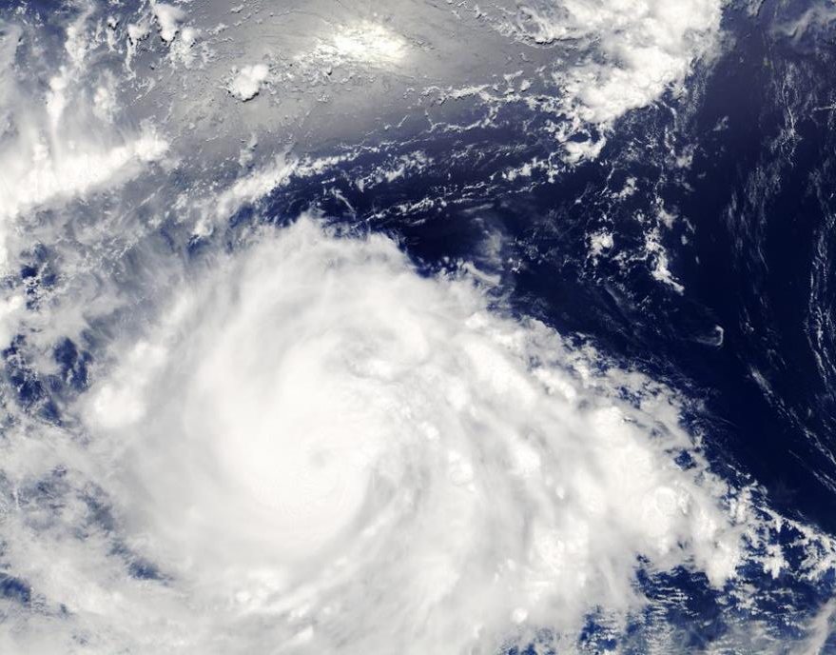
Identifying your natural capital impacts & dependencies
Overview: this session start to help participants understand the impacts/dependencies on various business activities on different stakeholders and areas of natural capital
Impact drivers and dependency pathways

Slide 61
Haagen-Dazs video
Videos make trainings more interactive and engaging and can stimulate discussion
(1) https://www.haagendazs.us/save-the-honey-bees
(2) https://www.nestleusa.com/media/pressreleases/haagen-dazs-virtual-reality-honey-bee-experience-vr-for-impact-program
(3) https://www.youtube.com/watch?v=qtgm-3EQOU4
(4) https://vimeo.com/104360868
(5)
(6)
(6)
(6)
Change this video example depending on what natural capital impacts and dependencies you want to highlight
(1)-(2): Articles about the Haagen-Dazs honeybee campaign
(3): Formal video, interviewing Haagen-Dazs employees about the campaign
(4): Short documentary style video following the campaign and the appearance of Haagen-Dazs in the supreme court
Notes:
Chat useful videos

Slide 62
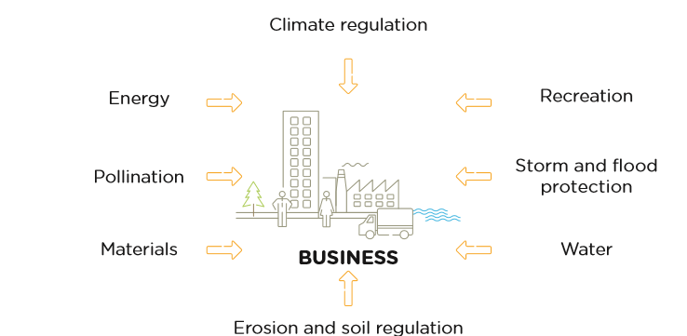
Natural capital dependencies
Refer p.34
of the
Natural Capital Protocol
A business reliance on or use of natural capital
Speakers notes include a number of dependency examples
Notes:
Dependencies: most recently have included water based work focus on quantity

Slide 63
Natural capital impacts and dependencies
Vary the delivery of this depending on the time available – spend more time on the definitions for participants who are unfamiliar with the content.
Dependency pathway example focuses on a pollination example.

Slide 64
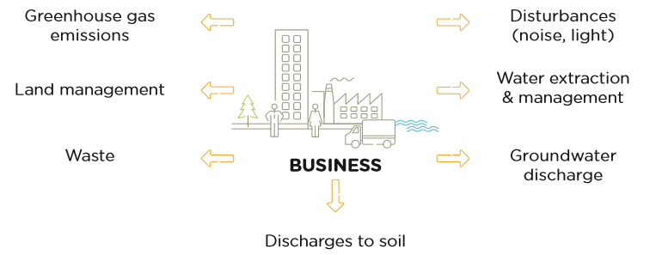
Natural capital impacts
Refer to p.16
of the
Natural Capital Protocol
The negative or positive effect of business activity on natural capital
Speakers notes include a number of impact examples
Notes:
Impact based work has included: carbon, waste (materials), plastics, food waste

Slide 65
Natural capital impacts and dependencies
Vary the delivery of this depending on the time available – spend more time on the definitions for participants who are unfamiliar with the content
The impact driver example provided is one for the manufacture of a T-Shirt.

Slide 66
Knowledge check
Are the following examples of impacts or dependencies, or both?
Soil regulation
Pollination
Water extraction
Impacts, dependencies, or both?
Change the ecosystem services to make sector/region specific or alter the difficulty level.
The presenter should be prepared to discuss the results of the poll with the audience.
Dependency / Impact
0
10

Slide 67
Mentimeter example

Slide 68
Identifying your natural capital impacts & dependencies (continued)
Impact drivers and dependency pathways

Slide 69
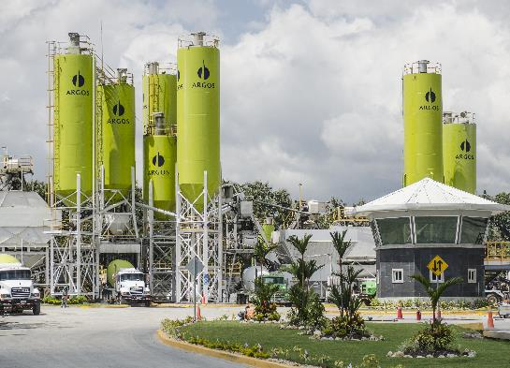
Case study example – Cementos Argos
Cementos Argos is a leading cement and ready-mix concrete producer & distributor
It is a conglomerate operating in different countries, including Colombia, the US, Central America and the Caribbean
The cement production process involves grinding, mixing and heating limestone and clay
Water, sand and gravel are added to the cement to form concrete
Detailed information is provided for two different case studies through out the speaker notes: cement manufacturer and clothing manufacturer
Notes:
Presenter to flag that this is a cut down exercise from a very advanced assessment.

Slide 70
Case study example – Cementos Argos
Cementos Argos is a leading cement and ready-mix concrete producer & distributor
It is a conglomerate operating in different countries, including Colombia, the US, Central America and the Caribbean
The cement production process involves grinding, mixing and heating limestone and clay
Water, sand and gravel are added to the cement to form concrete
Detailed information is provided for two different case studies through out the speaker notes: cement manufacturer and clothing manufacturer
Supporting resources on case studies can be found in the implementation guide
Notes:
Presenter to flag that this is a cut down exercise from a very advanced assessment.

Slide 71
Case study example – Cementos Argos
Option to change the case study to a sector or region-specific example (or one in which a speaker is available)
Presenter to list out the ecosystem services that could be considered when identifying the impacts and dependencies for the case study. Highlight that this is not an exhaustive list and that these services have been sub-grouped (a more detailed list is featured below).
Notes:
This set of ecosystems services will help frame the exercise and help demonstrate why the cut down list in slide 49 has been chosen:

Slide 72
Group exercise in breakout rooms
Presenter to read the points on the slide, explaining how the breakout rooms will work, for the virtual session.
Note: pre-assigning breakout rooms helps however, there can be a risk that some participants may not attend and need to be re-assigned during the course. For more practical tips on how to run breakout rooms, check out Zoom's dedicated webpage: https://support.zoom.us/hc/en-us/articles/206476093-Enabling-breakout-rooms
We will now split into breakout rooms
Approx. 3 groups of 4
You will work through a table of impacts & dependencies for Cementos Argos operations in Colombia
You will have 10 minutes to discuss in your group
You will be notified when you have 5’ of the time left
Each group will have one of the support team member to take notes
One member per group will be asked to feedback in plenary on the main points & reflections that came out

Slide 73
Group exercise at tables
In your groups of 3-4 at your tables
You will work through a cut-down table of impacts & dependencies and decide whether Cementos Argos has high, medium or low impacts and/or dependencies for its operations in Colombia
You will have 10 minutes to discuss in your group
You will be notified when you have 5’ of the time left
Each group will have one of the support team member to take notes
One member per group will be asked to feedback in plenary on the main points & reflections that came out

Slide 74
Case study example – Cementos Argos, Colombia
Natural Capital Impact:
The negative or positive effect of business activity on natural capital (e.g. water extraction)
Natural Capital Dependency:
Business reliance on or use of natural capital (e.g. pollination)
Cementos Argos key impacts and dependencies
Key ecosystem services | Dependency | Impact
Provisioning
Energy
Water
Regulating
Climate regulation
Air quality
Soli erosion
Depending on the knowledge of the audience (and time constraints), you can cut down the table to focus only on impacts/dependencies or only on certain ecosystem services.
This set of ecosystems services is a cut down list from those in the previous slides.

Slide 75
Case study example – Cementos Argos, Colombia
Cementos Argos key impacts and dependencies - Colombia
Key ecosystem services | Dependency | Impact
Provisioning
Energy | Med | Med
Water | High | High
Regulating
Climate regulation | Med/High (depending on specific location) | Med
Air quality | Low | High
Soil erosion | High | Med
You must include a complete table for the results – make sure to update this based on your case study
Presenter must have a reasonable background in carrying out NCA to be able to provide justifications for the scoring

Slide 76
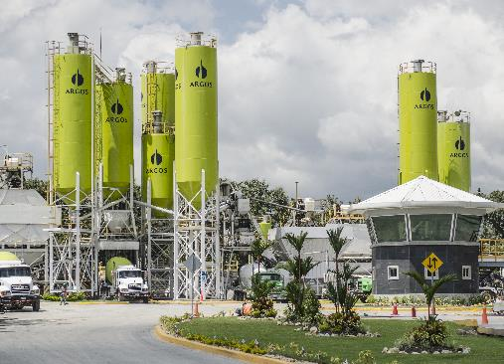
Cementos Argos’ Value Added Statement
Find further information about their VAS here.
Grupo Argos has applied their assessments since 2016
They assess 11 externalities whose contributions increase or reduce the value generated to their stakeholders
The analysis includes information from all of their regions and across all their business lines
The result of the total sum of their externalities is the net value generated to society
If using your own example, you should be able to show what the approach has led to
The speaker notes provide more details and information on the Cementos Argos example

Slide 77
What may be the most material natural capital impact and dependency for your business?
Use the blank spaces in your workbook p. 8 and refer to pp. 47-48 of the NCP
Individually reflect on what would be your business’ natural capital impacts & dependencies
Write down 1 impact & 1 dependency that seem most material to your business at the moment.
Option to skip this reflection if short on time
Potential to adapt the reflection (e.g. write down 1 impact that is material for your sector? Or material for a specific country?)

Slide 78
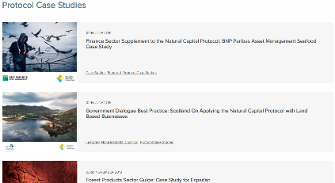
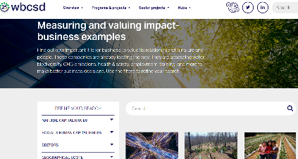
Case Studies platforms I
Natural Capital Coalition’s case studies
Over 160 case examples
Variety of business sectors, and public sector
Examples of how companies have made use of the Natural Capital Protocol
WBCSD’s business examples page
Nearly 60 business examples
Variety of business sectors
Examples of how companies have conducted a natural, social/human capital assessment

Slide 79
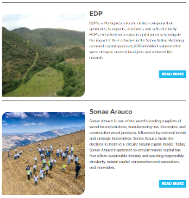
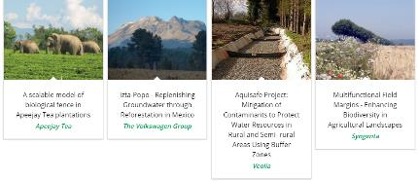
Case Studies platforms II
We Value Nature’s business stories
3 recent business stories relating to natural capital
Variety of business sectors
EDP, Sonae Arauco & Grupo Argo sharing their natural capital journey
Natural infrastructure for business platform
16 business case studies
Variety of business sectors
Examples of how companies have conducted a natural, social/human capital assessment
Case study library

Slide 80
Mentimeter question – sharing resources
Where else would you get case studies and examples from?
Notes:
Presenter to read the question out on the slide.
Once poll is complete, presenter should use the notes below to explain the different answers:
Framework to help generate trusted, credible and actionable information that business managers need to inform decisions
Includes how we interact with natural capital in decision asking
Offers standardization and clarity to identify, measure and value impacts and dependencies on natural capital
Builds on a number of approaches that already exist including the Corporate Ecosystem Services Review and the Guide to Corporate Ecosystem Valuation
Does not list specific tools or methodologies because the choice of tools is dependent largely on business context, resources and needs
Virtual session- https://zoom.us/
Add question & answers to a live poll in zoom as per instructions
To enable Polling: Sign in to the Zoom web portal. In the navigation menu, click Account Management then Account Settings (if you are an account administrator) or Settings (if you are an account member). Navigate to the Polling option on the Meeting tab and verify that the setting is enabled. If the setting is disabled, click the toggle to enable it. If a verification dialog displays, choose Turn On to verify the change. Note: If the option is greyed out, it has been locked at either the Group or Account level, and you will need to contact your Zoom administrator.
Creating a poll: Go to the Meetings page and click on your scheduled meeting. If you do not have a scheduled meeting, schedule a meeting now. From the meeting management page, scroll to the bottom to find the Poll option. Click Add to begin creating the poll. Enter a title and your first question. (Optional) Check the box to make the poll anonymous, which will keep the participant's polling information anonymous in the meeting and in the reports. Select whether you want the question to be single choice(participants can only choose one answer) or multiple choice question(participants can choose multiple answers). Type in the answers to your question and click Save at the bottom. If you would like to add a new question, click Add a Question to create a new question for that particular poll.
You can launch a poll by clicking on the live polling icon in the meeting controls and selecting the poll you want to launch. The participants in the meeting will now be prompted to answer the polling questions. The host will be able to see the results live. Once you would like to stop the poll, click End Poll. If you would like to share the results to the participants in the meeting, click Share Results. The results can be downloaded once the meeting has ended.
In person session – https://www.mentimeter.com/
Mentimeter is an interactive presentation software. The host can create a presentation once signing up to Mentimenter. Questions and activities can be added to each slide of the presentation. Participants can answer the questions and interact with the presentation by typing a 6-digit code found at the top of the presentation into Menti.com. The host can either create a new share on Zoom to display the Mentimeter slides, or download the Mentimeter plug-in for PowerPoint.
To run this question, select the Multiple Choice question type when creating your presentation, and fill in the question and answers as directed.

Slide 81
How to use Mentimeter
1
Go to www.menti.com
2
Enter this code: 56 63 18 7
3
Submit your answer
Notes:
KB

Slide 82
Summary tips: business case for assessing natural capital and identifying impacts and dependencies
Draw on specific examples of business risk and natural capital applications, think about
Situating theoretical points and arguments in real-world examples to help support the participants’ understanding and make the material more relevant for them
Tailor the reflection exercises to the participants’ background, consider whether:
There are certain ecosystem services that are more relevant to the participants’ sector?
How can you get the participants to think about their own natural capital risks and opportunities?
Use the most recent and relevant data, remember to check whether:
The data in the training material reflect current progress on natural capital assessments?
The data shows trends which are significant for the audience?
There are any trends towards assessment that are specific to your sector/region?
Update the case studies depending on the sectoral/regional context of the audience!
Use the case studies that relate to the audience and showcase examples that are meaningful and significant for them

Slide 83
Summary tips: business case for assessing natural capital and identifying impacts and dependencies
Draw on specific examples of business risk and natural capital applications, think about
Situating theoretical points and arguments in real-world examples to help support the participants’ understanding and make the material more relevant for them
Tailor the reflection exercises to the participants’ background, consider whether:
There are certain ecosystem services that are more relevant to the participants’ sector?
How can you get the participants to think about their own natural capital risks and opportunities?
Use the most recent and relevant data, remember to check whether:
The data in the training material reflect current progress on natural capital assessments?
The data shows trends which are significant for the audience?
There are any trends towards assessment that are specific to your sector/region?
Update the case studies depending on the sectoral/regional context of the audience!
Use the case studies that relate to the audience and showcase examples that are meaningful and significant for them
These tips are also summarised by tip type in the implementation guide

Slide 84
Q&A
Notes:
5 minutes, chat then others

Slide 85
15’

Slide 86
Agenda
Time (CET) | Session
15:00 | Welcome – Agenda, objectives, training material
15:10 – 15:20 | Introductions – Getting to know each other
15:20 – 15:30 | Brief presentation of We Value Nature’s capacity building work
15:30 – 16:05 | Go through 1st part of the training – Introduction, setting the scene, natural capital definition, the business case & natural capital impacts & dependencies
16:05 – 16:20 | Coffee break
16:20 – 17:10 | Go through 2nd part of the training – Scoping an assessment
17:10 – 17:40 | Go through 3rd part of the training – Introduction to monetary valuation & wrap-up
17:40 – 18:00 | Train the trainer course wrap-up – Key takeaways, next steps & engagement opportunities Group discussion on training material
18:00 | End of training
18:00 – 18:30 | Virtual Networking Drink (optional)
Notes:
KB

Slide 87
Scoping an assessment
Overview: this session concentrates on the first steps needed to scope an assessment.

Slide 88
Project ambition: scoping an assessment
The speaker’s notes provide examples for each action
Refer to p.42
of the
Natural Capital Protocol
Refer to p.46
of the
Natural Capital Protocol
Determine the organizational focus | Corporate / product / project
Determine the value-chain boundary | Upstream / direct operations / downstream
Specify whose value perspective | Business / society
Decide on assessing impacts and/or dependencies | Impacts / dependencies / both
Decide which types of value you will consider | Qualitative / quantitative / Monetary
Provide real-life examples of different categories (e.g. examples of assessments which are product focused or only focuses on one part of the value chain)
Familiarise your self with the definition of each term by referring to the NCP
Notes:
SH to provide own examples for this slide

Slide 89
Little Blue Research
About us
Little Blue Research is an independent consultancy that specialises in the provision of technical support for environmental economics and social impact valuation. We have an excellent network of experts to help meet client demand for specific skills.
Two case study examples to be discussed:
Food and beverage valuation
Banking and finance climate risk
Note: Information relating to several ‘real’ case studies has been adapted for training purposes and no actual data/information is presented.
Photo by Marvin Meyer on Unsplash
Email: info@littleblueresearch.com

Slide 90
Designing an impact measurement framework for a food & beverage company
Case study 1
Little Blue Research conducted valuation on the material social and environmental impacts and dependencies of a multinational food & beverage company.
Purpose of the assessment was to help inform the development of the company’s strategy and identify areas of potential risk.
The organizational focus of the project was corporate and included a broad assessment of information across the business
Stakeholder and impact mapping was carried out across the entire value-chain
The valuation was approached from a business, societal perspective
15 impacts and dependencies were measured ($), focus on environment
Challenges:
Identifying relevant internal and external data to allow for the completion of an indicative valuation across 15 different indicators in 12 weeks
Using visualization-based software for presentation of results
Impact mapping process with multiple teams in the company
Example outputs:
Social cost of water need for different
crops, the larger the circle the great the impact
SRC: modified water risk ratings from aqueduct water risk atlas
https://www.wri.org/
Demonstration data used for sourcing charts

Slide 91
Guide to assess Natural Capital Risk
Case study 2 – available online
Scoping
Organizational scope: corporate
Value chain: direct operations
Impact/dependencies: dependencies
Types of value: mixture depending on pilot
Little Blue Research helped to develop the world’s first step-by-step guide for financial institutions to conduct a rapid natural capital risk assessment. The guide was launched by the Natural Capital Finance Alliance in January 2019.
A Rapid Natural Capital Risk Assessment, which allows an institution to quickly identify the areas of highest natural capital risk
A Sector/asset-based analysis, which uses data on the drivers of environmental change and the state of natural capital assets, to determine the likelihood of disruption of relevant ecosystem services.
PwC Advisory Panel

Slide 92
Identifying stakeholders
Refer to p.26-27
of the
Natural Capital Protocol
Examples of Internal Stakeholders: | Examples of External Stakeholders:
Shareholders (if applicable) | Shareholders (if applicable)
Senior executives and directors | Investors
Heads of sustainability, environment etc. | Suppliers
Human resources or auditing and compliance | Government, regulators, customers etc.
Employees and contractors | Experts (e.g. academics, engineers etc.)
Departments like finance, strategy, procurement, marketing, communications, reporting, public affairs, investor relations etc. | Community and other affected stakeholders (local residents, schools, other businesses, special interest groups, farmers etc.) Civil society (NGO, labour unions etc.)
Provide real-life examples of the types of stakeholders who can be involved in assessments
Notes:
Internal stakeholders in the food and beverage example included (different groups engaged for impact mapping for different elements of the value-chain):
SMT (for buy-in)
Corporate affairs & strategy
Legal Team
Finance
Procurement
Sustainability
Farming team
Human rights team
HR

Slide 93
Identifying target audience and obtaining buy-in
Refer to p.26-27
of the
Natural Capital Protocol
Why do you need to identify a target audience?
Creating buy-in
In order to help define your objective, you need to identify the target audience and understand what drives them
The target audience is the main user of the assessment output, this means that outputs must be written with them in mind
In order to help drive your project forward you will need to get internal buy-in this can be achieved by:
Identifying individuals with an interest in the project and getting them involved
Identifying where company operations may be vulnerable in terms of dependencies
Identifying areas of opportunity that fit within the remit of department leaders in product development, etc.
Demonstrating how the outputs of an assessment can help with decision making where investment decisions are currently being discussed
Knowing how to adapt your language for the relevant department, to make options easy to understand
Provide additional examples of buy-in if you can
Notes:
F&B SMT

Slide 94
Mentimeter question
How have you created internal buy-in?
Notes:
Presenter to read the question out on the slide.
Once poll is complete, presenter should use the notes below to explain the different answers:
Framework to help generate trusted, credible and actionable information that business managers need to inform decisions
Includes how we interact with natural capital in decision asking
Offers standardization and clarity to identify, measure and value impacts and dependencies on natural capital
Builds on a number of approaches that already exist including the Corporate Ecosystem Services Review and the Guide to Corporate Ecosystem Valuation
Does not list specific tools or methodologies because the choice of tools is dependent largely on business context, resources and needs
Virtual session- https://zoom.us/
Add question & answers to a live poll in zoom as per instructions
To enable Polling: Sign in to the Zoom web portal. In the navigation menu, click Account Management then Account Settings (if you are an account administrator) or Settings (if you are an account member). Navigate to the Polling option on the Meeting tab and verify that the setting is enabled. If the setting is disabled, click the toggle to enable it. If a verification dialog displays, choose Turn On to verify the change. Note: If the option is greyed out, it has been locked at either the Group or Account level, and you will need to contact your Zoom administrator.
Creating a poll: Go to the Meetings page and click on your scheduled meeting. If you do not have a scheduled meeting, schedule a meeting now. From the meeting management page, scroll to the bottom to find the Poll option. Click Add to begin creating the poll. Enter a title and your first question. (Optional) Check the box to make the poll anonymous, which will keep the participant's polling information anonymous in the meeting and in the reports. Select whether you want the question to be single choice(participants can only choose one answer) or multiple choice question(participants can choose multiple answers). Type in the answers to your question and click Save at the bottom. If you would like to add a new question, click Add a Question to create a new question for that particular poll.
You can launch a poll by clicking on the live polling icon in the meeting controls and selecting the poll you want to launch. The participants in the meeting will now be prompted to answer the polling questions. The host will be able to see the results live. Once you would like to stop the poll, click End Poll. If you would like to share the results to the participants in the meeting, click Share Results. The results can be downloaded once the meeting has ended.
In person session – https://www.mentimeter.com/
Mentimeter is an interactive presentation software. The host can create a presentation once signing up to Mentimenter. Questions and activities can be added to each slide of the presentation. Participants can answer the questions and interact with the presentation by typing a 6-digit code found at the top of the presentation into Menti.com. The host can either create a new share on Zoom to display the Mentimeter slides, or download the Mentimeter plug-in for PowerPoint.
To run this question, select the Multiple Choice question type when creating your presentation, and fill in the question and answers as directed.

Slide 95
How to use Mentimeter
1
Go to www.menti.com
2
Enter this code: 56 63 18 7
3
Submit your answer
Notes:
KB

Slide 96
Case study example – Hugo Boss
Hugo Boss is one of the leading companies in the premium segment of the global apparel market
Around 17% of Hugo Boss products in total are produced at their own factories in Germany, Poland, Turkey, and Italy
83% of their finished products and a majority of the refined raw materials are sourced from suppliers all over the world
The aim of this exercise is to get participants to start applying their theoretical understanding of scoping an assessment to a real-life example
Option to change the case study to a sector or region-specific example (or one in which a speaker is available)
An alternative set of case study slides is available for this exercise

Slide 97
Further case study details are provided in the presentation
Refer to the speaker notes for more details on the case study example

Slide 98
Mentimeter question
Hugo Boss have conducted LCAs since 2009 to determine the environmental impact of their clothing products
The greatest environmental impacts arise during production
What do you think the value chain boundary is for Hugo Boss?
Notes:
Presenter to read the question out on the slide.
Once poll is complete, presenter should use the notes below to explain the different answers:
Framework to help generate trusted, credible and actionable information that business managers need to inform decisions
Includes how we interact with natural capital in decision asking
Offers standardization and clarity to identify, measure and value impacts and dependencies on natural capital
Builds on a number of approaches that already exist including the Corporate Ecosystem Services Review and the Guide to Corporate Ecosystem Valuation
Does not list specific tools or methodologies because the choice of tools is dependent largely on business context, resources and needs
Virtual session- https://zoom.us/
Add question & answers to a live poll in zoom as per instructions
To enable Polling: Sign in to the Zoom web portal. In the navigation menu, click Account Management then Account Settings (if you are an account administrator) or Settings (if you are an account member). Navigate to the Polling option on the Meeting tab and verify that the setting is enabled. If the setting is disabled, click the toggle to enable it. If a verification dialog displays, choose Turn On to verify the change. Note: If the option is greyed out, it has been locked at either the Group or Account level, and you will need to contact your Zoom administrator.
Creating a poll: Go to the Meetings page and click on your scheduled meeting. If you do not have a scheduled meeting, schedule a meeting now. From the meeting management page, scroll to the bottom to find the Poll option. Click Add to begin creating the poll. Enter a title and your first question. (Optional) Check the box to make the poll anonymous, which will keep the participant's polling information anonymous in the meeting and in the reports. Select whether you want the question to be single choice(participants can only choose one answer) or multiple choice question(participants can choose multiple answers). Type in the answers to your question and click Save at the bottom. If you would like to add a new question, click Add a Question to create a new question for that particular poll.
You can launch a poll by clicking on the live polling icon in the meeting controls and selecting the poll you want to launch. The participants in the meeting will now be prompted to answer the polling questions. The host will be able to see the results live. Once you would like to stop the poll, click End Poll. If you would like to share the results to the participants in the meeting, click Share Results. The results can be downloaded once the meeting has ended.
In person session – https://www.mentimeter.com/
Mentimeter is an interactive presentation software. The host can create a presentation once signing up to Mentimenter. Questions and activities can be added to each slide of the presentation. Participants can answer the questions and interact with the presentation by typing a 6-digit code found at the top of the presentation into Menti.com. The host can either create a new share on Zoom to display the Mentimeter slides, or download the Mentimeter plug-in for PowerPoint.
To run this question, select the Multiple Choice question type when creating your presentation, and fill in the question and answers as directed.

Slide 99
How to use Mentimeter
1
Go to www.menti.com
2
Enter this code: 56 63 18 7
3
Submit your answer
Notes:
KB

Slide 100
Answers for exercises focusing on the Hugo Boss example
Refer to the speaker notes for more details on the case study example

Slide 101
Planning an assessment
Refer to p.41-2
of the
Natural Capital Protocol
Timescale: How quickly does the assessment need to be completed
Funding/resources: What budget and human resources are available?
Capacity: What skills are available within the business to undertake an assessment?
Data availability and accessibility: What constraints on data are anticipated?
Stakeholder relationships: To what extent do you need to identify and establish relationships with stakeholders?
Elaborate on the factors considered when planning an assessment (e.g. data availability and how this has posed constraints on projects)
It is assumed in this section that the audience know the purpose of the assessment but highlight this is needed before starting to scope an assessment if this is not the case
Notes:
Main issue relates to timing: often unrealistic, and issues with the wrong data, the need for proxies
Many technical elements, are the values acceptable, why monetise why not, how to attribute impacts
Capacity: F&B example: environmental economists, regular economics, data analytics use of GIS in visualization software, ecology team, human rights team, stakeholder engagement

Slide 102
Other considerations
Refer to p.42
of the
Natural Capital Protocol
Baseline e.g. current conditions
Scenarios e.g. climate change based on published IPCC predictions
Spatial boundary e.g. 3 largest manufacturing facilities, 3 largest plantations in Kenya
What are the corporate boundaries (i.e. suppliers/ contractors)
Temporal boundary e.g. next 10 years
Notes:
SH to add own examples during the discussion
For the both the baseline was the current year
Scenarios were used in the case of the banking pilots using different risk values for different locations in terms of water and temperature
Temporal boundary was based on business timescales i.e. within a 5-year time frame

Slide 103
Practical tips & success factors
p.25 in the workbook
Provide examples of purpose based on case studies and sectors of interest
Define a clear purpose
Engage stakeholders
Address relevant issues, make your project tailor-made
Simple and accessible results
Develop clear recommendations and action plan
→ Highlight insights rather than absolute numbers
Provide examples of ways to display results such as a total value statement
Notes:
Main need is to cut through the complexity. The analyses of the case studies show outputs that are clear and straight forward, the analyses themselves can be extremely complex and that makes it a challenge to properly document the work in a way to ensure it leads to action

Slide 104
SHIFT platform and the Natural Capital Toolkit
There are lots of useful tools out there. SHIFT.tools is a searchable repository of tools, including the Natural Capital Toolkit.
Many tools on SHIFT are free so businesses don’t necessarily need support to get started by themselves
Change which tools to highlight depending on attendee background (e.g. if the attendee is from the food, beverage & agribusiness sector, you may want to highlight the Cool Farm Tool, which reports impacts of water use efficiency, biodiversity etc. on farms)
Notes:
SHIFT is mostly free so businesses don’t necessarily need a consultants and can start of themselves using SHIFT as a first step

Slide 105
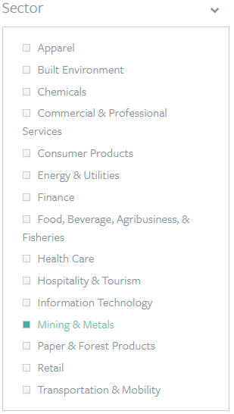
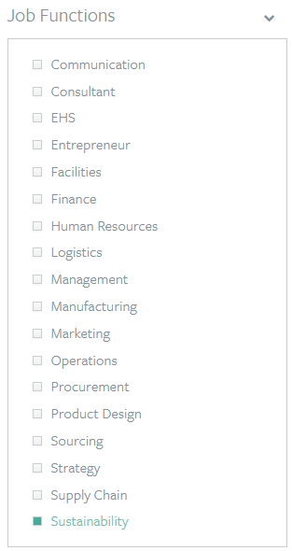
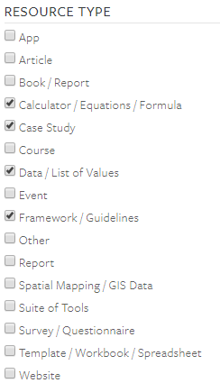
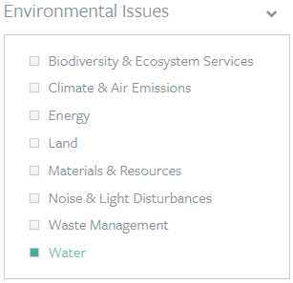
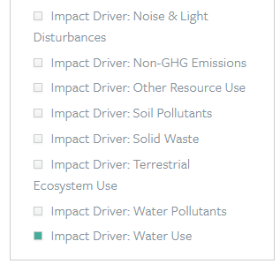
Natural Capital Toolkit example
Mining company
Conduct a company-wide assessment on its use of water
Sustainability team
Update tool selection depending on the sector/country or issue of interest to the audience

Slide 106
Some examples of tools to determine impacts and dependencies
ENCORE (Natural Capital Finance Alliance)
Impact and dependencies at economic sector level – qualitative
SASB (Sustainability Accounting Standards Board)
Impacts at a sector level – qualitative
Natural Capital Protocol Sector Guides
Impacts and dependencies but for limited sectors (food and beverage, apparel and forests)
I360X (Impact 360)
Impacts across all natural, human, social and financial capital – quantitative and qualitative
Use localised examples or tools that can be of use within your company

Slide 107
Mentimeter question
What other tools / resources have you found useful for natural capital assessments?
Notes:
Presenter to read the question out on the slide.
Once poll is complete, presenter should use the notes below to explain the different answers:
Framework to help generate trusted, credible and actionable information that business managers need to inform decisions
Includes how we interact with natural capital in decision asking
Offers standardization and clarity to identify, measure and value impacts and dependencies on natural capital
Builds on a number of approaches that already exist including the Corporate Ecosystem Services Review and the Guide to Corporate Ecosystem Valuation
Does not list specific tools or methodologies because the choice of tools is dependent largely on business context, resources and needs
Virtual session- https://zoom.us/
Add question & answers to a live poll in zoom as per instructions
To enable Polling: Sign in to the Zoom web portal. In the navigation menu, click Account Management then Account Settings (if you are an account administrator) or Settings (if you are an account member). Navigate to the Polling option on the Meeting tab and verify that the setting is enabled. If the setting is disabled, click the toggle to enable it. If a verification dialog displays, choose Turn On to verify the change. Note: If the option is greyed out, it has been locked at either the Group or Account level, and you will need to contact your Zoom administrator.
Creating a poll: Go to the Meetings page and click on your scheduled meeting. If you do not have a scheduled meeting, schedule a meeting now. From the meeting management page, scroll to the bottom to find the Poll option. Click Add to begin creating the poll. Enter a title and your first question. (Optional) Check the box to make the poll anonymous, which will keep the participant's polling information anonymous in the meeting and in the reports. Select whether you want the question to be single choice(participants can only choose one answer) or multiple choice question(participants can choose multiple answers). Type in the answers to your question and click Save at the bottom. If you would like to add a new question, click Add a Question to create a new question for that particular poll.
You can launch a poll by clicking on the live polling icon in the meeting controls and selecting the poll you want to launch. The participants in the meeting will now be prompted to answer the polling questions. The host will be able to see the results live. Once you would like to stop the poll, click End Poll. If you would like to share the results to the participants in the meeting, click Share Results. The results can be downloaded once the meeting has ended.
In person session – https://www.mentimeter.com/
Mentimeter is an interactive presentation software. The host can create a presentation once signing up to Mentimenter. Questions and activities can be added to each slide of the presentation. Participants can answer the questions and interact with the presentation by typing a 6-digit code found at the top of the presentation into Menti.com. The host can either create a new share on Zoom to display the Mentimeter slides, or download the Mentimeter plug-in for PowerPoint.
To run this question, select the Multiple Choice question type when creating your presentation, and fill in the question and answers as directed.

Slide 108
How to use Mentimeter
1
Go to www.menti.com
2
Enter this code: 56 63 18 7
3
Submit your answer
Notes:
KB

Slide 109
Summary tips: scoping an assessment
Provide real-life examples to support explanation of key concepts
Consider engaging a speaker that has undertaken an assessment in their business and can talk to the challenges and the benefits of conducting one.
Include case studies that are relevant and useful for the audience!
Showcase examples which provide practical and actionable tips that the participants can apply in their own natural capital assessments
Go through your own company’s sustainability projects to provide inspiration
Check the WBCSD and Capitals Coalition website for case studies that could be used for your sector
Change the tools presented depending on the audiences’ background and interest, think about whether:
The tools help the participants to meet their objective
The complexity of the tools you want to cover
Certain tools more suited to the audiences’ sector

Slide 110
Summary tips: scoping an assessment
Provide real-life examples to support explanation of key concepts
Consider engaging a speaker that has undertaken an assessment in their business and can talk to the challenges and the benefits of conducting one.
Include case studies that are relevant and useful for the audience!
Showcase examples which provide practical and actionable tips that the participants can apply in their own natural capital assessments
Go through your own company’s sustainability projects to provide inspiration
Check the WBCSD and Capitals Coalition website for case studies that could be used for your sector
Change the tools presented depending on the audiences’ background and interest, think about whether:
The tools help the participants to meet their objective
The complexity of the tools you want to cover
Certain tools more suited to the audiences’ sector
These tips have also been summarised in the implementation guide by tip type

Slide 111
Q&A

Slide 112
Materiality
Stepping through your company’s materiality statement, understand how issues have been assessed and where environmental factors are considered
Overview: Session that discusses the application of various approaches and considerations for materiality assessment as a basis for prioritisation
Not enough time to step through this section today but you may want to consider….

Slide 113
Agenda
Time (CET) | Session
15:00 | Welcome – Agenda, objectives, training material
15:10 – 15:20 | Introductions – Getting to know each other
15:20 – 15:30 | Brief presentation of We Value Nature’s capacity building work
15:30 – 16:05 | Go through 1st part of the training – Introduction, setting the scene, natural capital definition, the business case & natural capital impacts & dependencies
16:05 – 16:20 | Coffee break
16:20 – 17:10 | Go through 2nd part of the training – Scoping an assessment
17:10 – 17:40 | Go through 3rd part of the training – Introduction to monetary valuation & wrap-up
17:40 – 18:00 | Train the trainer course wrap-up – Key takeaways, next steps & engagement opportunities Group discussion on training material
18:00 | End of training
18:00 – 18:30 | Virtual Networking Drink (optional)
Notes:
KB

Slide 114
Introduction to monetary valuation for scoping an assessment
Overview: this session provides a summary of the different valuation techniques that can be used by businesses to conduct valuation

Slide 115
Assessments: Measure & Value
Refer to p.82
of the
Natural Capital Protocol
To measure ≠ to value
Before monetary valuation can occur impacts and/or dependencies must be measured i.e. the amount of change determined, extent and condition in physical terms e.g. m3, tons, number of injuries, number of jobs.
It is worth noting that we do not detail the complications of measurement within this section i.e. data availability, accuracy and calculations. However, this can be a complex process in its own right.
This section provides an introduction to monetary valuation so that those considering an assessment may consider whether they want to include this approach as part of their project ambition.
Elaborate on the complications of measurement for those already familiar with the material (e.g. data needed for NCA differs from that normally collected by companies, and that assessments often require a range of data that isn’t easily accessible, especially contextual data/data on trends.
Warning: failing to access data could undermine NCA/ put the ‘focus’ on easier to measure assets rather than those that are material)
Qualitative
Quantitative
Monetary
Notes:
Source: https://naturalcapitalcoalition.org/wp-content/uploads/2019/05/Final-Data-Full-Report.pdf (p4)

Slide 116
Why is monetary valuation useful and/or contentious?
Refer to p.35-38
of the
Natural Capital Protocol
Useful | Contentious
Common unit of measure Can measure social preferences Used to determine overall value for money of a project (i.e. whether it should go ahead or not; do the benefits exceed the costs) Can be used to measure risks and mitigate them before these are quantified by others | Not everything can be quantified in monetary terms (e.g. biodiversity) Can be time consuming/ expensive depending on technique or approach used Need to avoid double counting Potential reputational impacts
Could be useful to draw on examples whether monetary valuation has been useful/difficult
Show where monetary valuation is being used in a particular sector, country or to address an issue
Notes:
Additional issues are identified within the speaker notes

Slide 117
Intro to Total Economic Value (TEV)
Refer to p.15
of the
Natural Capital Protocol
Use
Non-use
Direct values
Outputs that can be consumed directly, such as fish, medicines, wild foods, recreation, etc.
Indirect values
Ecological services,
such as catchment protection, flood control, carbon sequestration, climatic control, aesthetics, etc.
Option values
The premium placed on maintaining resources and landscapes for future possible direct and indirect uses, some of which may not be known now.
Existence, altruistic and bequest values
The intrinsic value of resources and landscapes, irrespective of their use.
Potential to draw on real-life examples to make the distinctions between the types of value more clear
Source: Pearce, D.W., Markandya, A. and Barbier, E. (1989). Blueprint for a green economy. Earthscan, London WBCSD Connecting the dots
Additional details and references are available in the speakers notes
Notes:
Some issues with the different types of value mixed with aspects of corporate world i.e. indirect/direct sourcing is different to direct and indirect value

Slide 118
What may be included in your total economic value ?
Individually reflect on what value your business gets from different ecosystem goods or services
Direct value
Indirect value
Is natural capital more of a risk or an opportunity?
Potential to skip or turn into a longer discussion depending on the timings
Direct value = Outputs that can be consumed directly, such as fish, medicines, wild foods, recreation etc.
Indirect value = Ecological services, such as catchment protection, flood control, carbon sequestration, climatic control, aesthetics, etc.

Slide 119
Overview of Valuation Approaches and Techniques (type, time and resources)
Refer to p.84-87
of the
Natural Capital Protocol
 | Approach | Description | Time | Budget | Resources
Value Transfer | Value Transfer | Involves transferring value estimates from existing economic valuation studies to the study site in question, making adjustments where appropriate. | Days | ($100s-1000s; low budget) | Valuations from similar studies elsewhere. Data on key variables from different studies (e.g. GDP per person)
Notes:
I’ve highlighted VT as this is the technique that we use most but in order to do it properly you will need an understanding of all the other techniques
Types of adjustments include base year (inflation deflation of values), income of the population, using purchase power parity not exchange rates
Budget depends on the number of impacts and what is already available and it depends if the model being developed needs to be scaled across the whole organization – can be higher

Slide 120
Overview of Valuation Approaches and Techniques (type, time and resources)
Pros and cons for each type are discussed in the speaker’s notes
Depending on the background of the audience, potential to go in-depth on certain details of the techniques. Suggest selecting those that are most applicable to the audience
Presenter must have significant experience in environmental economics to be able to explain the valuation techniques properly
Provide real-life examples of where each valuation technique could be used

Slide 121
Hypothetical case study examples
Presenter must be able to provide justifications for the answers provided (e.g. why does this context lend itself to a certain valuation technique more than others?
The audience would benefit from discussing the results of the hypothetical examples, providing different possible explanations and reasons for the choices made

Slide 122
Hypothetical case study examples
Put in real-life case studies related to certain sectors/regions to make the examples more engaging
Notes:
Commissioning discussion

Slide 123
Ecosystem Monetary Valuation Tools
 | ARIES | TESSA | EVL Tool* | CEV | InVEST
Identifying new investments, markets, prices and products | ✓ |  |  | ✓
Managing risks | ✓ | ✓ |  | ✓ | ✓
Articulating environmental performance and costing environmental impacts | ✓ | ✓ | ✓ | ✓ | ✓
Potential to change the tools presented or criteria the tools are evaluated against that would be more useful for the audiences’ background and objectives with using the tools

Slide 124
Tips for Valuation
Test more than one value (sensitivity testing)
Report a range
Convert values to the same time period
Consider local country context of values
Understand where the tipping point leads to a change in a decision
Consider using peer reviewers
Re
Option to add a real-life example or support from an external speaker here!
Notes:
Natural capital checker, we use own reviewers and have provided reviews

Slide 125
Tips for Valuation
Test more than one value (sensitivity testing)
Report a range
Convert values to the same time period
Consider local country context of values
Understand where the tipping point leads to a change in a decision
Consider using peer reviewers
Re
Option to add a real-life example or support from an external speaker here!
Notes:
Natural capital checker, we use own reviewers and have provided reviews

Slide 126
Summary tips: valuation
Go into more detail on concepts and debates where possible!
Depending on the background of the attendees, the presenter can elaborate on points on the slides, providing evaluative comments and technical insight. Or talk through a specific valuation example.
Draw attention to the points that are most relevant for the audience consider:
The techniques that are the most practical and actionable for the audience. Which techniques are being used most in the relevant sector/to address a particular issue?
Showcase real-life case studies and examples
Especially when the audience is new to the material, using examples and case studies can support understanding
Consider using an external speaker to discuss how they went about using valuation

Slide 127
Summary tips: valuation
These tips have also been summarised in the implementation guide by tip type
Go into more detail on concepts and debates where possible!
Depending on the background of the attendees, the presenter can elaborate on points on the slides, providing evaluative comments and technical insight. Or talk through a specific valuation example.
Draw attention to the points that are most relevant for the audience consider:
The techniques that are the most practical and actionable for the audience. Which techniques are being used most in the relevant sector/to address a particular issue?
Showcase real-life case studies and examples
Especially when the audience is new to the material, using examples and case studies can support understanding
Consider using an external speaker to discuss how they went about using valuation

Slide 128
Q&A

Slide 129
Wrap-up & next steps

Slide 130
Reflections and mentimeter question
The audience may benefit from providing some example answers to the questions to help them engage with the reflection
The reflection and question poll are both optional depending on timing

Slide 131
Eager to get started? We are here to help!
Provide links to other resources available from We Value Nature or elsewhere.
Notes:
KB

Slide 132
Train-the-trainer wrap-up
Notes:
KB

Slide 133
We’d like to hear from you!
Do you have any further questions on the material?
Any feedback you would like to share?
What suggestions have you written down?
What else would you need to feel prepared to host your own training session in March 2021 or in the future?
What would you hope to see in future modules?

Slide 134
Next steps that YOU can take
Download & familiarize yourself with the Natural Capital Protocol
Share training learnings & material with colleagues and your manager
Participate in WVN’s final train-the-trainer re-freshers in January – Register here
Sign-up & provide a training session during WVN’s big 10 day challenge event in March 2021 ☺

Slide 135
Mentimeter closing questions
Use p. 37 in your workbook
What is your
1 key learning from the training?
Share 1 concrete next action you will take after this training

Slide 136
How to use Mentimeter
1
Go to www.menti.com
2
Enter this code: 76 02 69 4
3
Submit your answer
Notes:
KB

Slide 137
We are here to help!
Next call:
21 Janury
11h-12h CET
Next train-the-trainer sessions:
7 Dec., 26 Jan. & 28 Jan. 2021
Deep-dive webinars
In-person training
Helpdesk calls
Virtual office hour/
Q&A
Virtual training
Train-the-trainer
Keep in touch & sign-up: wevaluenature.eu
Exchange with peers:
LinkedIn Group
Provide your feedback: Survey
We want to learn too – how have we helped?
Notes:
WHAT ELSE would you need? What support would you need?
Sign-up for in-person day training, t-t-t
If want support, need to fill out survey (Google form survey)
Refining training further, keen to know how have used this training and catch-up via call (if don’t want to, let us know)

Slide 138
Join us for a well-deserved virtual networking break!
Let’s continue the discussions in a less formal setting by sharing a virtual drink.
It can also be an opportunity to ask any further questions you may have.
When:
18:00-18:30
You can simply stay in this call
How:

Slide 139
Notes:
KB

Slide 140
Disclaimer
Disclaimer
WVN module 2 is a capacity building program released in the name of the WVN network. It is the result of a collaborative effort by WBCSD, Little Blue Research, Ltd. with input from an Advisory Board composed of experts on natural capital, businesses, NGOs, academic institutions, and others.
The training was tested with the WBCSD membership. It does not mean, however, that every advisory board member, and WBCSD member company agrees with every word. The WVN module 2 has been prepared for capacity building only and does not constitute professional advice. You should not act upon the information contained in the WVN module 2 training without obtaining specific professional advice. No representation or warranty (express or implied) is given as to the accuracy or completeness of the information contained in the WVN module 2 training and its translations in different languages, and, to the extent permitted by law, WBCSD, Little Blue Research, Ltd., members of the Advisory Board, their members, employees and agents do not accept or assume any liability, responsibility or duty of care for any consequences of you or anyone else acting, or refraining to act, in reliance on the information contained in this capacity building program or for any decision based on it.
Copyright © WVN
October 2020

