Slide 1
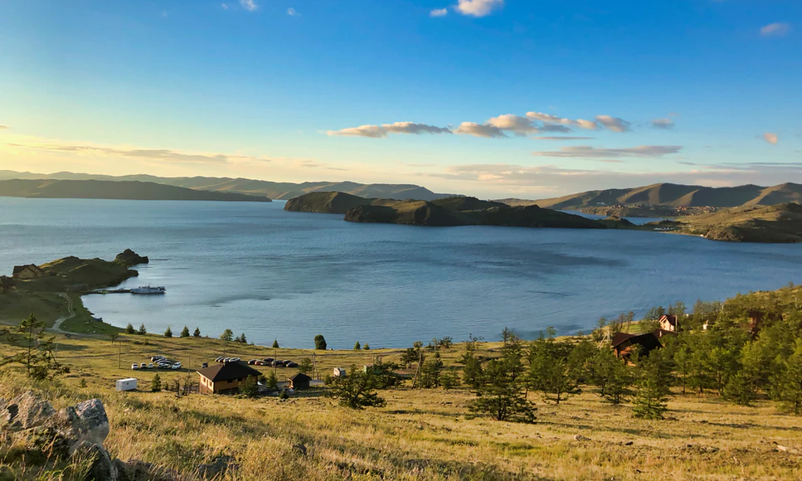
Business training on natural capital & biodiversity
What are the relationships between your business and nature?
Full version training
Notes:
KB

Slide 2
We Value Nature – Who are we?
We Value Nature is a campaign supporting businesses and the natural capital community to make valuing nature the new normal for business across Europe, by:
Sharing research, resources & best practices;
Identifying barriers & opportunities for adopting a natural capital approach;
Providing practical support to help business improve their risk management, communication & stakeholder engagement;
Reinforcing & boosting the work of the Natural Capital Coalition.
Notes:
Before kicking-off the training, introduce that this training is being given as part of the We Value Nature Campaign and explain what it is, its purpose, objectives and partners involved:
The We Value Nature Campaign is a €2 million EU-funded campaign supporting businesses and the natural capital community across Europe with the aim of making valuing nature the new normal for business. As we will have a chance to explore during today’s training, by valuing nature, businesses can make smarter decisions that benefit themselves, society and the planet as a whole.
The campaign is coordinated by the Institute of Chartered Accountants in England and Wales (ICAEW), World Business Council for Sustainable Development (WBCSD), The International Union for Conservation of Nature (IUCN) and Oppla. And it is supporting the Natural Capital Coalition, which has recently merged with the Social & Human Capital Coalition to become now the ‘Capitals Coalition’.
The campaign will aim to increase the uptake of the natural capital approach (including: natural capital assessment, natural capital accounting, nature-based solutions and green infrastructure) by identifying barriers and opportunities, providing practical support to business through activities (such as webinars, helpdesk calls, etc.) and training such as this one, as well as by inspiring businesses to adopt the NCP.
Take this opportunity to also thank the different stakeholders that supported the training (if relevant).

Slide 3
Today’s trainer
Name, Title
Company logo
Notes:
Katia
Introductions for those who are presenting the session (virtual or in person)

Slide 4
A few “house rules”
Please change your username to your full name and (organization)
E.g. John Doe (WBCSD)
Please submit comments or questions in the chat function
Make sure to be joining us through Zoom app or computer
This session is being recorded and you will be muted
Be prepared for some interactivity: We’ll be using polling Qs., breakout rooms & live Google doc.

Slide 5
Learning Objectives
At the end of the training, you will be able to understand:
What is natural capital and biodiversity and their linkages with business,
Why it is important for business decision-making and risk management,
What are some of the key approaches & tools to integrating natural capital and biodiversity in decision-making.
Notes:
The objectives for today are …
Emphasize that this training is particularly targeted at businesses in the early stages of their natural capital journey wanting to understand where to get started / organizations that want to help businesses get started.

Slide 6
Agenda
Time (CET) | Session
15:00 | Welcome – Agenda, objectives & material
15:10 – 15:20 | Introductions – Getting to know each other
15:20 – 16:05 | What is natural capital & biodiversity – Natural capital impacts & dependencies Group exercise
16:05 – 16:20 | Coffee break
16:20 – 16:30 | Why are natural capital & biodiversity important– The business case
16:30 – 17:10 | Natural capital, biodiversity risks & opportunities – Building business resilience Group game
17:10 – 17:45 | Applying natural capital & biodiversity & case studies – Brief overview of approaches & business applications
17:45 – 17:50 | First step of a biodiversity-inclusive natural capital assessment
17:50 – 18:00 | Wrap-up– Key takeaways, next steps & engagement opportunities
18:00 | End of training

Slide 7
The Natural Capital Protocol as a basis for the training content
p. 2 & 6 in the NCP, p.22 in the workbook
The Natural Capital Protocol is a standardized framework for business to identify, measure and value its direct and indirect impacts and dependencies on natural capital
Link to the Protocol here
Notes:
The Natural Capital Coalition is a collaborative space to harmonize approaches to natural capital
The network represents over 300 organizations across all parts of society and around the world
Purpose: To mainstream the inclusion of natural capital in decision making, harmonizing approaches and getting them to scale, quickly
The Protocol aims to support better decisions by taking into account how business interacts with natural capital in decision making. Until now, natural capital has for the most part and still is, being excluded from decisions.
So it is to be understood as a Framework that was really designed to help generate trusted, credible and actionable information that business managers need to inform decisions by identifying, measuring and valuing impacts and dependencies on natural capital.
The Protocol builds upon many approaches already used within business.
It acts as an overarching globally accepted framework to build and expand this information into robust natural capital assessments.
STRUCTURE of the Protocol:
4 overarching stages of frame (why), scope (what), measure and value (how) and apply (so what) and 09 logical steps. It should be easy to follow and should be suitable for any business across any sector or geography.
The stages and steps are iterative so expect that you may need to revisit a previous step.
Important to note that the NCP as an overarching framework, won’t give you actual results and need to therefore use the Nat Cap toolkit to get tools.
Highlight that while we will briefly cover tools and approaches for stages of ‘Measure & Value’ – the aim of the training will mainly focus on first two stages of the Protocol and that going into measurement and valuation technical details, requires a separate training.

Slide 8
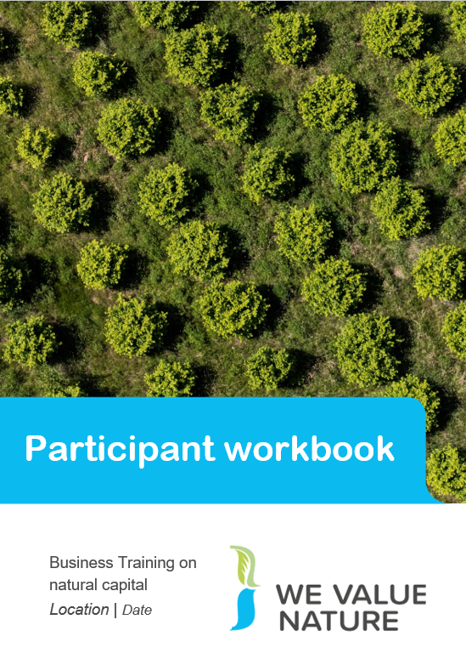
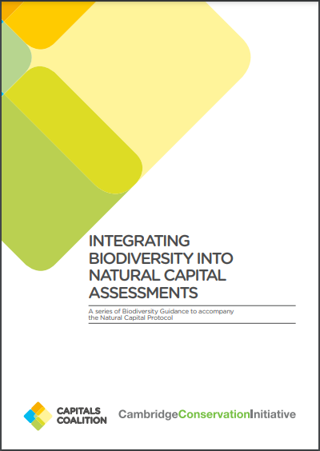
Training material
Full version
Executive summary
Take notes!
&
Write down any suggestion(s) in the chat

Slide 9
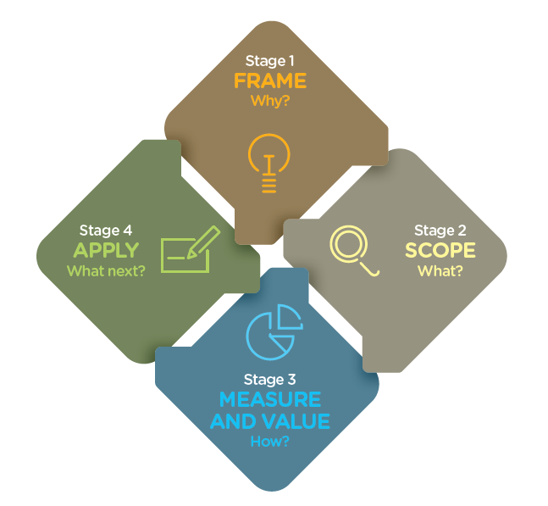
A stepwise approach to incorporate biodiversity into decision-making. It guides companies to better capture the value of biodiversity in decision making and develop management strategies accordingly. Applicable to all business sectors, at any geography and any organizational level. Appropriate for terrestrial, freshwater and marine realms.
WHAT IS THE BIODIVERSITY GUIDANCE?
Notes:
The Biodiversity Guidance offers a stepwise approach to incorporate biodiversity into natural capital assessments. It guides companies to better capture the value of biodiversity in their natural capital assessments and develop management strategies accordingly. The Guidance is applicable to all business sectors, at any geography and any organizational level. The Guidance is appropriate for terrestrial, freshwater and marine realms.
It is designed to work in 4 stages:
‘Why’ (Framing Guidance)
‘What’ (Scoping Guidance),
‘How’ (Measure and Value Guidance) and
‘What next’ (Application Guidance).
These stages are broken down into 9 steps, which address a specific question that must be answered when integrating biodiversity into your natural capital assessments.
The Guidance is written for businesses and financial institutions who already recognise the importance of natural capital and wish to ensure their assessments incorporate biodiversity, as well as businesses and financial institutions who are managing their relationship with biodiversity and want to expand those considerations to a broader natural capital perspective.
It can also help civil society, government, multi stakeholder organizations, standard setters, disclosure organizations and science / academia to engage with business and support them in their journey to embed the value of nature in their decision-making.

Slide 10
How to use Mentimeter
1
Go to www.menti.com
2
Enter this code: xx xx xx
3
Submit your answer

Slide 12
Introductions
Notes:
Ask every person in the room to very briefly present themselves – name, company and role

Slide 13
Introductions
Please tell us more about you by sharing your thoughts in the chat:
What are you hoping to get out from this training?
Any specific expectations or early questions?
Notes:
KB

Slide 14
Setting the scene & Introduction to natural capital & biodiversity
Notes:
KB

Slide 15
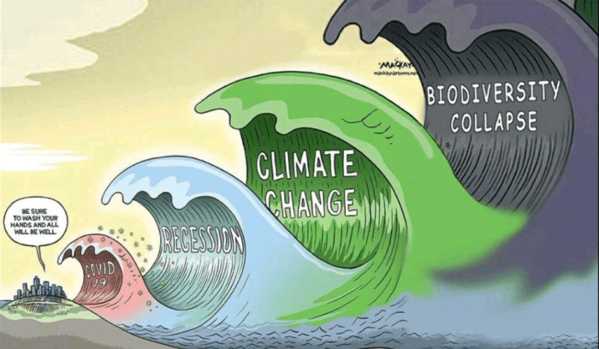
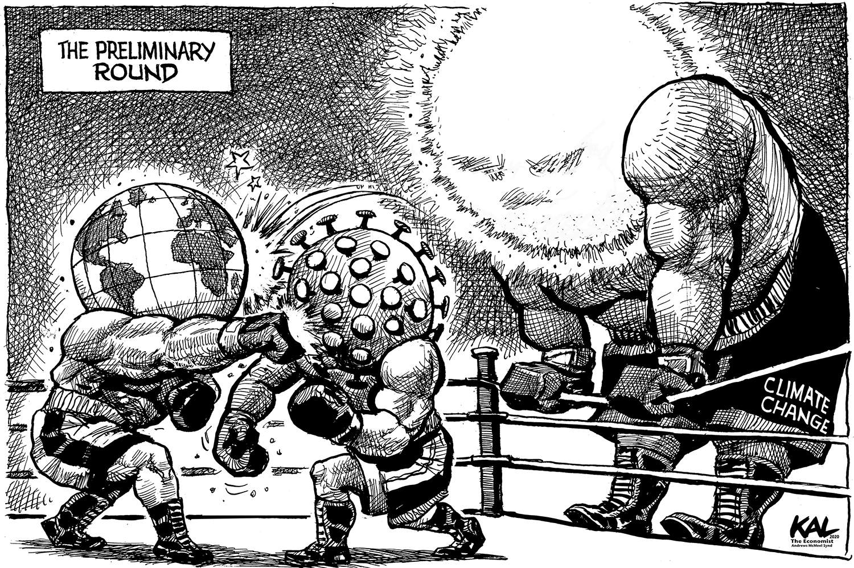
The scale of the challenge ahead…
By Graeme MacKay
By Kal, The Economist

Slide 16
Keeping up momentum during the COVID-19 crisis
What have we learnt so far?
Institutions urging a green recovery. Christine Lagarde, President of ECB: "transition towards a greener economy is a crucial part of economic recovery"
Crisis shows that "business as usual" is vulnerable to a range of outside influences, not just market forces
Need to consider all capitals and all stakeholder values for decision-making

Slide 17
Capitals thinking
pp. 5-6 of your workbook
Business depends on
Natural capital | Social capital | Human capital
Stock of renewable and non-renewable natural resources, (e.g. plants, animals, air water, soils, minerals) that combine to yield a flow of benefits to people | Networks together with shared norms, values and understanding that facilitate cooperation within and among groups. | The knowledge, skills, competencies and attributes embodied in individuals that facilitate the creation of personal, social and economic well-being.
Business impacts on

Slide 18
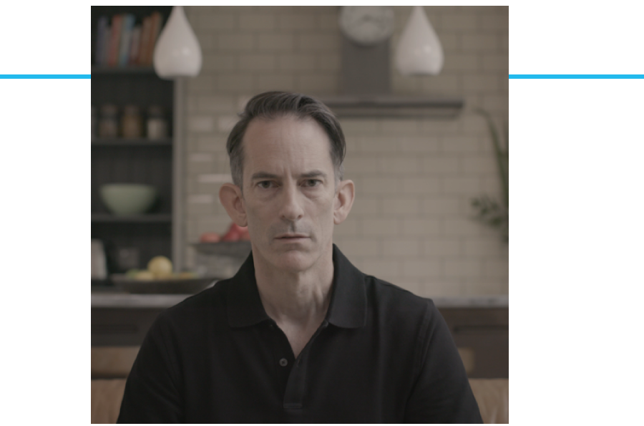
https://www.youtube.com/watch?v=UXZhlJyuw8A
Other option of video you could share:
https://www.youtube.com/watch?v=IyL272Q1N0s
Notes:
After showing video, open the floor to anyone that wishes to share something
Potential questions that can be asked to participants:
Has anyone of you seen this video before? Show of hands. Direct them to where they can find the video: https://www.youtube.com/watch?v=UXZhlJyuw8A. The video was produces by WBCSD with the help of many of its members and with the aim to raise awareness among businesses on the importance to apply natural capital thinking into business.
What did you think of the video?
What feelings or perceptions were perhaps triggered when viewing the video?

Slide 19
Hypothetical example
Let’s start by imagining that you work for an agribusiness, producing crops such as oranges
What could be your impacts on nature (+ or -)?
What could be your dependencies on nature (i.e what natural resources does your business depend on – fish stocks, pollinators, soil quality etc)?
Don’t forget your impacts and dependencies on biodiversity!
Notes:
Give participants 5’ to reflect on both questions at their respective table and then offer each table to very briefly mention what ideas came out. Depending on how you have framed your training, you may wish to allow more time for this.
Reflect on responses:
Reference of resources
Scope of impacts – some examples referenced at product level others at supply chain level – direct operations or through supply chain
Some may be directly related to the business. Others more indirect: water use through the process and noise/disturbances in extracting and manufacturing process, small particles
Manufacturing process, customer phase – thinking about full suit
How may depend on nature: if car manufacturing downstream from a forest for example, it depends on it to protect from flooding which if didn’t have that forest, factory could be at risk of being swamped
Potential answers:
Impacts: water use, soil degradation through overuse, (but also health: preventing too much rainwater runoff etc…), absorbing carbon, biodiversity (loss because of monoculture, or helping through providing habitats), use of fertilizer
Dependencies: water, fertile soil, appropriate temperature and climate,
Elements to be considered:
What stages of value chain are we considering, where is farm based, is it organic or mass production?

Slide 20
Natural Capital Definition
Refer to p. 5 of your workbook & p.12 of the Natural Capital Protocol (NCP)
Natural capital is the stock of renewable and non-renewable natural resources, (e.g. plants, animals, air water, soils, minerals) that combine to yield a flow of “services” to people. In turn, these flows provide value to business and society.
Biodiversity underpins both stocks and ecosystem services
Source: Natural Capital Protocol
Notes:
We have started thinking about natural resources an agricultural producer relies and impacts on but what do we mean when we talk about natural capital?
Well in fact, everything you have discussed through the previous example is natural capital is some form or another. Whether it is the assets/resources it represents (such as water and soil you have identified as needed for the farm) or the services it brings.
From climate adaptation to ecosystem services, the environmental jargon is everywhere. What is important, is not to remember all the terminology used, but rather that these are all connected to the value of nature and that people have different entry points and priorities and will use one or another terminology based on that. But fundamentally, we are all speaking about the same things, just in different ways.
This is the definition according to the Natural Capital Protocol. Refer to p. 12 of Natural Capital Protocol.
The stocks refer to the natural resources available to us while the flows refer to the different benefits people receive from ecosystems such as:
timber,
fiber,
pollination,
water regulation,
climate regulation,
Recreation,
etc.
Abiotic services are benefits to people that do not depend on ecological processes but arise from fundamental geological processes e.g. – supply of minerals, metals and oil and gas, as well as geothermal heat, wind, tides, etc.
In the Protocol biodiversity (part of stocks) is considered to be critical to the health and also the stability of natural capital in so much that it provides resilience to shocks like:
Floods
Droughts
As well as supports fundamental processes such as:
carbon and water cycles
soil formation
Ecosystem services – key distinction between:
Supporting services: fundamental ecological processes that support the delivery of our ecosystem services
Regulating services: indirect benefits from nature generated through regulation of ecosystem processes e.g. – mitigation of climate change through carbon sequestration, water filtration by wetlands, erosion control and protection from storms

Slide 21
Ecosystem Services
Refer to p. 6 of your workbook & p.12 & p.111
of the NCP
Ecosystem services are the benefits to people from ecosystems
(e.g. climate regulation, water purification, soil biodiversity, pollination,
timber, recreation, mental health). These services can be categorised into
Provisioning
Regulating
Supporting and
Cultural
Source: Natural Capital Protocol
Notes:
Presenter to explain ecosystem services using the notes below and referring to p. 12 /111 of the Natural Capital Protocol:
Ecosystems services are the benefits to people from ecosystems, where an ecosystem is defined as the interaction between complex plants, animals and microorganisms and their non-living environment
Examples of ecosystem services include timber, fiber, pollination, water regulation, climate regulation, recreation, mental health and others
Ecosystem services can be classified into provisioning, regulating, cultural and supporting services
Provisioning: material outputs from nature (e.g. fiber)
Regulating: indirect benefits from nature generated through regulation of ecosystem processes (e.g. mitigation of climate change through carbon sequestration)
Cultural: non-material benefits from nature (e.g. recreational, spiritual, aesthetic)
Supporting: fundamental ecosystem processes that support the delivery of other ecosystem services (e.g. nutrient cycling)
There are many classification schemes for ecosystem services including the CICES and the FEGS-CS which measure ecosystem outputs that are directly consumed or used by beneficiaries

Slide 22
Ecosystems Services
Refer to p. 6 in the workbook
Provisioning
Goods produced or provided by ecosystems
Food
Timber
Fiber
Biochemicals
Natural medicines
Regulating
Natural processes regulated by ecosystems
Air quality regulation
Climate regulation
Water purification, flow regulation & waste treatment
Erosion regulation
Cultural
Intangible benefits obtained from ecosystem services
Recreation
Ecotourism
Spiritual & religious values
Educational
Ethical values
Supporting
Functions that maintain all other services
Nutrient cycling
Water cycling
Primary production
Photosynthesis

Slide 23
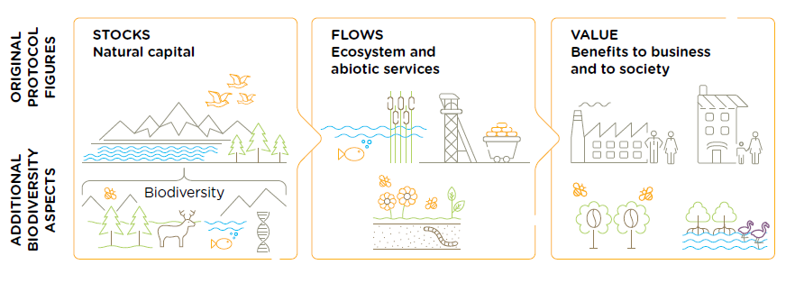
Why is biodiversity important?
Biodiversity: ‘The variability among living organisms from all sources including, inter alia, terrestrial, marine, and other aquatic ecosystems and the ecological complexes of which they are a part; this includes diversity within species, between species, and of ecosystems’ (Art 2, CBD 1992).
Notes:
Biodiversity describes the variety of life and is the living component of what can be
thought of as natural capital stocks. It plays an important role in the provision of the
services we receive from nature. The presence of, and interactions
between, natural capital stocks generate a flow of goods and services; these goods and
services create value through the benefits they provide to business and society.
Biodiversity is an integral part of natural capital and underpins the goods and services that
natural capital generates.
Biodiversity includes the variety of all living things, from genes through species and
populations to habitats and ecosystems. Many of the flows of benefit from natural capital
come directly from the interactions within and between biodiversity and non-living
resources. The interactions that generate these benefits are vast, complex, and often
poorly understood.

Slide 24
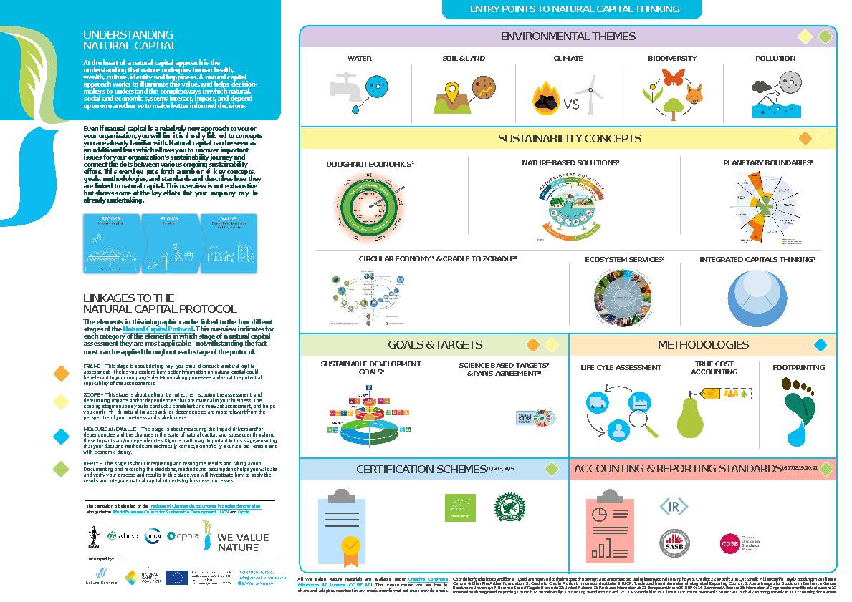
Linkages with other key concepts
Download the cards in the media library
A lot of synergy exists between various concepts and efforts can often be aligned to contribute to several goals.
Natural capital can be seen as an additional lens which allows you to uncover important issues for your organizations sustainability journey and connect the dots between various ongoing sustainability efforts.
Download through WeValueNature - Digital media library
Notes:
UNDERSTANDING NATURAL CAPITAL
A lot is happening on sustainability and that can be overwhelming. Luckily, a lot of synergy exists between various concepts and efforts can often be aligned to contribute to several goals. In this infographic we aim to illustrate how natural capital is linked to many sustainability concepts that your company may already be working on.
Even if natural capital is a relative new concept to you or your organizations, you will find it is closely linked to other things you are already familiar with. Natural capital can be seen as an additional lens which allows you to uncover important issues for your organizations sustainability journey and connect the dots between various ongoing sustainability efforts. This infographic explains for each concept, goal, methodology, scheme or framework what it is and how it is linked to natural capital.

Slide 25
Linkages between natural capital, biodiversity and NbS

Slide 26
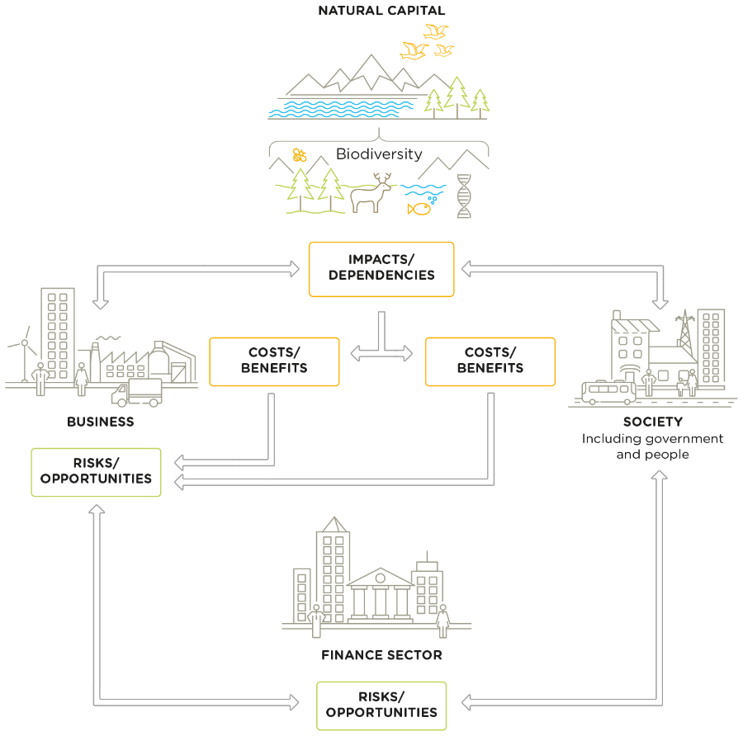
Business depends on & impacts natural capital
p. 7 of your workbook & p.15 of the NCP
All businesses impact and depend upon natural capital.
1
This relationship delivers costs and benefits back to themselves and to society.
2
These in turn lead to risks and opportunities to business & the finance sector
3
Notes:
Natural capital and the benefits that flow from it sustain us all: individuals, families, companies, and society as a whole. At the same time, our individual or collective actions can build or degrade natural capital, depending on how we use it. Every business impacts and depends on natural capital to some degree and will experience risks and/or opportunities associated with those impacts and/or dependencies.
Biodiversity plays an important role in the provision of the services we receive from nature. The terms “capital” and “stocks” are used as metaphors to help describe the role of nature within the economy. The presence of, and interactions between, natural capital stocks generate a flow of goods and services; these goods and services create value through the benefits they provide to business and society. Biodiversity is an integral part of natural capital and underpins the goods and services that natural capital generates. It is important to note that biodiversity is not an asset, rather a descriptive feature of assets we call natural capital.
This figure is from the natural capital Protocol and is fundamental to the whole Protocol as it highlights how natural, social and economic issues are fundamentally interconnected and cannot be separated from one another. It also illustrates how natural capital underpins all the other capitals and without it we would not have social and human or financial capital.
1. All businesses impact and depend upon natural capital, and the biodiversity that underpins it
2. This relationship delivers costs and benefits back to themselves and to society.
3. These in turn lead to risks and risks and opportunities to the business
But this isn’t just theory and a nice diagram, these impacts and dependencies have the potential to affect businesses in a real way, and we’re seeing that right now.
What the examples show (from the previous slide) is that natural, social and economic issues are fundamentally interconnected and cannot be separated from one another. It also illustrates how natural capital underpins all the other capitals and without it we would not have social and human or financial capital.

Slide 27
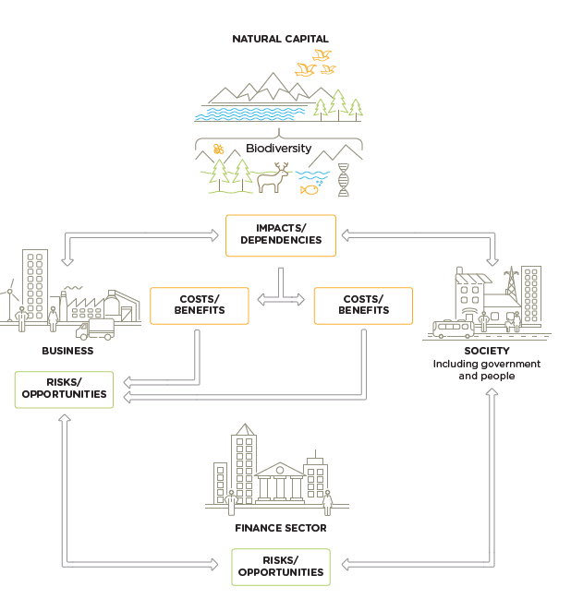
Why integrate biodiversity in natural capital assessments?
All businesses impact and depend on biodiversity.
These result in economic costs and benefits for business and society
Integrating biodiversity allows you to identify R&Os that might otherwise be hidden or missed.
Notes:
All businesses impact and depend on biodiversity.
Impacts and dependencies on biodiversity result in economic costs and benefits for business and society. These generate risks to your business, but good management can also create opportunities, either directly, or indirectly.
Integrating biodiversity values into a natural capital assessment allows you to identify risks and opportunities that might otherwise be hidden or missed.
Because the current economic system assumes infinite availability of these resources, use and extraction are currently unsustainable, and provide a systemic risk to your business, and society as a whole.
Failing to capture risks and opportunities can result in unexpected financial costs to a business

Slide 28
Natural capital impacts
Refer to p. 8 of your workbook
& p. 16
of the NCP
The negative or positive effect of business activity on natural capital
Notes:
Steph
Presenter to provide detail on natural capital impacts using the notes below and referring to p. 16 of the Natural Capital Protocol:
The Protocol defines a natural capital impact as: The negative or positive effect of business activity on natural capital. They can arise directly from business operations or indirectly from the use of products and services. As a result of your impact on natural capital you can generate impacts on your business as well as impacts on society.
Presenter to link natural capital impacts with the risks and opportunities material covered in M1, using the notes below. Presenter to elaborate on the business impact diagram, using some examples:
Thinking back to some of the content in M1, we can see how natural capital impacts can pose different risks and opportunities for businesses.
GHG emissions e.g. transportation
This may pose societal risks for businesses due to the health risks arising from the effect of air pollution on respiratory disease
On the other hand, this could pose a reputational and marketing opportunity due to new revenue streams offered in areas like carbon offsetting
Land management e.g. forest management
This may pose an operational risk by increasing natural hazard costs through degradation of natural ecosystems
This may also pose an operational opportunity if businesses invest in sustainable and green land management, hence reducing costs by protecting against natural hazards
Waste e.g. post-consumer waste
This may pose legal and regulatory risks if new laws or license fees are established, charging more for waste disposal
This may also pose an operational opportunity for businesses if they minimise or add value to waste and recapture valuable materials otherwise discarded
Discharges to soil e.g. fertilizers
This may pose a financial risk if the business’ sales fall due to negative publicity about the business’ impacts on natural capital
Groundwater discharge e.g. wastewater
This may pose operational risks if social conflict over polluted water adds to security costs
This may also pose societal opportunities if businesses use managed water catchments to improve water quality for local communities
Water extraction and management e.g. factory equipment cleaning
This may pose a financial opportunity if businesses alter the way in which they go about water extraction, thus attaining ”green funds” or investor interest in sustainability
Disturbances e.g. heavy machinery operation
This may pose societal issues again as wider society is impacted negatively from heightened noise and light
Links to risk – read one example from module 1
Reputation risk – increased public & consumer awareness of environmental and social damages + consumers are increasingly demanding assurance that the products they buy are produced in way that protect our environment (link to pollution)
Legal risk – giant Texas oil company, Anadarko Petroleum, has agreed to pay $5.1 billion for a vast environmental cleanup - aimed at restoring thousands of sites polluted by toxins and compensating thousands of people with personal injury claims.(link to pollution) https://www.nytimes.com/2014/04/04/business/energy-environment/anadarko-petroleum-to-pay-5-1-billion-to-settle-pollution-case.html
Financial risk – Underlying all of these risks & opportunities are financial ones! As we have seen, these risks imply important financial costs. Canadian gold mining company, Infinito Gold, lost over 50% of its share value as a result of the withdrawal of a mining concession in Costa Rica due to concerns about the potential impacts on agriculture, endangered species and forests. This led to a reference in the audit accounts to material uncertainties regarding the company’s ability to continue as a going concern (Link to land management and pollution)
Source: KPMG, Flora and Fauna International, Acca, Is natural capital a material issue? (2012)
Links to opportunity
Operational opportunity – EDF rainwater harvesting to manage water scarcity risks leading to reduction in water consumption, economical & energy savings https://www.wbcsd.org/Programs/Food-Land-Water/Water/Circular-water-management/Resources/Case-studies/Rainwater-harvesting-for-water-reduction
Reputation opportunity – IKEA to use only renewable and recycled materials by 2030 https://www.reuters.com/article/us-ikea-sustainability/ikea-to-use-only-renewable-and-recycled-materials-by-2030-idUSKCN1J31CD

Slide 29
Impact drivers
Refer to p. 8 of your workbook & p. 44-55
of the NCP
Impact drivers are:
Measurable quantities of a natural resource used as an input to production
(e.g. fresh water)
Or:
Measurable non-product output of a business activity
(e.g. water discharges)
Notes:
Steph
Presenter to walk through the slide, explaining the general steps of an impact pathway, using the notes below and referring to p. 44-55 of the Natural Capital Protocol:
Business activities produce an impact driver (e.g. non-GHG air pollution)
Impact drivers lead to changes in natural capital (e.g. reduced air quality)
Changes in natural capital result in impacts (e.g. health problems)
Presenter to list some example impact drivers for either plastic cup manufacture or cotton t-shirt manufacture, using the notes below:
(1) Plastic cup manufacture example impact drivers:
Inputs: freshwater consumption
Outputs: emissions from GHGs and other air pollutants (in oil extraction and processing); water pollutants; plastic waste
(2) T-shirt manufacture example impact drivers (based on p. 26 of the Natural Capital Protocol)
Inputs: water use; terrestrial ecosystem use; freshwater ecosystem use
Outputs: GHG emissions; non-GHG air pollutants; water pollutants; soil pollutants

Slide 30
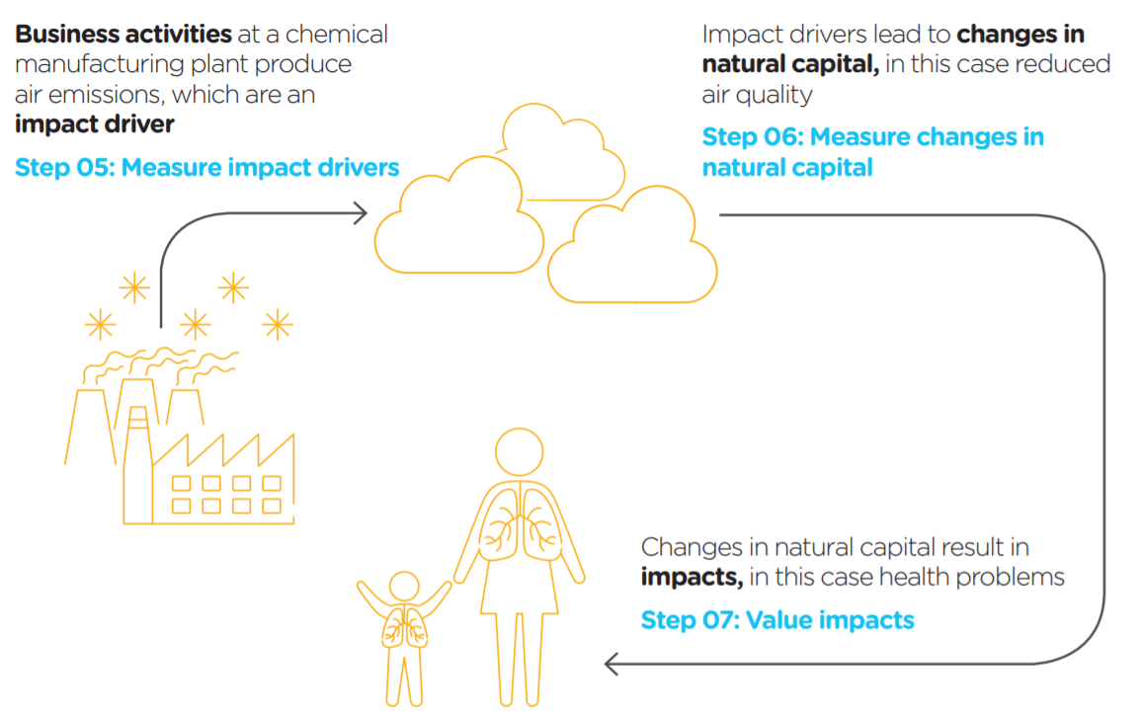
Impact pathway
Business activities can impact on specific features of natural capital
Impact pathways describe how, as a result of specific business activity, a particular impact driver results in changes in natural capital and how these changes impact different stakeholders

Slide 31
Natural capital dependencies
Refer to p. 9 of your workbook & p. 34
of the NCP
A business reliance on or use of natural capital
Notes:
Steph
Presenter to provide detail on natural capital dependencies using the notes below and referring to p. 34 of the Natural Capital Protocol:
The protocol defines natural capital dependency as: A business reliance on or use of natural capital. This can occur in your direct operations or somewhere else in your value chain.
Presenter to link natural capital dependencies with the risks and opportunities material covered in M1, using the notes below. Presenter to elaborate on the business impact diagram, using some examples:
Again, thinking back to some of the content in M1, we can see how natural capital dependencies can pose different risks and opportunities for businesses. This is useful in establishing the value of natural capital dependencies in relation to other inputs and services that you rely on.
Energy e.g. energy as a critical production input in a factory
A reliance on energy may pose financial risks due to volatilities in the energy market which could impose higher costs on the business
This could also open up financial opportunities if “green funds” become available for more renewable energy sources
Pollination e.g. regulating service critical in agriculture
This may pose an operational risk for agricultural sectors if pollination services start to vary
Materials e.g. reliance on wood
This may pose a societal risk if local communities start to experience reduced access to woodland or related ecosystem services as a result of business activities
This may pose a societal opportunity if local communities start to benefit from forestry management
Erosion and soil regulation e.g. essential for hydropower operations and beverage companies
This may post legal and regulatory risk if businesses are faced with fines, penalties, compensation or legal cost from regulation efforts
Water e.g. reliance on water to make cement
This may pose reputational and marketing risk if loyalty of key suppliers of business service provides in the water industry falls
Storm and flood protection e.g. local flood barriers
Reliance on flood barriers could pose increasing risk as climate change makes flooding more likely in certain regions
Investing in natural flood measures could provide wider benefits to local communities and thus benefit the business through reputation
Recreation e.g. for tourist attraction
If businesses rely on recreation such as tourist attractions to raise employee morale, they may be at risk of attracting and attaining their employees due to the volatility of the tourism industry – this could lead to higher recruitment and retention costs
Climate regulation e.g. natural filtration of water
This may provide an operational opportunity if businesses invest in green infrastructure like water filtration services, thus reducing overall costs

Slide 32
Dependency pathways
Refer to p. 9 of your workbook & p. 46
of the NCP
Business activities can be dependent on specific features of natural capital
A dependency pathway can identify how changes in specific features of natural capital can affect these activities
Knowing how changes affect business activities helps you identify the cost of doing business
Notes:
Steph
Presenter to explain dependency pathways, using the notes on the slide. Presenter to then walk through the coffee production/pollination example using the notes below and referring to p. 46 of the Natural Capital Protocol:
Business activities at a coffee production plant have a dependency on the pollination of coffee plants.
Changes in natural capital cause the bee population to decline due to:
The business itself, e.g. overuse of pesticides
Natural changes e.g. extreme weather events
Human-induced changes, including due to the activity of other businesses, e.g. habitat change
Changes in natural capital affect business dependency, so pollination services are important
Presenter to walk through the t-shirt manufacture example below, using the notes below and referring to p. 24 of the Natural Capital Protocol:
At the agricultural level, water is needed to irrigate cotton plants, creating a dependency on water.
Changes in the natural capital, in this case water availability, can change due to both external factors (e.g. climate change, other agriculture dependent on the same water source, other upstream water usage) and internal factors (e.g. over-abstraction of water for irrigation, water extraction to clean machinery).
Because of these changes in natural capital, the company has to chose whether to accept a decreased cotton yield, adapt to a more resilient form of agriculture, or pay more for an alternative water supply.
Links to risk – read one example from module 1
Operational risk – Vale damn collapse – mass stabilisation (land slides)

Slide 33
Quiz example
Are the following examples of impacts or dependencies, or both?
Soil regulation
Water extraction
Pollination
Impacts, dependencies, or both?
Dependency / Impact
0
10

Slide 34
Mentimeter example

Slide 35
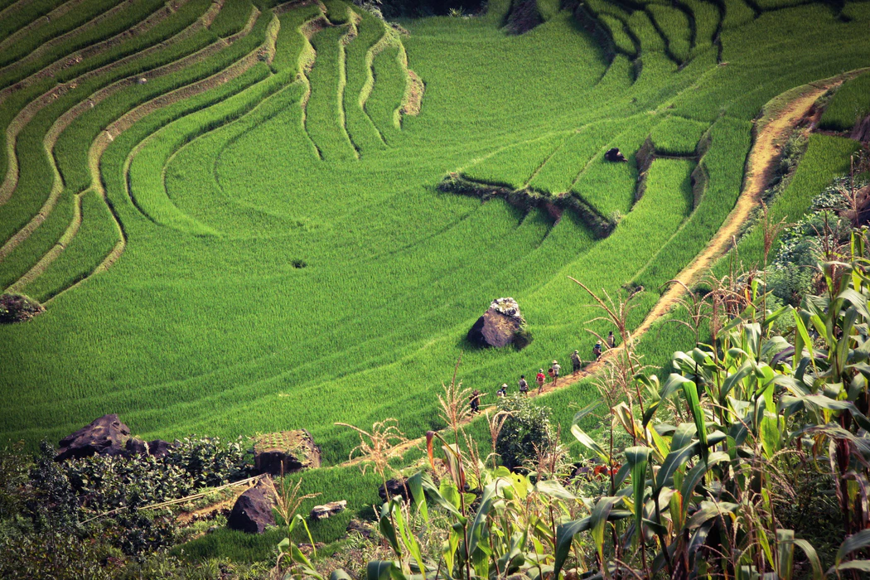
Group exercise – Impacts & Dependencies
Imagine you are having to assess the impacts and dependencies of a company that produces rice in Indonesia
The company exports its rice production across the world
As a group, determine the level of impact and dependency of each given issue
HIGH / MEDIUM / LOW

Slide 36
Group exercise – Impacts & Dependencies
Rice producer: Key impacts & dependencies identified in Indonesia
Key ecosystem services | Issues | Impact | Dependency
Provisioning | Water
 | Land use
Regulating | Climate
 | Air quality
Supporting | Soil quality
Cultural | Ecotourism
Additional | Biodiversity
Write down your answers directly in the live Google doc. shared with you
HIGH / MEDIUM / LOW

Slide 37
Group discussions in breakout rooms
We will now split into breakout rooms
3-4 people per group
You will have 10’ to complete the table
Have a designated person in your group to share their screen with the table and write down the answers
You will be notified of the amount of time you have left
We will then share feedback in plenary
Write down your answers directly in the live Google doc. shared with you

Slide 38
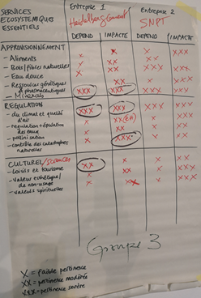
Feedback in plenary
What were your highest impacts and dependencies?
What were your reflections on the process and the exercise?
Joint exercise between NGOs and a cement company to understand and prioritize impacts and dependencies
Grand Popo, Benin, September 2018

Slide 39
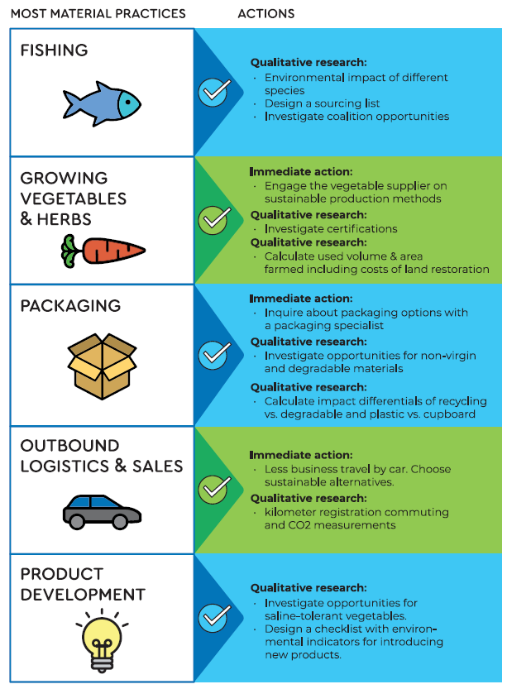
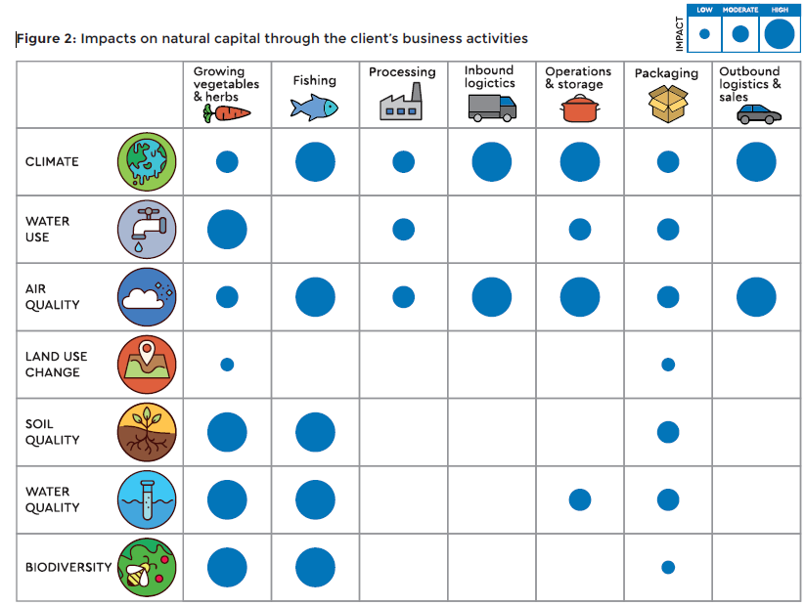
Example of a qualitative assessment from an SME in the fishery industry
Notes:
This is a great example of how you can conduct a qualitative assessment of your natural capital impacts and dependencies which can already translate into concrete actions to take in response to this. Here are just the impacts, but the same exercise was repeated for dependencies too.
To complete it, they discussed relative importance with different stakeholders and simply provided relative orders of magnitude, based on resources but also.
From this, they were able to identify most material elements of their practices and then prioritise which actions to take.
This exercise can be repeated in consultation with your own employees and stakeholders.
You don’t necessarily need to measure and value your impacts, this type of assessment can already be very informative without require a lot of time, expertise or budget. Again, it depends of what your objective is.

Slide 40
15’

Slide 41
Agenda
Time (CET) | Session
15:00 | Welcome – Agenda, objectives & material
15:10 – 15:20 | Introductions – Getting to know each other
15:20 – 16:05 | What is natural capital & biodiversity – Natural capital impacts & dependencies Group exercise
16:05 – 16:20 | Coffee break
16:20 – 16:30 | Why are natural capital & biodiversity important – The business case
16:30 – 17:10 | Natural capital risks & opportunities – Building business resilience Group game
17:10 – 17:45 | Applying natural capital, biodiversity & case studies – Brief overview of approaches & business applications
17:45 – 17:50 | First step of a biodiversity-inclusive natural capital assessment
17:50 – 18:00 | Wrap-up– Key takeaways, next steps & engagement opportunities
18:00 | End of training

Slide 42
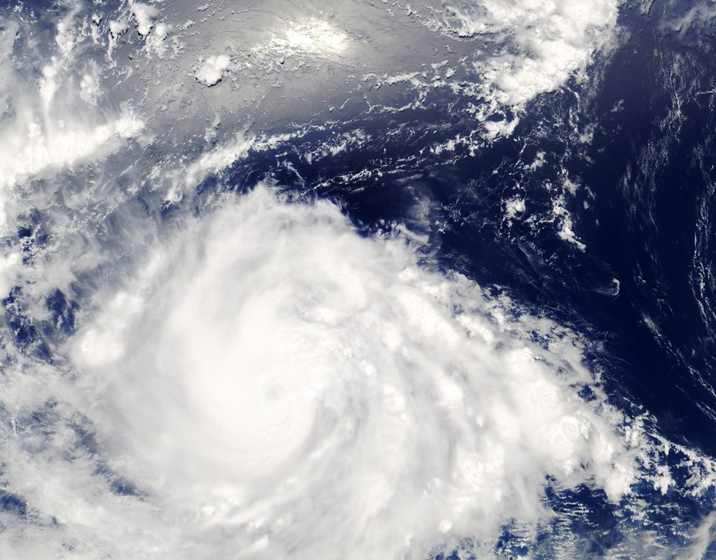
Why are natural capital & biodiversity important?
Notes:
CvC – Why is natural capital important in a business context?

Slide 43
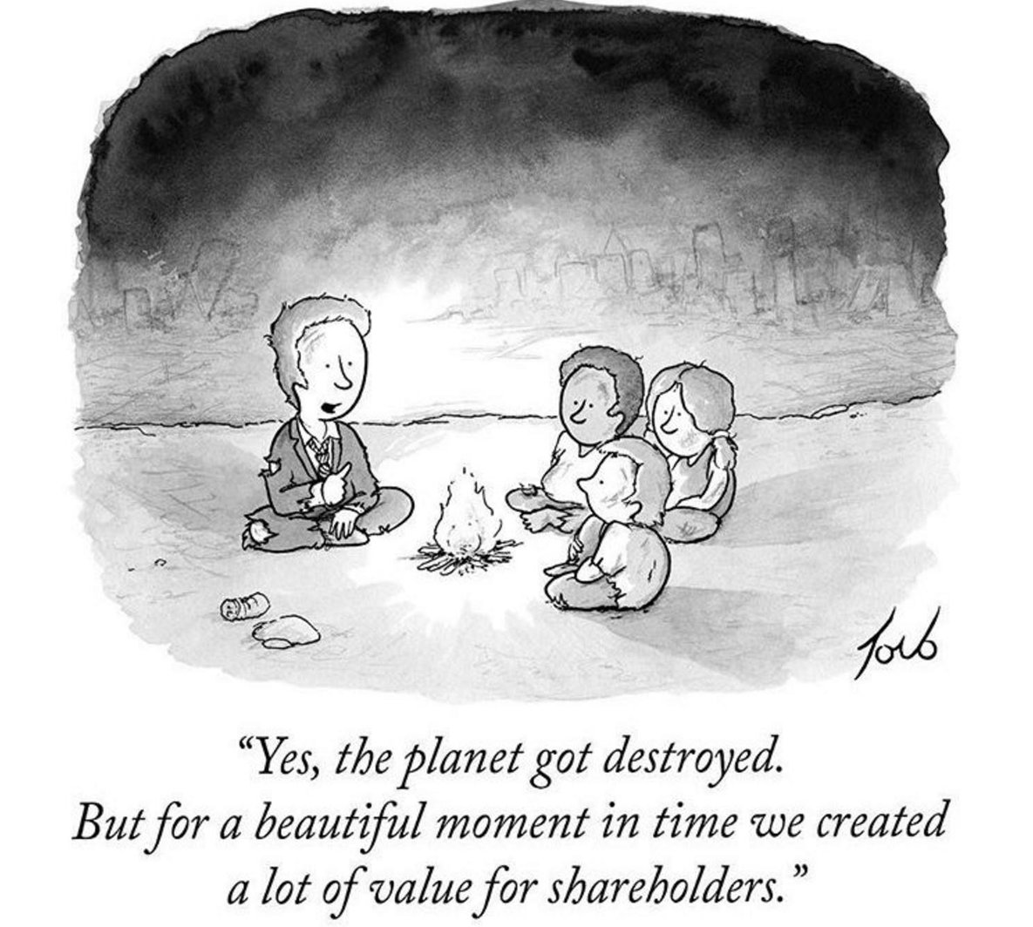
Why should business care about natural capital?
Financial performance is irrelevant on a dead planet
Notes:
Great to use a comic to spark interest and imagination. This says it all really
Business as usual is no longer possible.
By destroying our natural world and its resources, we are destroying the critical foundations of our own survival.
We are going to see how business is part of the problem but also part of the solution.

Slide 44
Why should business care about natural capital?
100 million hectares of tropical forest lost in 20 years
1 million species at risk of extinction
“Biodiversity and nature’s contributions to people are our common heritage and humanity’s most important life-supporting ‘safety net’. But our safety net is stretched almost to breaking point.”
Prof. Sandra Díaz (Argentina), IPBES Global Assessment
75% of terrestrial environment “severely altered” by human actions
50% of live coral reefs lost since 1870s
Notes:
Its good to have numbers to back up your point, and help stress the urgency of the work we are trying to do and why business should care NOW.
Stats all from IPBES media release re global assessment; https://www.ipbes.net/news/Media-Release-Global-Assessment

Slide 45
The global risk landscape has changed
2010 | 2011 | 2012 | 2013 | 2014 | 2015 | 2016 | 2017 | 2018 | 2019 | 2020 | 2021
Asset price collapse |  |  |  |  |  |  |  |  |  |  | Extreme weather
Slowing Chinese economy (<6%) |  |  |  |  |  |  |  |  |  |  | Climate action failure
Chronic disease |  |  |  |  |  |  |  |  |  |  | Human-made environmental disasters
Financial crisis |  |  |  |  |  |  |  |  |  |  | Infectious diseases
Global governance gap |  |  |  |  |  |  |  |  |  |  | Biodiversity
Asset price collapse |  |  |  |  |  |  |  |  |  |  | Infectious diseases
Retrenchment from globalization (developed) |  |  |  |  |  |  |  |  |  |  | Climate action failure
Oil price spike |  |  |  |  |  |  |  |  |  |  | Weapons of mass destruction
Chronic disease |  |  |  |  |  |  |  |  |  |  | Biodiversity loss
Fiscal crises |  |  |  |  |  |  |  |  |  |  | Natural resources crises
Top 5 Global Risks: likelihood
Top 5 Global Risks: impact
Source: WEF 2020
Economic Environmental Geopolitical Societal Technological
Notes:
Some you might be familiar with this graphic, this is the WEF Global Risk Report. This puts the world’s risk every year into a global context, look how much it has changed since 2010. Aside from the obvious addition of Infectious disease from COVID-19 which has changed the world’s priorities drastically. But the Environment risk are still very significant in terms of likelihood and impact.
This shows the real crisis that we are in and that we need to act now

Slide 46
Notes:
Its great to have numbers but real-life examples are so important for bringing home how this could actually affect them. You can easily adapt this slide to your business context and your country or region.
Real life examples:
California fires: Last summer, California faced the deadliest and most destructive wildfire season ever recorded. The same year, a heat wave baked the entire Northern Hemisphere, killing dozens from Quebec to Japan.
Low Rhine levels:
BASF: In 2018, BASF had to stop production of a component of polyurethanes at its main plant in Germany because low water levels in the Rhine river are impeding its ability to transport raw materials to the site. https://www.apnews.com/28755ad9694c4248b4e0c8fec6605b62
Shell: the low levels of the Rhine meant than barges were unable to enter the harbor upon which Shell’s oil refinery depends on in Germany, therefore causing Shell to adjust production levels. https://uk.reuters.com/article/uk-refining-germany-shell/shell-adjusts-german-refineries-output-because-of-low-rhine-level-idUKKCN1NP1BX?il=0
Pitch for nature: ‘negative impacts on nature cost the economy world-wide around $4.7 trillion a year.’ https://pitchfornature.org/
Climate change will wipe $2.5tn off: according to estimates from economic modelling, clamate change could cut the value of the world’ financial assets by $2.5tn. The research also showed the financial sense in taking action to keep climate change under the 2C danger limit agreed by the world’s nations. In this scenario, the value of financial assets would fall by $315bn less, even when the costs of cutting emissions are included. https://www.theguardian.com/environment/2016/apr/04/climate-change-will-blow-a-25tn-hole-in-global-financial-assets-study-warns
Soil erosion: A new study estimates $8 billion in global economic losses caused by soil erosion reducing crop yields and increasing water usage. On average, 24% of arable land globally is undergoing severe erosion, with a severely detrimental effect on global food production
Australia’s sheep farmers in crisis due to severe drought that has caused the sheep population to plummet, leaving some farmers doubtful if the industry can survive at all.
GrainCorp shares fall: after group warned it was likely to post a loss due to battling severe drought in Australia. GrainCorp’s stocks fell 10% on the news, leveling out at a 7% fall later in the day. It expected disruption to grain production due to drought
Hurricane Dorian costs retailers 1.5billion dollars: Foot traffic at apparel stores is expected to fall 25%, while visits to outlet centers will decline 32%. Restaurant traffic is expected to decrease 14%, threatening the typical labor day boost retailers in the region normally see at this time of year. The storm also affected ports on the Carolinas coast when many retailers are expecting to get their shipments for Christmas season around this time, disrupting supply chains.
Biodiversity loss is a business issue: speaking at the Forbes Global Sustainability Forum, executive secretary of UNCBD said so because destruction is driven by business, whilst the consequences will also have significant impacts on business
Bad air: researchers at the national university of Singapore studied pollution levels and worker output at two textile factories in China and found that having to work in poor air conditions leads to a decrease in productivity over time
Freeport-McMoRan: mining company agrees to pay USD 100million to Louisiana communities in response to the damage it has caused to the coast through drilling for oil. Freeport is one of 98 companies that have been sued in 46 lawsuits over the disappearing Louisiana coastline. The agreement is likely to light the way for future litigation and settlements with industry big players such as Shell, Exxon, Chevron etc…
ADDITIONAL BACKGROUND:
Climate-related disasters have cost the world $650 billion over the last three years, and NA is shouldering most of the burden, according to a report from Morgan Stanley. 14 weather and climate disasters cost the nation $91 billion in 2018, Earth's fourth hottest year on record. A warmer planet could mean a big hit to G.D.P. in the coming decades.
IPCC report:
Consequences of 1°C of global warming through extreme weather, rising sea levels and diminishing Arctic sea ice
If the global temp. heats up by 1.5°C , Central and Eastern North America (Toronto, Ottawa and Montreal) will see highest levels of warming of extreme hot days.
Grasslands and wetlands that spread across Alberta, Saskatchewan and Manitoba down into the U.S. are breeding grounds for 50-80 percent of waterfowl in NA. Loss of biodiversity if the planet heats up by 2°C.
Heavy taxes or prices on carbon dioxide emissions —as high as $27,000 per ton by 2100 — would be required. Almost politically impossible move in the U.S., world’s largest economy and second-largest greenhouse gas emitter behind China.
By 2050, use of coal as an electricity source would’ve to drop from nearly 40 percent today to 1-7 percent. Renewable energy such as wind and solar, which make up about 20 percent of the electricity mix today, would have to increase
References:
https://www.forbes.com/sites/linhanhcat/2019/05/21/soil-erosion-washes-away-8-billion/#25f56dca5b6c
https://www.ft.com/video/87defc86-8c45-478b-a9c1-2b3b21e1ad6f
https://www.ft.com/content/836e9e4a-b4bc-11e9-8cb2-799a3a8cf37b
https://www.cnbc.com/2019/09/04/hurricane-dorian-to-cost-retailers-1point5-billion-threaten-back-to-school-sales.html
https://fortune.com/2019/09/05/the-worlds-biodiversity-collapse-is-a-business-issue/
https://www.fastcompany.com/90288343/bad-air-makes-you-bad-at-your-job
https://platform.reprisk.com/news/detail/?id=966736 https://www.nytimes.com/2019/09/26/us/louisiana-freeport-mcmoran-deal.html?emc=rss&partner=rss

Slide 47
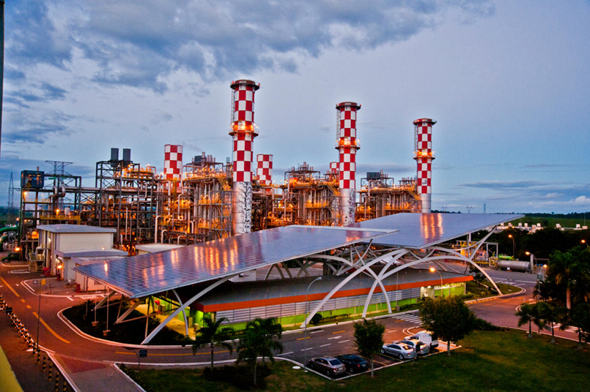
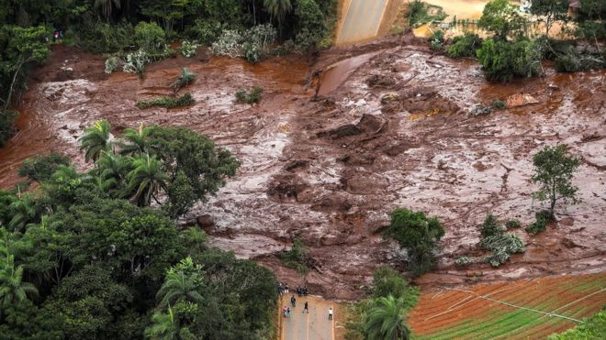
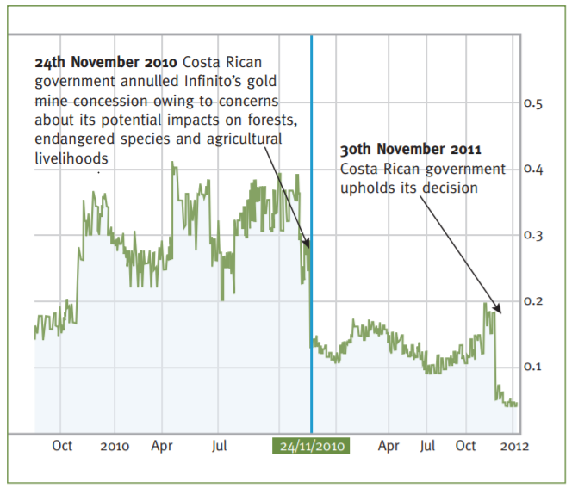
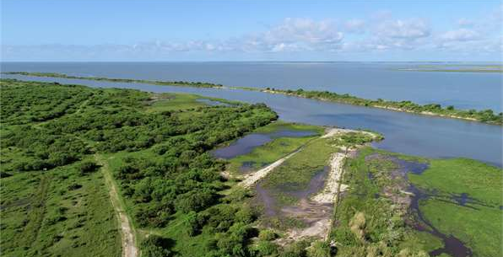
Reputational & Societal Opportunity
Operational Opportunity
Reputational & Societal Risk
Operational Risk
Risks & Opportunities for business
Financial Opportunity
Legal Opportunity
Financial Risk
Legal Risk
Financial Risk
Notes:
In years gone by, sustainability issues have sometimes taken business by surprise and companies have paid the cost. Companies are increasingly being impacted by the changing risk landscape discussed earlier (WEF report slide).
Operational risk – Vale damn collapse in Brazil, which caused the death of 300 people
Reputation risk – increased public & consumer awareness of environmental and social damages + consumers are increasingly demanding assurance that the products they buy are produced in way that protect our environment and respect human rights – link with SOCIETAL risks – health impacts on local communities, social license to operate
Legal risk – giant Texas oil company, Anadarko Petroleum, has agreed to pay $5.1 billion for a vast environmental cleanup - aimed at restoring thousands of sites polluted by toxins and compensating thousands of people with personal injury claims.
Financial risk – Underlying all of these risks & opportunities are financial ones! As we have seen, these risks imply important financial costs. Canadian gold mining company, Infinito Gold, lost over 50% of its share value as a result of the withdrawal of a mining concession in Costa Rica due to concerns about the potential impacts on agriculture, endangered species and forests.
But good news is that, where there is risk, there is opportunity to:
Secure natural resources
Save costs
Manage future risks
Engage stakeholders
Operational opportunity – EDF rainwater harvesting to manage water scarcity risks leading to reduction in water consumption, economical & energy savings Reputation opportunity – IKEA to use only renewable and recycled materials by 2030, which improves their image and engages with customers
Legal opportunity – Union Carbide Corporation, subsidiary of The Dow Chemical Company: Seadrift, TX Wetlands for Wastewater Treatment Project description: 110-acre engineered wetland in lieu of an industrial wastewater treatment plant In 1995, the Seadrift water treatment facility was seeking a solution to consistently meet regulatory requirements for water discharge. An innovative GI solution consisting of a constructed wetland was installed and has been successfully operating upon startup and for the last 15 years.
Financial opportunity – But when these risks are taken into account, we saw how it can also lead to reduced financial costs, or improve access to finance. Companies like those you can see here have managed to secure substantial billion dollar loan facilities where the interest rate of repayments is linked to ESG performance. That is to say if the company has string environmental and social performance they pay back less on the loan.

Slide 48
What are the risks & opportunities for your business?
Use the blank pages in your workbook pp. 12-13 and refer to pp. 47-48 of the NCP
Individually reflect in what ways do you think your own company impacts and depends on nature
Write down 3 risks & 3 opportunities you think your company could be facing in the next 10 years
Notes:
What is also important is to have questions so that your audience bring it back to the context of their company and their lives, it’s good to reflect on what you have just learnt.
You give them 5 minutes to reflect, you can use the workbook to write down their answers an think about the risk and opportunities to their business.
If you are doing this in a virtual setting you can use Menti meter
Business impacts and dependencies are closely linked. For example, a company may depend on water, while the quality of its water management practices will affect the scale of impacts generated through its use of water.

Slide 49
Notes:
Sharing it through menti meter can help show they are not alone and that other people have the same challenge.
Briefly reflect upon the results as they come up
Highlight the different types and nature of risks
Highlight commonalities that appear

Slide 50
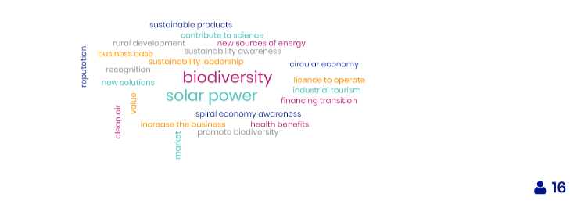
Notes:
Briefly reflect upon the results as they come up
Highlight the different types and nature of opportunities
Highlight commonalities that appear

Slide 51
Why assess your impacts & dependencies? The business case…
Refer to pp. 15-16 of your workbook
Many natural capital risks and opportunities are becoming increasingly visible, and business needs a way to understand and manage these.
Understand relationships with nature in a structured way
Challenge your business model
Mitigate risks
Increased competitive advantage
Create opportunities
Inform decisions that are really important to your business
Access to finance
Recruitment & retention of staff
Notes:
What is the business case for assessing your impacts and dependencies?
Where does natural capital come into this - how can it
help you manage these risks?
To assess natural capital is to assess your company’s impacts and dependencies on nature.
It provides information that will help you to understand your relationship with nature. By focusing on impacts and dependencies, natural capital provides structure to this understanding.
Once you have a better understanding of your relationship with nature, you can use this to challenge your business model, mitigate risks and create opportunities. Natural capital can also be a valuable tool for broadening the conversation to include all parts of your business, including the finance team.

Slide 52
Business case study
Kering developed an EP&L to measure and quantify the impacts of its activities on natural capital.
Biodiversity impacts are included, however more explicit integration is a key priority for the organization.
Benefits include increased transparency of their impacts and insights on where in their value chain impacts are occurring (majority in their supply chain).
More explicit integration of biodiversity will help Kering identify and implement actions to reduce biodiversity impacts, reducing the risk of disruption to their supply chains.

Slide 53
Notes:
Briefly reflect upon the results as they come up
Highlight commonalities that appear

Slide 54
Agenda
Time (CET) | Session
15:00 | Welcome – Agenda, objectives & material
15:10 – 15:20 | Introductions – Getting to know each other
15:20 – 16:05 | What is natural capital – Natural capital impacts & dependencies Group exercise
16:05 – 16:20 | Coffee break
16:20 – 16:30 | Why is natural capital important – The business case
16:30 – 17:10 | Natural capital risks & opportunities – Building business resilience Group game
17:10 – 17:45 | Applying natural capital & case studies – Brief overview of approaches & business applications
17:45 – 17:50 | First step of a natural capital assessment
17:50 – 18:00 | Wrap-up– Key takeaways, next steps & engagement opportunities
18:00 | End of training

Slide 55
Game time!
See instructions on p. 17 & write down your answers on pp. 18-20 of your workbook
“Pro P&P” company
You are part of the senior management team of “Pro P&P”, a pulp & paper company, based in South America.
Identify your key environmental risks
Implement appropriate risk responses
Notes:
KB
Image source: https://www.elconfidencial.com/alma-corazon-vida/2015-06-01/un-experimento-te-convierte-en-director-de-una-fabrica-china-esto-es-lo-que-harias_855364/

Slide 56
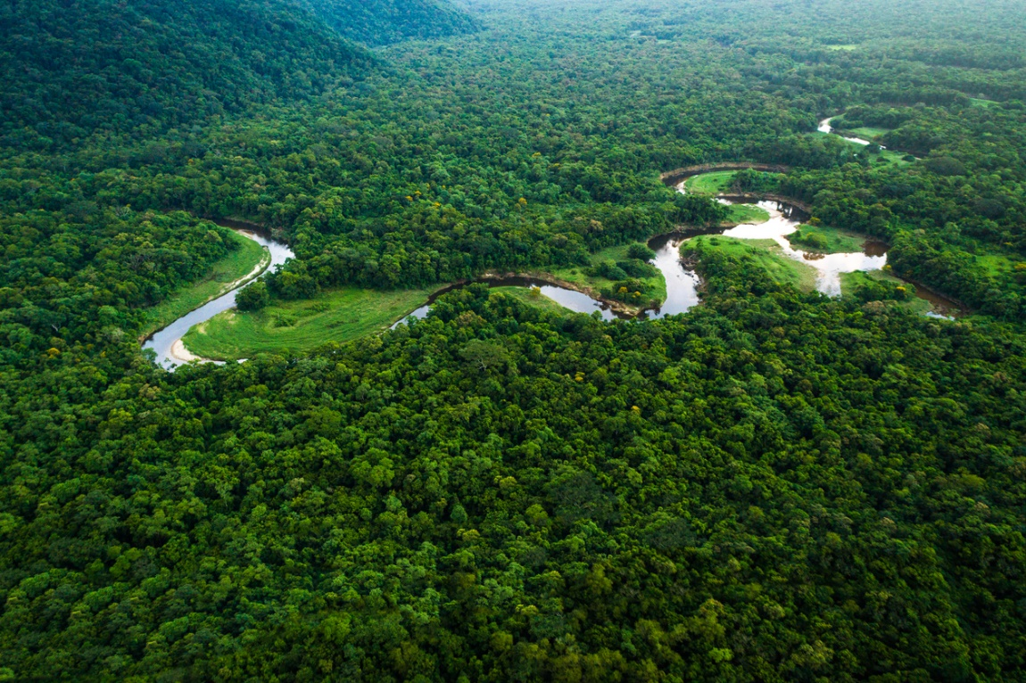
Scenario
Context: Issues of climate change and deforestation have increasingly been in the spotlight; one of your competitors has even been impacted by floods in one of its operational plants in Brazil.
Objective: Your CEO has asked you to re-assess the company’s environmental risks and put into place appropriate risk mitigation measures.
Pro P&P’s overall objective: be a recognized brand in the industry that takes into account increasing demand for responsible brands and products.

Slide 57
An NGO is campaigning against Pro P&P
More online shopping increases demand for packaging
Droughts impact one of Pro P&P's major suppliers
A ban on single use plastics is announced
A revised global climate deal increases raw material prices
SPIN!
The CEO commits to 100% recyclable/reusable packaging
Shareholder resolution requesting an ESG impact specialist
Increased customer demand for alternatives to plastic bottles
Notes:
Spin the wheel to land on a risk event. Participants should follow the fuller instructions on the relevant card which will be on their table. Do this until either all 8 risk events have been selected, or until 5 or 6 have been selected (if playing a shorter version of the game). Make sure participants are tracking their share price on the supplied graph.

Slide 58
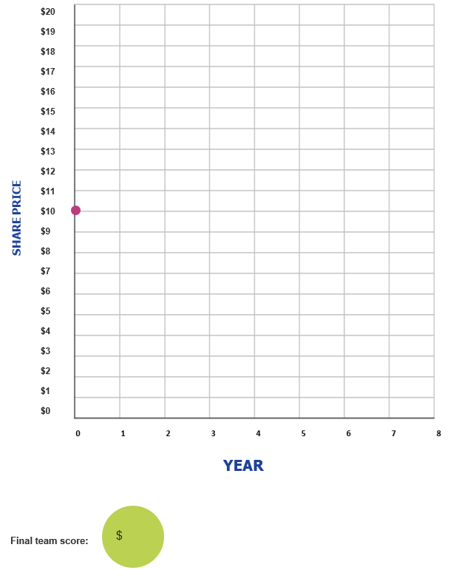

Slide 59
Debrief discussion
Write down your answers on p. 21 of your workbook
What did your team do well? What were some challenges?
What did you learn from this activity about natural capital risk and how it can be managed more effectively?
How does your company manage its environmental risks?
What are your key takeaways from the activity?
Notes:
Debrief discussion in plenary for 15’.

Slide 60
Where are we in our learning objectives?
So far, we have:
Demonstrated an understanding of natural capital and biodiversity and its linkages with business decision-making and risk management,
Identified natural capital impacts & dependencies as well as risks & opportunities and related these to your respective business context,
Familiarized ourselves with a few key approaches and tools to integrating natural capital & biodiversity into business decision-making.
Notes:
Briefly summarise what participants have learnt so far, and highlight what’s next.

Slide 61
Agenda
Time (CET) | Session
15:00 | Welcome – Agenda, objectives & material
15:10 – 15:20 | Introductions – Getting to know each other
15:20 – 16:05 | What is natural capital & biodiversity – Natural capital impacts & dependencies Group exercise
16:05 – 16:20 | Coffee break
16:20 – 16:30 | Why natural capital & biodiversity important – The business case
16:30 – 17:10 | Natural capital risks & opportunities – Building business resilience Group game
17:10 – 17:45 | Applying natural capital, biodiversity & case studies – Brief overview of approaches & business applications
17:45 – 17:50 | First step of a biodiversity-inclusive natural capital assessment
17:50 – 18:00 | Wrap-up– Key takeaways, next steps & engagement opportunities
18:00 | End of training

Slide 62
Applying natural capital & biodiversity in decision-making
An overview of approaches
Notes:
KB
Re-connect to game and how through this, they have already thought of some tools and methods they could implement and perhaps even realized that some of these, they are already applying in their own company.
Before kick off this next session, give space for 1 person from each table to share some of the key barriers, challenges & solutions that came out from game.

Slide 63
Assessments: Measure & Value
Refer to p. 23 in the workbook and p. 84 of the Natural Capital Protocol
To measure ≠ to value
To measure: determine the amounts, extent and condition in physical terms
e.g. m3, tons, number of injuries, number of jobs
To value: estimate the relative importance, worth, or usefulness of natural / social / human capital to people (or to a business), in a particular context.
Qualitative
Quantitative
Monetary
Costs and benefits to the business, and to society
Notes:
There are different ways of valuing – could be qualitative, quantitative and monetary
Measuring does not always mean value
Important to note that monetary values without any context (i.e. accompanying quantification) are less meaningful!
The method you chose depends on which natural capital impact drivers or dependencies you wish to assess, the chosen value perspective (e.g. business, societal, or both), the ultimate objective of your assessment, and the time and resources available.
Monetary valuation: some find it difficult to accept or interpret monetary valuation of certain benefits (e.g. spiritual values). In such situations, special efforts may be required to explain the advantages and also to acknowledge the limitations of monetary valuation.
Advocates of natural capital are sometimes accused of ‘putting a price on nature’ or ‘pricing the priceless’, but in fact our core assertion is that prices have failed to reflect the true value of the natural world, and that the economic systems that we are using are broken.
We use the common definitions of price and value: Where price is ‘the quantity of one thing that is exchanged or demanded in barter or sale for another/the amount of money given or set as consideration for the sale of a specified thing’ and value as ‘The regard that something is held to deserve; the importance, worth, or usefulness of something i.e. “your support is of great value”. If something is not for sale, we do not describe it as having a ‘price’, but we may nevertheless recognise the value that it holds, and make decisions on this basis.

Slide 64
Business application
See p. 20 in the NCP,
p. 23 in the workbook
Natural capital information can be used in plenty of ways. You need to decide what information you need and how it will be used.
Potential Business Applications
Assess risks and opportunities
Compare options
Assess impacts on stakeholders
Estimate total value and/or net impact
Communicate internally or externally
Notes:
A natural capital assessment provides information. Whilst this can be valuable in its own right, this means there are also numerous ways to use this information for further purposes.
The NCP focuses on using natural capital for decision-making, measurement and valuation, but it can also be used for disclosure and communication, or to help formulate strategy.
The best way for your company to use natural capital information is highly individual – think back to the challenges and risks you identified earlier in the training and consider how exactly how more information could help you meet these challenges.

Slide 65
Business applications in numbers
Estimate total value and/or net impact, 34%
Assess risks and opportunities, 27%
Assess impacts on stakeholders, 13%
Integrate and mainstream natural capital into policy, 7%
Compare options, 5%
Create and support insights, 5%
Other, 9%
Notes:
Steph
Data from the Natural Capital Coalition Case Study Database
Presenter to give an overview of the pie chart presented on the slide. Presenter to explain that the main purpose for carrying out assessments are to estimate total value/or net impact of/on natural, or social and human, capital. The next greatest application is to assess risks and opportunities for the companies carrying out the assessment, and the third biggest reason is to assess company impacts on stakeholders.

Slide 66
Overview of current assessments
NC or SHC
Organization type
Notes:
Steph
Data from the Natural Capital Coalition Case Study Database
Presenter to give an overview of the pie charts presented on the slide. Presenter to explain that the majority of assessments carried out include only natural capital, and that very few assessments measure social and human capital without also measuring natural capital. Presenter to explain that the majority of companies carrying out assessments are businesses, with governments carrying out ¼ of all assessments and finance carrying out the fewest.

Slide 67
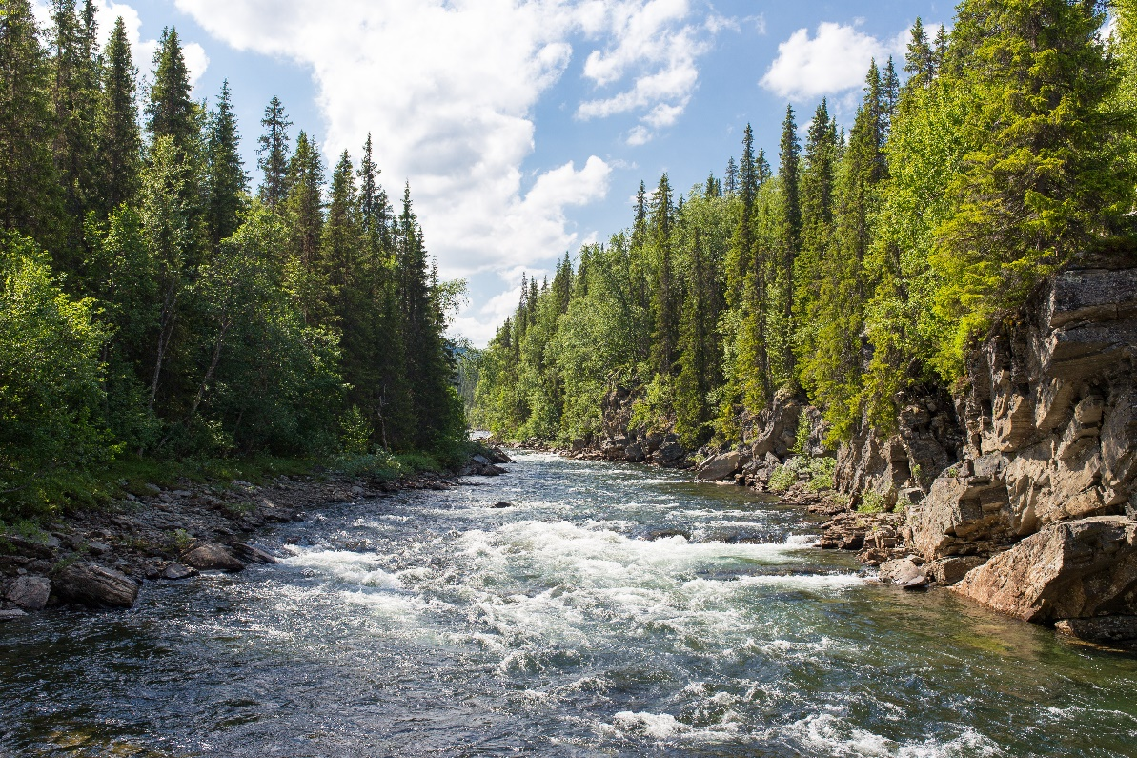
Business Example –
Check the NCC’s website or WBCSD’s website for more case studies
What was assessed: cost and value of water to the company, to the community and to other local users.
How this was used: To help shape the approach to water risk management and stewardship efforts.
Going forward: IP will design a plan for integrating water value into their operational models to internalize key externalities related to water intake and discharge. This might involve
a new governance structure
a new strategic framework
Assess risks and opportunities
Notes:
https://naturalcapitalcoalition.org/forest-products-sector-guide-case-study-for-international-paper/
Highlight that this is a business example which focuses on the application of “assessing risks and opportunities”.
International Paper (IP) is one of the world’s leading producers of fiber-based packaging, pulp and paper.
They conducted an assessment of its water use, looking at the costs and value of water to both the company and to the community and other uses of the water, therefore looking at both the impacts and dependencies and also considering not just the impact on the company but on society too. Finally, they assessed the company’s value-add per unit of water used. This information was then used to shape IP’s approach to water risk management and their stewardship efforts. Going forward, IP will design a plan for integrating water value into their operational models to internalize externalities.

Slide 68
Business example –
Check the NCC’s website or WBCSD’s website for more case studies
What was assessed: a comparison of the effects of sustainable forest management vs pristine conservation and palm oil production.
How this was used: Results were communicated with internal and external stakeholders
Sustainable forest management by IHC allowed the preservation of integrity of forest and associated values (provision of economic and social benefits)
Going forward: The assessment will guide future monitoring indicators to be integrated into business decision-making.
Compare options
Communicate internally or externally
Notes:
https://naturalcapitalcoalition.org/forest-products-sector-guide-case-study-for-interholco/
Interholco (IHC) specializes in forest management and wood production and is one of the largest producers of African tropical hardwood
IHC undertook a study comparing the effects on the forest of undertaking sustainable forest management in the Congo basin vs pristine conservation and palm oil production.
They found that SFM provided more economic value and comparable natural value as conservation. Palm oil theoretically provides 700x economic value than conservation and 40x more than SFM, but this is outweighed by significant co2 emissions associated with deforestation for palm oil and irreversible loss of ecosystem (showing benefit of taking NC approach).
Going forward: the assessment will be used to provide insight on impacts and dependencies, and guide future monitoring indicators to be integrated into business decision making. IHC may in future undertake specific NC assessment for new business development scenarios.

Slide 69
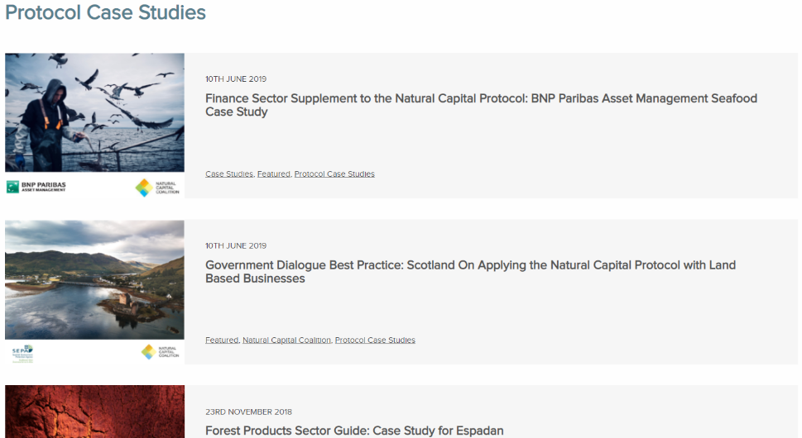
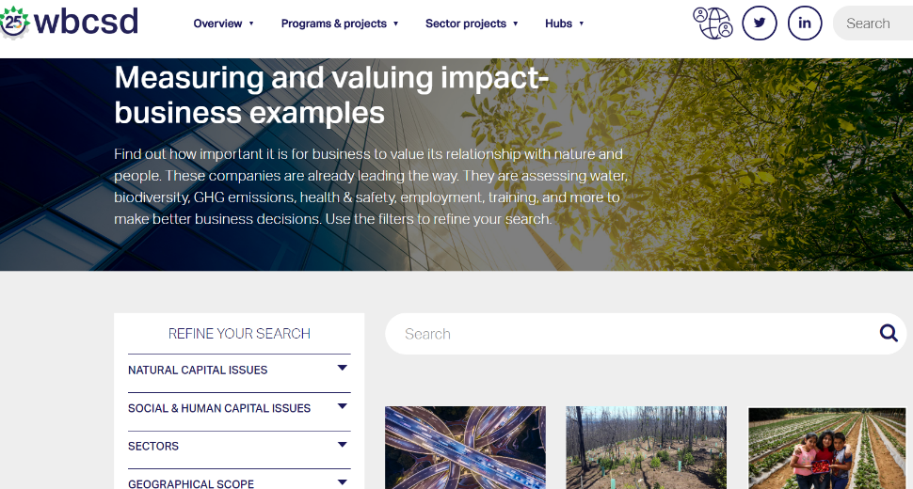
Case Studies platforms I
Natural Capital Coalition’s case studies
Over 160 case examples
Variety of business sectors, and public sector
Examples of how companies have made use of the Natural Capital Protocol
WBCSD’s business examples page
Nearly 60 business examples
Variety of business sectors
Examples of how companies have conducted a natural, social/human capital assessment

Slide 70
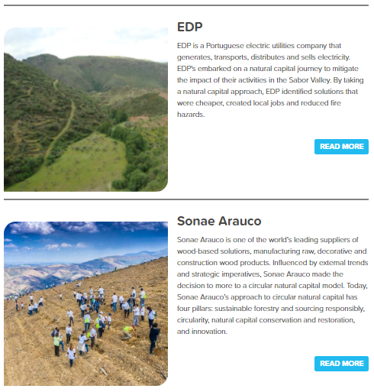
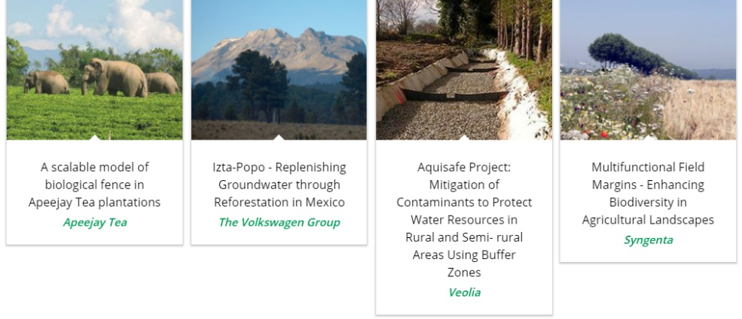
Case Studies platforms II
We Value Nature’s business stories
3 recent business stories relating to natural capital
4 business stories from F&B sector
Variety of business sectors
EDP, Sonae Arauco & Grupo Argo sharing their natural capital journey
Natural infrastructure for business platform
16 business case studies
Variety of business sectors
Examples of how companies have conducted a natural, social/human capital assessment
Case study library

Slide 71
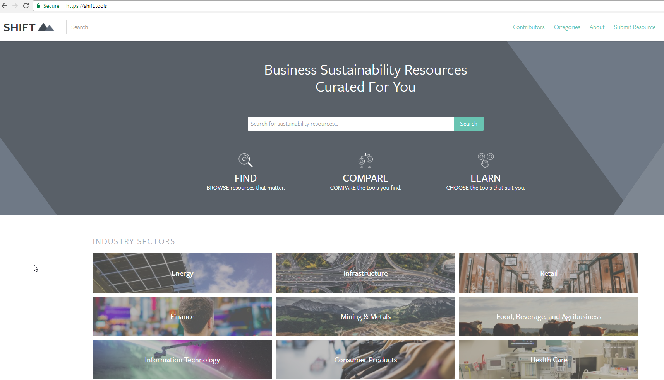
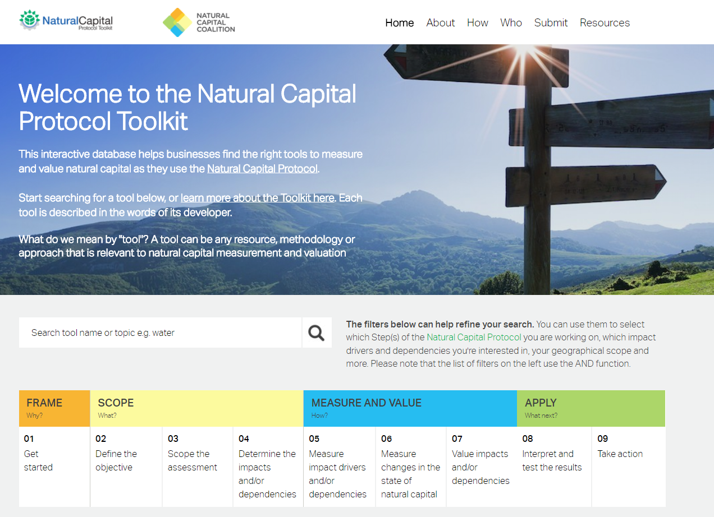
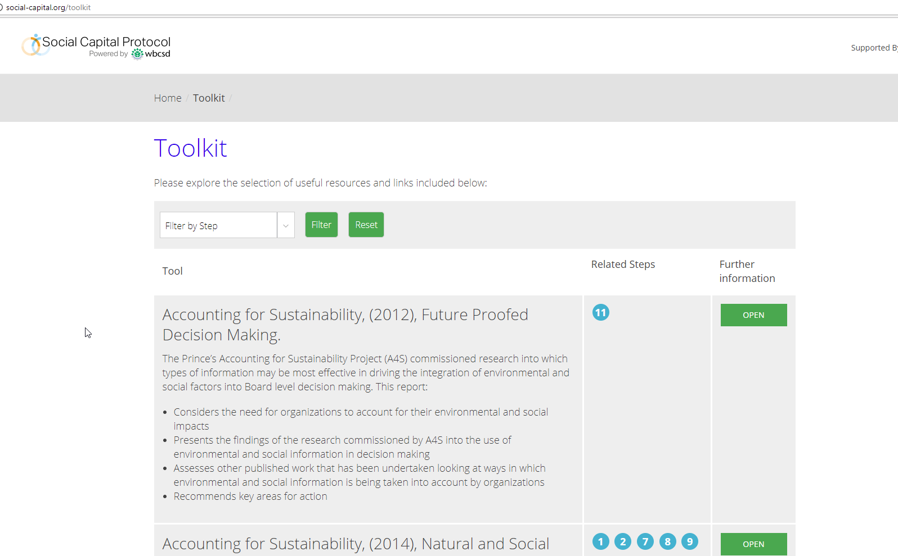
Notes:
We can see from this slide, the wealth of intellectual content, tools and approaches that already exist in the natural capital field.
This certainly highlights the need for standardization, and a process into which all of these existing resources can input. As we have seen, the Natural Capital Protocol does NOT aim to recreate or invent any new methodologies – instead leverages what we already have.
This also shows that while there are many tools, methodologies and resources out there, this can add to the confusion hence the importance to have a good understanding of what it is you are trying to achieve, what kind of information you are trying to collect or decision you are trying to inform in order to chose the most appropriate tool / resource.

Slide 72
Group exercise: exploring tools and resources
Use p. 26 in the workbook
In pairs:
Go to The Natural Capital Toolkit on the SHIFT platform: https://shift.tools/nct
Imagine that you work for a mining company. Your senior management team has asked you to explore ways to conduct a company-wide assessment on its use of water.
3. Using the toolkit, determine which tool(s) could help you conduct such an assessment.
Notes:
CvC
Now, we have an exercise for your participants familiarize themselves with these tools by doing an exercise that will have them explore some of them.
For this exercise, participants will need their laptops. They will be connection onto SHIFT, which is an extensive repository of tools and resources on how to undertake a natural capital assessment and valuation. Because it’s so huge, we’ve picked the natural capital toolkit to help narrow your search a bit. The natural capital toolkit was developed by the natural capital coalition and WBCSD.
This is a nice exercise to have them realize that there are many tools available and that the one they will choose will depend on many aspects.

Slide 73
Use p. 27 in the workbook
Debrief discussion
What tool(s) have you chosen?
What are the advantages and disadvantages of the chosen tool?
What kind of information did you look for when navigating on the Natural Capital Toolkit?
What factors did you consider to help make the choice of the tool?
In what way(s) could the Natural Capital Toolkit and SHIFT be helpful to you?
What did you learn from this activity?
Notes:
Conclusion of this exercise is that:
There are no perfect answers!
The choice of tool will depend on various factors:
What is the objective / what are you trying to achieve? / What decision are you trying to inform? – Is it to inform business strategy? Business management? Or operating decision?
What is the scope? Are you looking at product, corporate level?
What perspective are you looking at? Business? Societal? Both?
How much resources do you have available to conduct the assessment?
How much information / data do you already have?
Will you need external help?
Etc.

Slide 74
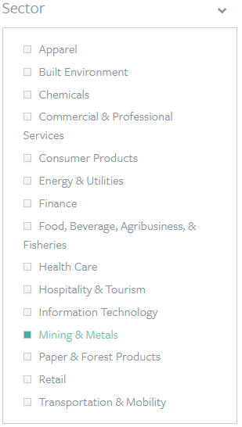
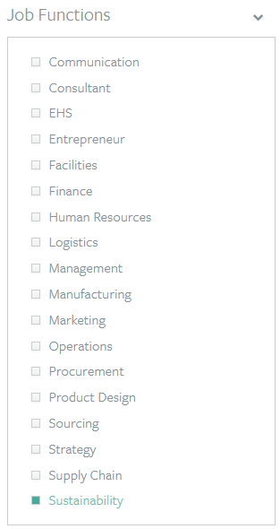
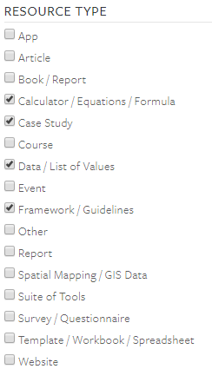
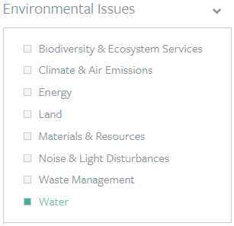
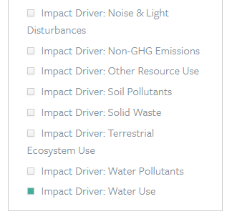
Natural Capital Toolkit example
Mining company
Conduct a company-wide assessment on its use of water
Sustainability team
Notes:
An example of how the platform works, providing a fictive scenario.
Conclusion is that:
There are no perfect answers!
The choice of tool will depend on various factors:
What is the objective / what are you trying to achieve? / What decision are you trying to inform? – Is it to inform business strategy? Business management? Or operating decision?
What is the scope? Are you looking at product, corporate level?
What perspective are you looking at? Business? Societal? Both?
How much resources do you have available to conduct the assessment?
How much information / data do you already have?
Will you need external help?
Etc.

Slide 75
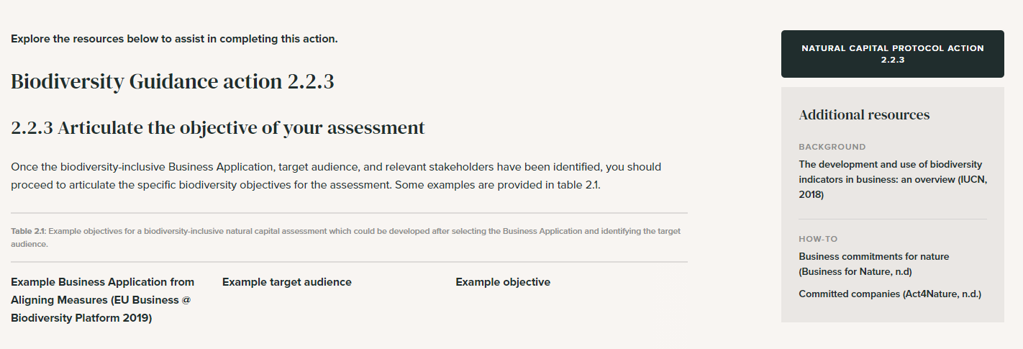
Biodiversity Guidance Navigation Tool
Using the Navigation Tool as a checklist to prepare for next step of the assessment
Explore additional resources

Slide 76
Some other examples of tools to determine impacts and dependencies
ENCORE (Natural Capital Finance Alliance)
Impact and dependencies at economic sector level – qualitative
SASB (Sustainability Accounting Standards Board)
Impacts at a sector level – qualitative
Natural Capital Protocol Sector Guides
Impacts and dependencies but for limited sectors (food and beverage, apparel and forests)
I360X (Impact 360)
Impacts across all natural, human, social and financial capital – quantitative and qualitative
Use localised examples or tools that can be of use within your company
Notes:
We have some examples of tools that can help determine, impact and dependencies that you can suggest to your trainiees. You can also update this for tools for your industry or company.

Slide 77
Presentation of case studies
Notes:
CvC
Its great to have speakers/case studies from other companies or external advisor that can share their experience of integrating natural capital.
3 speakers from 3 different companies will be invited to the training to share their experience in integrating natural capital into their business decision-making processes.
Speakers will be encouraged to share:
Their experience
The solutions put in place
Challenges/barriers faced, how these were overcome and what would they do differently looking back
Collaboration with stakeholders involved in the process – who was key in supporting the solution, making it happen and perhaps also discussion around communications, how do you have to communicate differently e.g. if trying to convince risk management vs
During presentation of case studies, participants will be encouraged to take note of:
Challenges & barriers
Solutions, activities
Key stakeholders / enablers in the process
Encourage case studies speakers to also discuss how they would have done things differently.

Slide 78
Case study presentation from xyz
Use pp. 28-33 in your workbook
Pay attention to the following elements while listening to the presentation:
Objective of assessment & process undertaken (incl. tools, methodologies adopted)
Barriers, challenges
and how overcame these
Decision-making, collaboration, next steps
Notes:
A colleague in your company or a peer company, or videos are good alternative
3 speakers from 3 different companies will be invited to the training to share their experience in integrating natural capital into their business decision-making processes.
Speakers will be encouraged to share:
Their experience
The solutions put in place
Challenges/barriers faced, how these were overcome and what would they do differently looking back
Collaboration with stakeholders involved in the process – who was key in supporting the solution, making it happen and perhaps also discussion around communications, how do you have to communicate differently e.g. if trying to convince risk management vs
Encourage case studies speakers to also discuss how they would have done things differently.
ave

Slide 79
Agenda
Time (CET) | Session
15:00 | Welcome – Agenda, objectives & material
15:10 – 15:20 | Introductions – Getting to know each other
15:20 – 16:05 | What is natural capital & biodiversity – Natural capital impacts & dependencies Group exercise
16:05 – 16:20 | Coffee break
16:20 – 16:30 | Why are natural capital & biodiversity important – The business case
16:30 – 17:10 | Natural capital risks & opportunities – Building business resilience Group game
17:10 – 17:45 | Applying natural capital, biodiversity & case studies – Brief overview of approaches & business applications
17:45 – 17:50 | First step of a biodiversity-inclusive natural capital assessment
17:50 – 18:00 | Wrap-up– Key takeaways, next steps & engagement opportunities
18:00 | End of training

Slide 80
1st steps to assessing natural capital
Defining an objective
Notes:
CvC
This is the first step of the natural capital assessment and the protocol that comes before module 2

Slide 81
Concrete steps to undertaking a 1st natural capital assessment
ASSESSMENT STEPS
Define your objective
Iterative process
Identify your impacts and/or dependencies
An initial view
Timing
Scope your assessment
Organizational focus
Value chain boundary
Value perspective
Impacts and/or dependencies
Type of value
Skills
PLANNING
Data
Resources
Stakeholders
Practicalities
Baseline, scenarios, spatial & temporal boundaries, etc.
Next steps
Notes:
CvC
Presenter to explain the steps to undertaking a 1st natural capital assessment using the diagram on the slide. Presenter to explain that defining the objective can be quite difficult.
So here we are only looking at Defining your objective is really important for how you go about your whole assessment. The other 3 assessment steps are explained in module 2.

Slide 82
Actions to take when setting an objective
Refer to p. 35 in the workbook and pp. 26-29 of the NCP
Identify the target audience
Identify stakeholders and the appropriate level of engagement
Articulate the objective of your assessment
Notes:
Its important to identify and engage with your stakeholders and why you are doing this assessment.
There is a really useful hypothetical example in the NCP and the workbook, that goes through this process of setting an objective. Identifying your audience ect

Slide 83
Practical considerations when starting a natural capital assessment
What is your objective? How will assessments help your company and who is asking for this information, e.g. customers, investors?
Define the project scope and application
Address relevant issues, make your project tailor-made
Skills and data: what have you got and what do you need to get?
What is your budget?
Make sure there is sufficient support for the project and involve the right partners
Develop clear recommendations and action plan
→ Highlight insights rather than absolute numbers
Refer to p. 34 in the workbook
Notes:
How much will it cost? It depends on what you're trying to do. It will depend on the scope of the assessment, what you're asking for and what data is already available.
Skills and data: what have you got and what do you need to get? companies can start to conduct many other aspects of an assessment themselves by doing things like getting the project going, scoping the assessment and integrating natural capital considerations into internal processes.
How can we secure the resources? In many cases, natural capital assessments can be a bottom-up effort. Trying to drive natural capital assessments from sustainability, environment or health and safety departments is sometimes difficult, but nevertheless, the Protocol provides guidance on integrating the assessment into the business itself. One way to facilitate engagement internally can be to show that "many companies are already doing natural capital assessments; they're just using different terminology and steps.
The bottom line is that although carrying out a natural capital assessment is technical, it's also achievable. Not every assessment has to be a huge undertaking, so companies should start off with a scope that makes most sense to their situation. The Protocol will help you do this.
Also to keep in mind:
How will assessments help your company and who is asking for this information, e.g. customers, investors?
Decision-making
External reporting
Stakeholder engagement
What kind of information would help?
How good does the information have to be, e.g. financial grade?
Comparable?
Monetary (and what does it mean?)
How much of a leader does your company want to be in this space?
Share to help converge on what is practical, e.g. case studies, learnings
Explicitly connect your approach with generally-accepted frameworks like Natural Capital and Social & Human Capital Protocols.
Influence WBCSD’s RV Board, raise awareness around monetary valuation
Most companies believe that the real value of using consultants is in the valuation itself, meaning the number-crunching analysis. This is because - unfortunately! - the Protocol isn't a calculator and it won't tell you which monetary values to use in any given situation. However, companies can start to conduct many other aspects of an assessment themselves by doing things like getting the project going, scoping the assessment and integrating natural capital considerations into internal processes.
It's usually much more efficient to build on existing data that's readily available in-house, and the Protocol provides guidance on gathering and using that data too.
For example, many companies have data on their own GHG emissions, water, waste, and some also have results of product Life Cycle Assessments - this existing information can provide a really good starting point for a natural capital assessment. How applicable it is will depend on the objectives and scope of the assessment though, so it's important to find the balance between getting perfect data (e.g. from monitoring in the field) and using proxies that are not as accurate but can be more practical and still lead to better decisions.

Slide 84
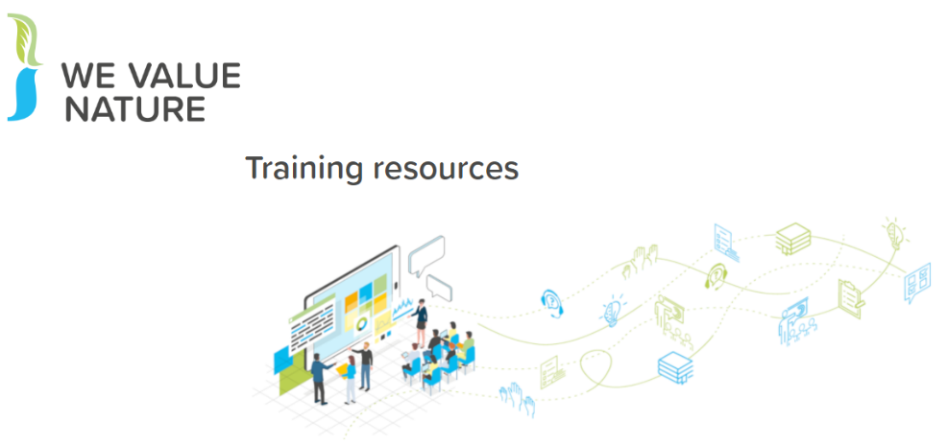
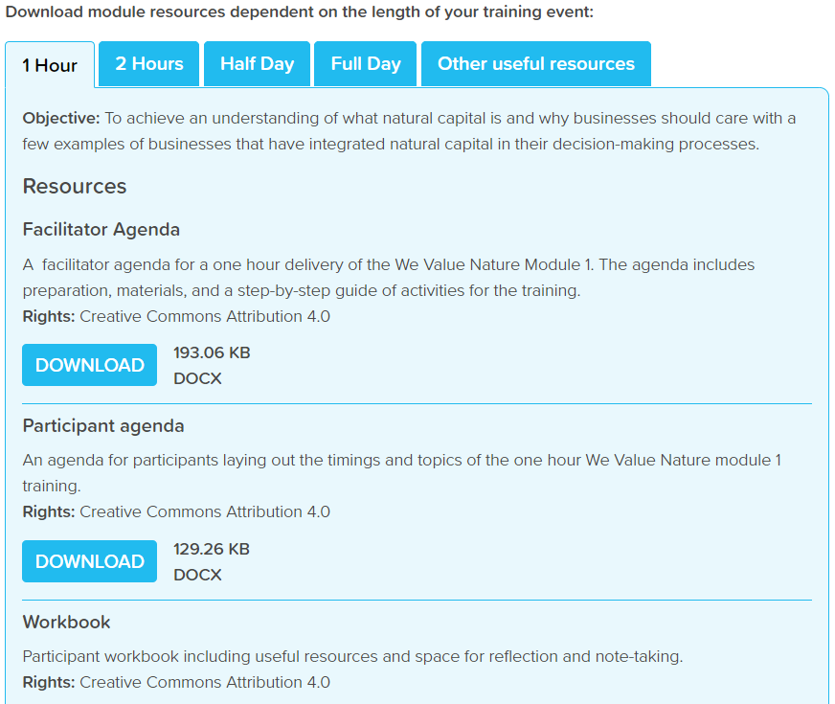
Eager to get started?
Check out NCC’s interactive training videos
Make use of WVN’s training resources
Notes:
We have the WVN training resources are available on the website which is a great places to get started.
The Natural Capital Coalition has recently launched a set of training videos that will guide you in an interactive way through a natural capital assessment to explore just how much can be achieved with limited resources.
Each little video will guide you through step by step through a natural capital assessment.

Slide 85
Where are we in our learning objectives?
So far, we have:
Demonstrated an understanding of natural capital and biodiversity and its linkages with business decision-making and risk management,
Identified natural capital impacts & dependencies as well as risks & opportunities and related these to our respective business context,
Familiarized ourselves with a few key approaches and tools to integrating natural capital and biodiversity into business decision-making.
Notes:
Always good to reflect on the learning objectives we have gone through today. The objectives for today are …

Slide 86
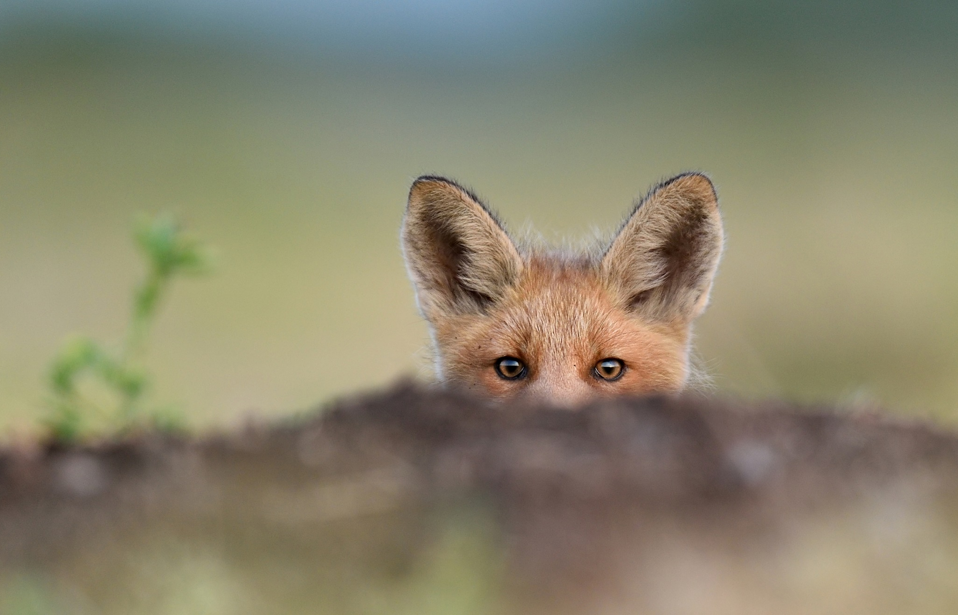
Wrapping-up
Notes:
KB

Slide 87
Ask again here the 1st Menti Q. on how much do they know about natural capital to see if answers progress at the end of the training

Slide 88
Key takeaways / Closing word
See p. 36 in your workbook
Business impacts and depends on nature and biodiversity
Applying a biodiversity-inclusive natural capital approach helps make better & more informed decisions
There are many existing tools & resources
Companies can start to conduct an assessment themselves
Buy-in must extend beyond the sustainability team
Notes:
Business impacts and depends on nature – the NCP provides the framework to identify and assess impacts and dependencies,
Understanding, measuring and valuing natural capital (i.e. taking into account) will help business make better decisions,
There are many existing tools & resources to measure and value impacts and dependencies. The one you chose depends on the information you are aiming to get or the decision you are trying to inform,
Companies can start to conduct an assessment themselves by getting the project going, scoping the assessment and integrating natural capital considerations into internal processes,
For natural capital to become strategically important, buy-in must extend beyond the sustainability team.
ADDITIONAL BACKGROUND INFORMATION
How much will an assessment cost?
Some of the Protocol pilot testers - like our members Nestlé and Roche - estimated they spent about USD $50,000 on consulting services for their assessments over a six-month period. Some companies spend less, others spend more.
Dow, Kering and Natura have invested significantly more over a longer term, for in-depth assessments that contribute to their multi-year strategic ambitions
The Protocol can help companies navigate these kinds of situations by making sure the services required align with the assessment's objective.
Skills & data needed:
It's usually much more efficient to build on existing data that's readily available in-house, and the Protocol provides guidance on gathering and using that data too.
For example, many companies have data on their own GHG emissions, water, waste, and some also have results of product Life Cycle Assessments - this existing information can provide a really good starting point for a natural capital assessment. How applicable it is will depend on the objectives and scope of the assessment though, so it's important to find the balance between getting perfect data (e.g. from monitoring in the field) and using proxies that are not as accurate but can be more practical and still lead to better decisions.
Internal buy-in:
In many cases, natural capital assessments can be a bottom-up effort. Trying to drive natural capital assessments from sustainability, environment or health and safety departments is sometimes difficult, but nevertheless, the Protocol provides guidance on integrating the assessment into the business itself.
One way to facilitate engagement internally can be to show that "many companies are already doing natural capital assessments; they're just using different terminology and steps.
To support this engagement, it is important to look beyond those benefits that can be valued through the natural capital assessment itself, and acknowledge how a natural capital approach can motivate organizational change in support of broader business goals." This means that there will be more leadership from the top to better measure, value and then integrate natural capital into business.
The bottom line is that although carrying out a natural capital assessment is technical, it's also achievable. Not every assessment has to be a huge undertaking, so companies should start off with a scope that makes most sense to their situation. The Protocol will help you do this.
Finally, we must make sure the information obtained from the assessment is included in core business decision-making. This will ensure you have the best possible impact on your business, and on the environment.

Slide 89
Creating an inducive company environment for integrating natural capital
Download the cards in the media library
Sustainability Manager
Chief Executive Officer
Chief Financial Officer
Integrating natural capital into business decision-making is a collaborative process.
Each person in a company has its own role to play in driving sustainability. Sometimes, i.e. in the case of SMEs, one person can embody different roles.
To empower your colleagues and managers and collaborate effectively, you need to be aware of the challenges and needs for each role.
Please visit WeValueNature’s digital media library, to find all action cards describing useful actions for a various roles & ways to engage others in the company on natural capital.
Procurement Officer
Marketing manager
Farmer

Slide 90
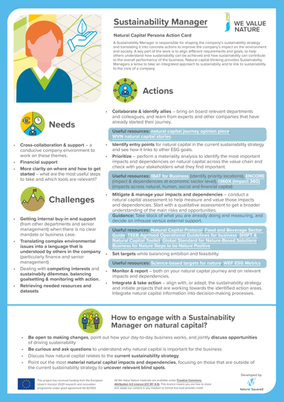
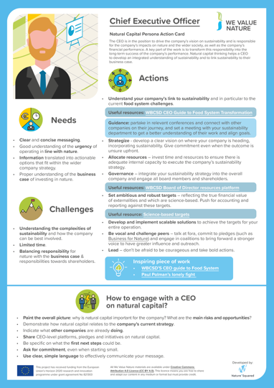
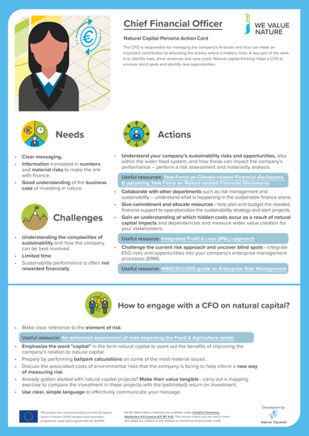
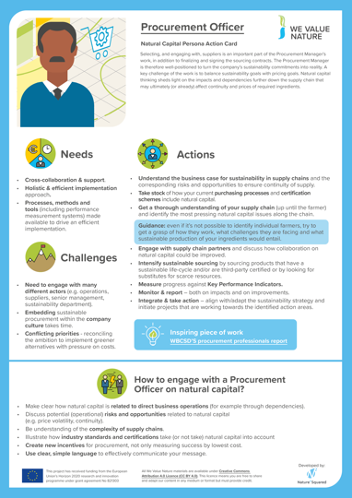
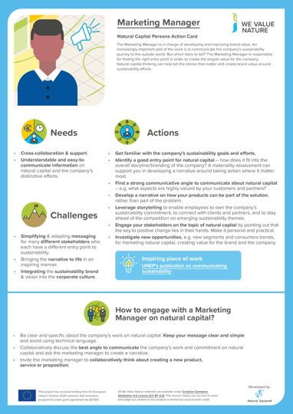
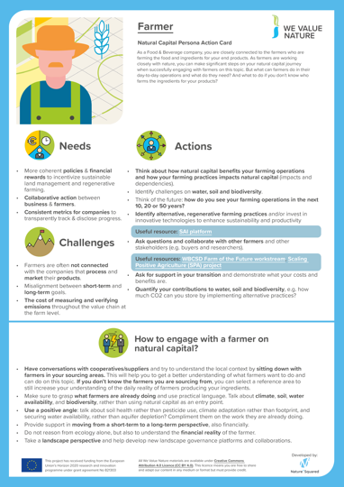
Creating an inducive company environment for integrating natural capital
Find a personas action card for each identified role through We Value Nature’s digital media library
Notes:
Sustainability Manager
Actions
Collaborate & identify allies
Identify entry points
Mitigate & manage your impacts and dependencies
Set targets
Monitor & report
Integrate & take action
Needs
Cross-collaboration & support
Financial support
More clarity on how and where to get started
Barriers
Getting internal buy-in and support
Translating complex environmental issues into a language that is understood by others
Retrieving needed resources and datasets
How to engage?
Be open to making changes
Be curious and ask questions
Discuss how natural capital relates to the current sustainability strategy
Point out the most material natural capital impacts and dependencies
CEO
Actions
Understand your company’s link to sustainability
Strategize and allocate resource
Governance
Set ambitious goals and targets
Develop and implement scalable solutions
Be vocal and challenge peers
Lead
Needs
Clear and concise messaging
Good understanding of the urgency and business case
Information translated into actionable options
Barriers
Understanding the complexities of sustainability
Limited time
Balancing responsibility for nature with responsibilities towards shareholders
How to engage?
Paint the overall picture of why NC is important to the company
Show how NC related to the current strategy
Indicate what other companies are already doinng
Ask for commitment, even when starting small
All cards can be retrieved through: LINK FORTHCOMING

Slide 91
Mentimeter closing questions
Use p. 37 in your workbook
What is your
1 key learning from the training?
Share 1 concrete next action you will take after this training

Slide 92
How to use Mentimeter
1
Go to www.menti.com
2
Enter this code: xx xx xx
3
Submit your answer
Notes:
KB

Slide 93
Next steps that YOU can take
Download & familiarize yourself with the Natural Capital Protocol and the Biodiversity Guidance
Inspire yourself from our business stories on natural capital
Share training learnings & material with colleagues and network

Slide 94
We Value Nature training is open
You are free to:
Share — copy and redistribute the material in any medium or format
Adapt — remix, transform, and build upon the material for any purpose, even commercial
Under the following terms:
Attribution — You must give appropriate credit, link to the licence & indicate if changes were made (but not suggest endorsement).
No additional restrictions — You may not legally restrict others from doing anything the license permits.
CC BY 4.0 Creative Commons Attribution 4.0 International
If any images are more restricted this is noted on caption.
Notes:
We have a Creative Commons Attribution license which means that you are free to share and adapt your own organization and industry to make it more relevant. To make it targeted to your audience, we’d love to know how you’ve adapted them.

Slide 95
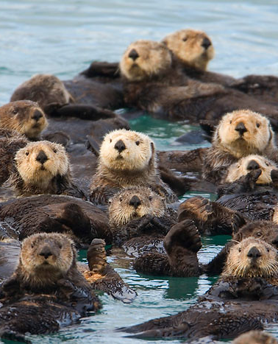
It’s good to share!
Let us know how you use the We Value Nature training materials.
How have you adapted them for your own training?
We will be pleased to share your news & resources with the We Value Nature community.
Share your remixed materials in our open media library
Training@wevaluenature.eu
@WeValueNature
smileycreek CC BY-NC-SA 2.0
Notes:
Please share with us when your are doing a training, we are always excited to hear when you are doing a training and how you adapted the training. We love sharing this on our website, which can be really useful for other people!

Slide 96
We are here to help!
Deep-dive webinars
In-person training
Helpdesk calls
Virtual office hour/
Q&A
Virtual training
Train-the-trainer
Keep in touch & sign-up: wevaluenature.eu
Exchange with peers:
LinkedIn Group
Provide your feedback: Survey
We want to learn too – how have we helped?
Notes:
WHAT ELSE would you need? What support would you need?
Sign-up for in-person day training, t-t-t
If want support, need to fill out survey (Google form survey)
Refining training further, keen to know how have used this training and catch-up via call (if don’t want to, let us know)

