Slide 1



Business training on natural capital
What are the relationships between business and nature?
Location, Date

Slide 2
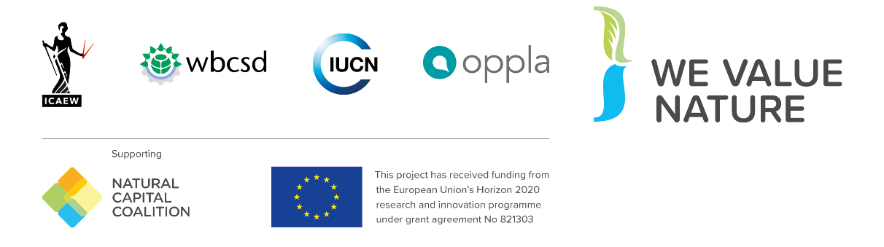
We Value Nature – Who are we?
We Value Nature is a campaign supporting businesses and the natural capital community to make valuing nature the new normal for business across Europe, by:
Sharing research, resources & best practices;
Identifying barriers & opportunities for adopting a natural capital approach;
Providing practical support to help business improve their risk management, communication & stakeholder engagement;
Reinforcing & boosting the work of the Natural Capital Coalition.
Notes:
Before kicking-off the training, introduce that this training is being given as part of the We Value Nature Campaign and explain what it is, its purpose, objectives and partners involved:
The We Value Nature Campaign is a €2 million EU-funded campaign supporting businesses and the natural capital community across Europe with the aim of making valuing nature the new normal for business. As we will have a chance to explore during today’s training, by valuing nature, businesses can make smarter decisions that benefit themselves, society and the planet as a whole.
The campaign is coordinated by the Institute of Chartered Accountants in England and Wales (ICAEW), World Business Council for Sustainable Development (WBCSD), The International Union for Conservation of Nature (IUCN) and Oppla. And it is supporting the Natural Capital Coalition, which has recently merged with the Social & Human Capital Coalition to become now the ‘Capitals Coalition’.
The campaign will aim to increase the uptake of the natural capital approach (including: natural capital assessment, natural capital accounting, nature-based solutions and green infrastructure) by identifying barriers and opportunities, providing practical support to business through activities (such as webinars, helpdesk calls, etc.) and training such as this one, as well as by inspiring businesses to adopt the NCP.
Take this opportunity to also thank the different stakeholders that supported the training (if relevant).

Slide 3

Objectives
At the end of the training, you will be able to understand:
What is natural capital and its linkages with business,
Why it is important for business decision-making and risk management,
How business can start applying a natural capital approach to support decision-making.
Notes:
The objectives for today are …
Emphasize that this training is particularly targeted at businesses in the early stages of their natural capital journey wanting to understand where to get started / organizations that want to help businesses get started.

Slide 4
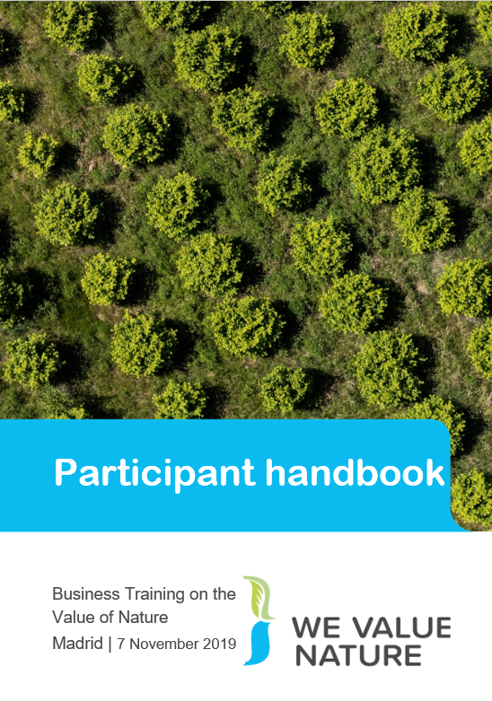

Training material
Take notes!
Notes:
Mention that they should all have a ‘Participant handbook’ and explain that its purpose is to use it throughout the training. We have included in there some of the slides from the training but also additional information. There is space for them to regularly take note as well as write down their key learnings through each chapter. The aim is that at the end of the training they have a useful resource to look back to when wanting to get stated on the natural capital journey.

Slide 5
A few house rules
 | Participate
 | Contribute
 | Listen
 | Take note
 | Respect
 | Have fun!
Notes:
Run through the training ‘house riles’ re common courtesy, what is expected of participants.

Slide 6
Programme
Time | Session
14:00 | Welcome
14:10 – 14:20 | Introduction to natural capital
14:20 – 14:45 | Why is natural capital important?
14:45 – 15:30 | Exploring practical approaches
15:30 – 15:50 | Case study presentation
15:50 – 16:00 | Lessons learned & wrap up
16:00 | End of training
Notes:
Run through the training program for the session.

Slide 7


Introduction to natural capital

Slide 8
https://www.youtube.com/watch?v=UXZhlJyuw8A
Notes:
After showing video, open the floor to anyone that wishes to share something
Potential questions that can be asked to participants:
Has anyone of you seen this video before? Show of hands
What did you think of the video?
What feelings or perceptions were perhaps triggered when viewing the video?

Slide 9


Hypothetical example
Let’s start by imagining that you work for an agribusiness, producing crops such as oranges
What could be your impacts on nature (+ or -)?
What could be your dependencies on nature (i.e what natural resources you depend on to run your business)?
Notes:
Give participants 3’ to reflect on both questions at their respective table and then offer participants to share in plenary some of the ideas that came out – 2’.
Reflect on responses:
Reference of resources
Scope of impacts – some examples referenced at product level others at supply chain level – direct operations or through supply chain
Some may be directly related to the business. Others more indirect: water use through the process and noise/disturbances in extracting and manufacturing process, small particles
Manufacturing process, customer phase – thinking about full suit
How may depend on nature: if car manufacturing downstream from a forest for example, it depends on it to protect from flooding which if didn’t have that forest, factory could be at risk of being swamped
Potential answers:
Impacts: water use, soil degradation through overuse, (but also health: preventing too much rainwater runoff etc., absorbing carbon, biodiversity (loss because of monoculture, or helping through providing habitats), use of fertilizer
Dependencies: water, fertile soil, appropriate temperature and climate,
Elements to be considered:
What stages of value chain are we considering, where is farm based, is it organic or mass production?

Slide 10
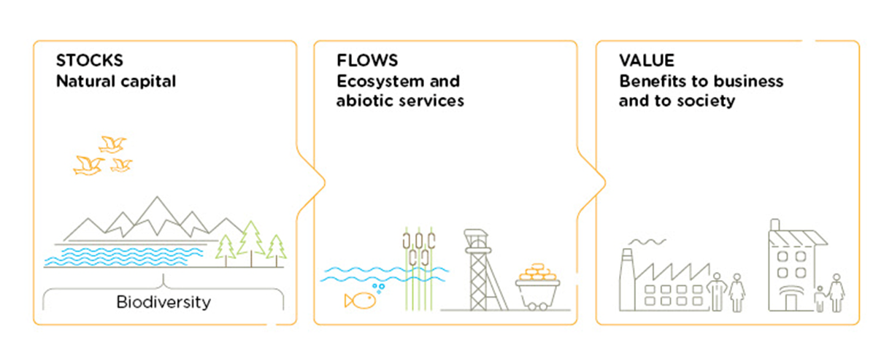
Natural Capital Definition
Refer to p. 5 of your handbook & p.12 of the Natural Capital Protocol
Natural capital is the stock of renewable and non-renewable natural resources, (e.g. plants, animals, air water, soils, minerals) that combine to yield a flow of “services” to people. In turn, these flows provide value to business and society.
Biodiversity underpins both stocks and ecosystem services
Source: Natural Capital Protocol
Notes:
We have started thinking about natural resources an agricultural producer relies and impacts on but what do we mean when we talk about natural capital?
Well in fact, everything you have discussed through the previous example is natural capital is some form or another. Whether it is the assets/resources it represents (such as water and soil you have identified as needed for the farm) or the services it brings (e.g. pollination, etc.).
From climate adaptation to ecosystem services, the environmental jargon is everywhere. What is important, is not to remember all the terminology used, but rather that these are all connected to the value of nature and that people have different entry points and priorities and will use one or another terminology based on that. But fundamentally, we are all speaking about the same things, just in different ways.
This is the definition according to the Natural Capital Protocol. Refer to p. 12 of Natural Capital Protocol.
The stocks refer to the natural resources available to us while the flows refer to the different benefits people receive from ecosystems such as:
timber,
fiber,
pollination,
water regulation,
climate regulation,
recreation,
etc.
Abiotic services are benefits to people that do not depend on ecological processes but arise from fundamental geological processes e.g. – supply of minerals, metals and oil and gas, as well as geothermal heat, wind, tides, etc.
In the Protocol biodiversity (part of stocks) is considered to be critical to the health and also the stability of natural capital in so much that it provides resilience to shocks like:
Floods
Droughts
As well as supports fundamental processes such as:
carbon and water cycles
soil formation
ADDITIONAL BACKGROUND:
Ecosystem services – key distinction between:
Supporting services: fundamental ecological processes that support the delivery of our ecosystem services
Regulating services: indirect benefits from nature generated through regulation of ecosystem processes e.g. – mitigation of climate change through carbon sequestration, water filtration by wetlands, erosion control and protection from storms

Slide 11
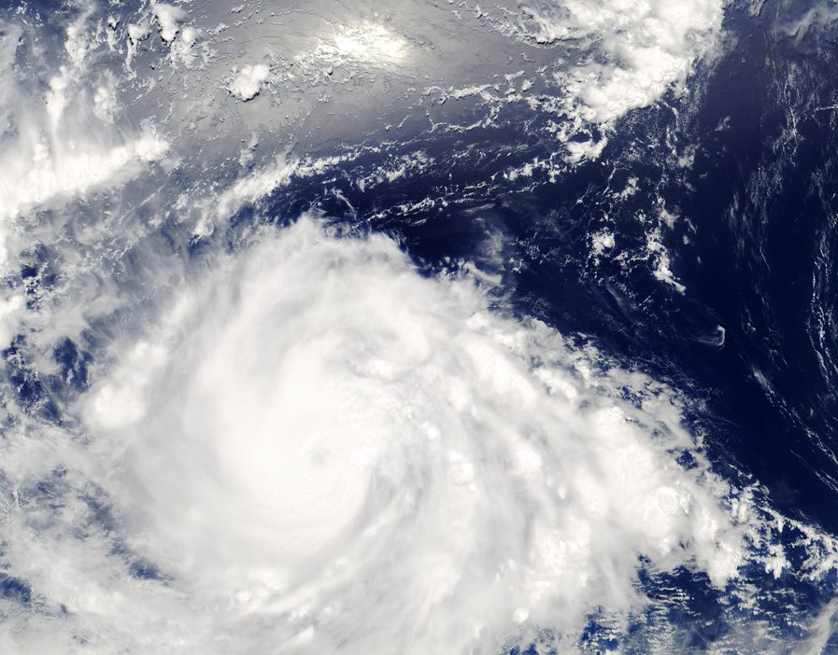
Why is natural capital important?

Slide 12
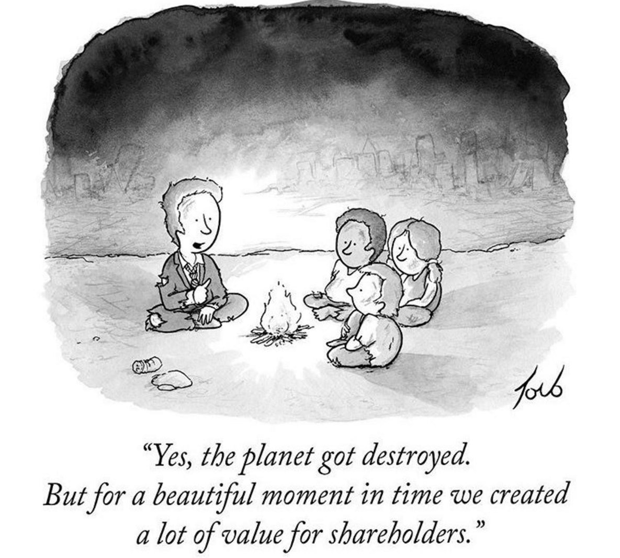
Why should business care about natural capital?
Financial performance is irrelevant on a dead planet
Notes:
Business as usual is no longer possible.
Our ‘take-make-dispose’ way of consuming is no longer possible.
By destroying our natural world and its resources, we are destroying the critical foundations of our own survival.
We are going to see how business is part of the problem but also part of the solution.

Slide 13
The global risk landscape continues to shift
2009 | 2010 | 2011 | 2012 | 2013 | 2014 | 2015 | 2016 | 2017 | 2018 | 2019
Asset price collapse |  |  |  |  |  |  |  |  |  | Extreme weather events
Slowing Chinese economy (<6%) |  |  |  |  |  |  |  |  |  | Failure of climate-change mitigation and adaptation
Chronic disease |  |  |  |  |  |  |  |  |  | Natural disasters
Global governance gaps |  |  |  |  |  |  |  |  |  | Data fraud or theft
Retrenchment from globalization |  |  |  |  |  |  |  |  |  | Cyberattacks
Asset price collapse |  |  |  |  |  |  |  |  |  | Weapons of mass destruction
Retrenchment from globalization (developed) |  |  |  |  |  |  |  |  |  | Failure of climate-change mitigation and adaptation
Oil and gas price spike |  |  |  |  |  |  |  |  |  | Extreme weather events
Chronic disease |  |  |  |  |  |  |  |  |  | Water crises
Fiscal crises |  |  |  |  |  |  |  |  |  | Natural disasters
Top 5 Global Risks: likelihood
Top 5 Global Risks: impact
Economic Environmental Geopolitical Societal Technological
Source: WEF’s Global Risks Report 2019
Notes:
This is from World Economic Forum’s global risks report.
We can see that there’s been a complete shift of risks from 10 years ago. You can see that 10 years ago, none of the top risks by likelihood or impact fell under the umbrella of “environmental”. Come back to today, and 3 of the top 5 risks by both likelihood and impact are environmental.
Companies are increasingly facing natural capital related risks. More than ever, they are having to be able to understand, manage and mitigate their natural capital impacts and dependencies.
WEF’s Global Risks Report 2019 is published against a backdrop of worrying geopolitical and geo-economic tensions. https://www.weforum.org/reports/the-global-risks-report-2019

Slide 14
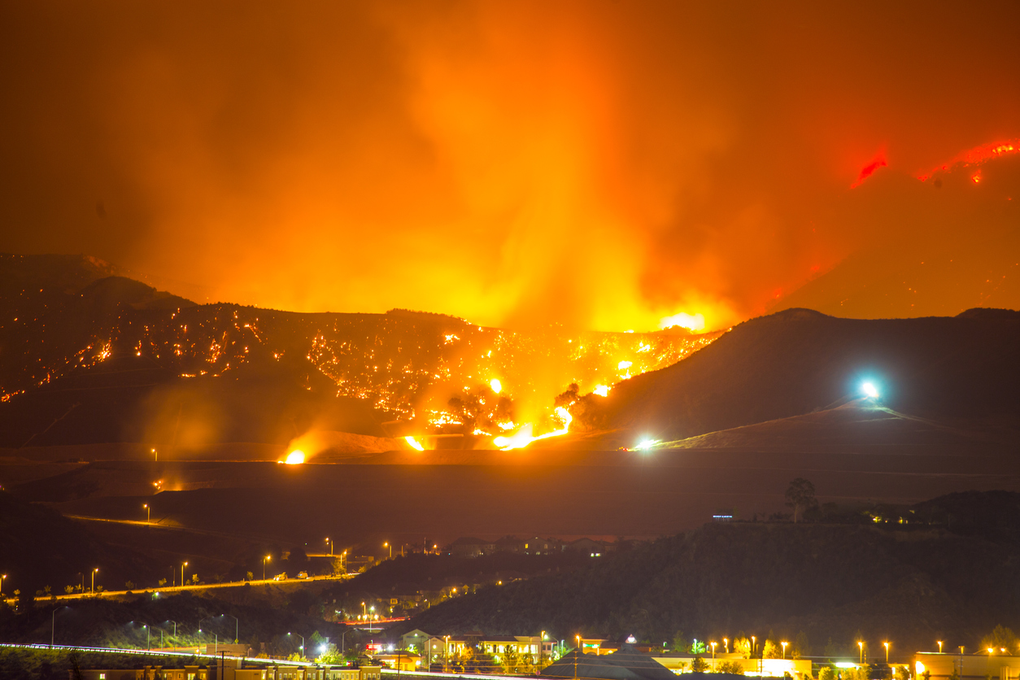

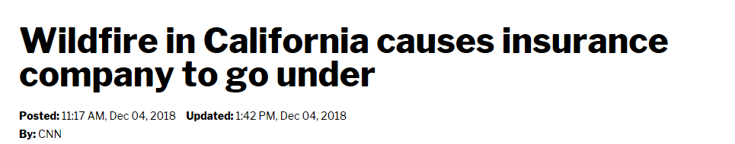
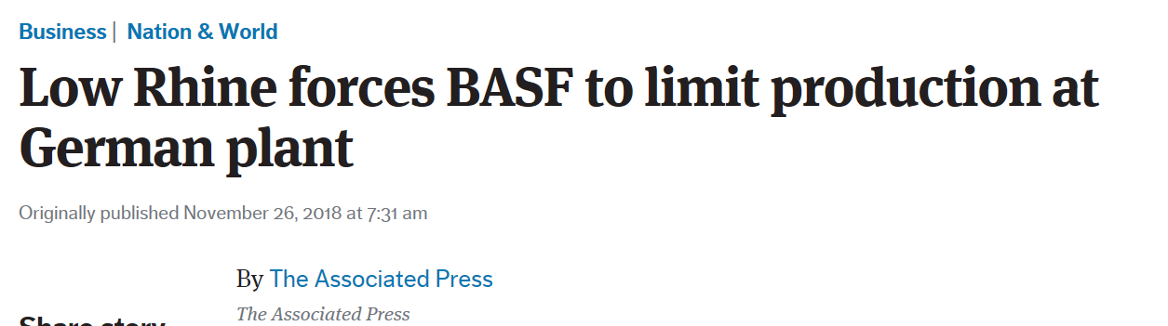
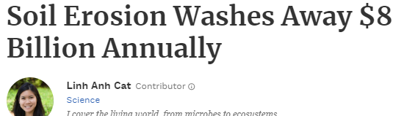
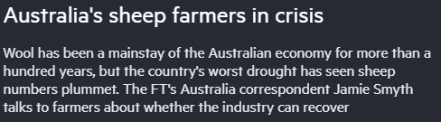

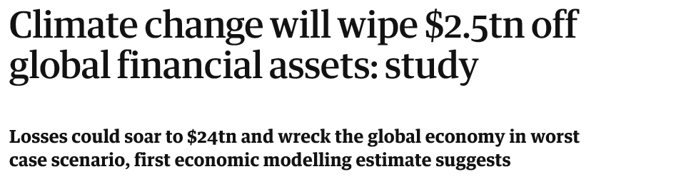

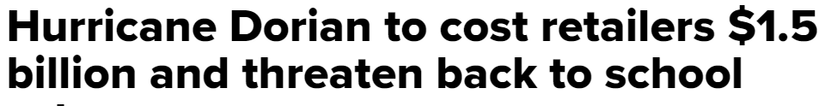
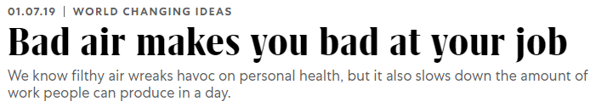
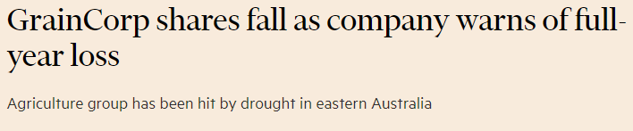
Notes:
Real life examples:
California fires: Last summer, California faced the deadliest and most destructive wildfire season ever recorded. The same year, a heat wave baked the entire Northern Hemisphere, killing dozens from Quebec to Japan.
Low Rhine levels:
BASF: In 2018, BASF had to stop production of a component of polyurethanes at its main plant in Germany because low water levels in the Rhine river are impeding its ability to transport raw materials to the site. https://www.apnews.com/28755ad9694c4248b4e0c8fec6605b62
Shell: the low levels of the Rhine meant than barges were unable to enter the harbor upon which Shell’s oil refinery depends on in Germany, therefore causing Shell to adjust production levels. https://uk.reuters.com/article/uk-refining-germany-shell/shell-adjusts-german-refineries-output-because-of-low-rhine-level-idUKKCN1NP1BX?il=0
Pitch for nature: ‘negative impacts on nature cost the economy world-wide around $4.7 trillion a year.’ https://pitchfornature.org/
Climate change will wipe $2.5tn off: according to estimates from economic modelling, clamate change could cut the value of the world’ financial assets by $2.5tn. The research also showed the financial sense in taking action to keep climate change under the 2C danger limit agreed by the world’s nations. In this scenario, the value of financial assets would fall by $315bn less, even when the costs of cutting emissions are included. https://www.theguardian.com/environment/2016/apr/04/climate-change-will-blow-a-25tn-hole-in-global-financial-assets-study-warns
Soil erosion: A new study estimates $8 billion in global economic losses caused by soil erosion reducing crop yields and increasing water usage. On average, 24% of arable land globally is undergoing severe erosion, with a severely detrimental effect on global food production
Australia’s sheep farmers in crisis due to severe drought that has caused the sheep population to plummet, leaving some farmers doubtful if the industry can survive at all.
GrainCorp shares fall: after group warned it was likely to post a loss due to battling severe drought in Australia. GrainCorp’s stocks fell 10% on the news, leveling out at a 7% fall later in the day. It expected disruption to grain production due to drought
Hurricane Dorian costs retailers 1.5billion dollars: Foot traffic at apparel stores is expected to fall 25%, while visits to outlet centers will decline 32%. Restaurant traffic is expected to decrease 14%, threatening the typical labor day boost retailers in the region normally see at this time of year. The storm also affected ports on the Carolinas coast when many retailers are expecting to get their shipments for Christmas season around this time, disrupting supply chains.
Biodiversity loss is a business issue: speaking at the Forbes Global Sustainability Forum, executive secretary of UNCBD said so because destruction is driven by business, whilst the consequences will also have significant impacts on business
Bad air: researchers at the national university of Singapore studied pollution levels and worker output at two textile factories in China and found that having to work in poor air conditions leads to a decrease in productivity over time
Freeport-McMoRan: mining company agrees to pay USD 100million to Louisiana communities in response to the damage it has caused to the coast through drilling for oil. Freeport is one of 98 companies that have been sued in 46 lawsuits over the disappearing Louisiana coastline. The agreement is likely to light the way for future litigation and settlements with industry big players such as Shell, Exxon, Chevron etc…
ADDITIONAL BACKGROUND:
Climate-related disasters have cost the world $650 billion over the last three years, and NA is shouldering most of the burden, according to a report from Morgan Stanley. 14 weather and climate disasters cost the nation $91 billion in 2018, Earth's fourth hottest year on record. A warmer planet could mean a big hit to G.D.P. in the coming decades.
IPCC report:
Consequences of 1°C of global warming through extreme weather, rising sea levels and diminishing Arctic sea ice
If the global temp. heats up by 1.5°C , Central and Eastern North America (Toronto, Ottawa and Montreal) will see highest levels of warming of extreme hot days.
Grasslands and wetlands that spread across Alberta, Saskatchewan and Manitoba down into the U.S. are breeding grounds for 50-80 percent of waterfowl in NA. Loss of biodiversity if the planet heats up by 2°C.
Heavy taxes or prices on carbon dioxide emissions —as high as $27,000 per ton by 2100 — would be required. Almost politically impossible move in the U.S., world’s largest economy and second-largest greenhouse gas emitter behind China.
By 2050, use of coal as an electricity source would’ve to drop from nearly 40 percent today to 1-7 percent. Renewable energy such as wind and solar, which make up about 20 percent of the electricity mix today, would have to increase
References:
https://www.forbes.com/sites/linhanhcat/2019/05/21/soil-erosion-washes-away-8-billion/#25f56dca5b6c
https://www.ft.com/video/87defc86-8c45-478b-a9c1-2b3b21e1ad6f
https://www.ft.com/content/836e9e4a-b4bc-11e9-8cb2-799a3a8cf37b
https://www.cnbc.com/2019/09/04/hurricane-dorian-to-cost-retailers-1point5-billion-threaten-back-to-school-sales.html
https://fortune.com/2019/09/05/the-worlds-biodiversity-collapse-is-a-business-issue/
https://www.fastcompany.com/90288343/bad-air-makes-you-bad-at-your-job
https://platform.reprisk.com/news/detail/?id=966736 https://www.nytimes.com/2019/09/26/us/louisiana-freeport-mcmoran-deal.html?emc=rss&partner=rss

Slide 15
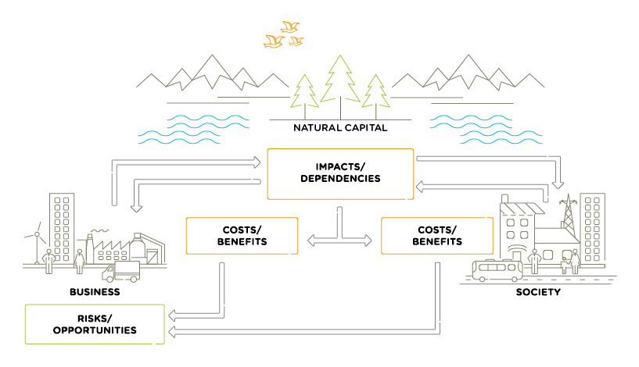
Business depends on & impacts natural capital
Refer to p. 6 of your handbook & p.15 of the Natural Capital Protocol
1
2
3
All businesses impact and depend upon natural capital.
This relationship delivers costs and benefits back to themselves and to society.
These in turn lead to risks and opportunities to the business
Source: Natural Capital Protocol
Notes:
Again, coming back to this idea of interconnectedness. Because it’s all interconnected.
What the example shows is that natural, social and economic issues are fundamentally interconnected and cannot be separated from one another.
1. All businesses impact and depend upon natural capital in some way. So those stocks and those flows we were talking about earlier, are either used by businesses and are very important to them, or they are impacted (positively or negatively!) by business activities.
2. These impacts and dependencies translate to costs and benefits, to both businesses and society.
3. These in turn lead to risks and opportunities to the business
But this isn’t just theory and a nice diagram, these impacts and dependencies have the potential to affect businesses in a real way, and we’re seeing that right now.

Slide 16
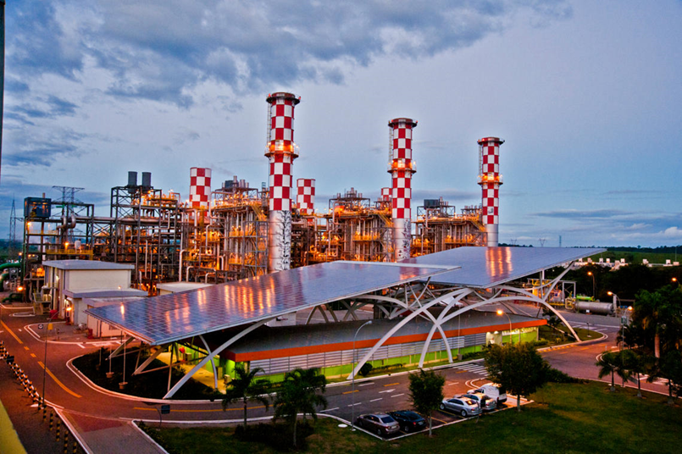
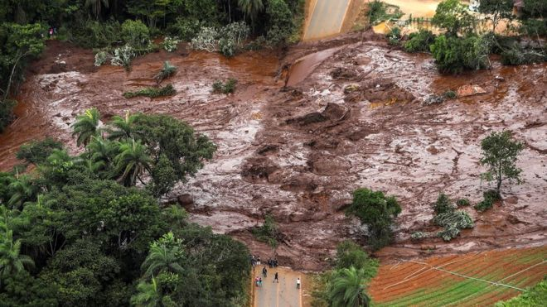
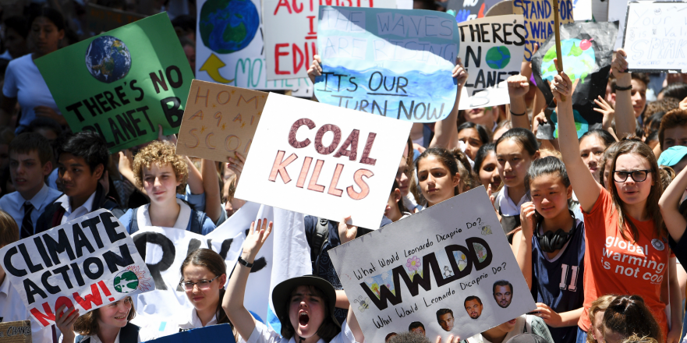
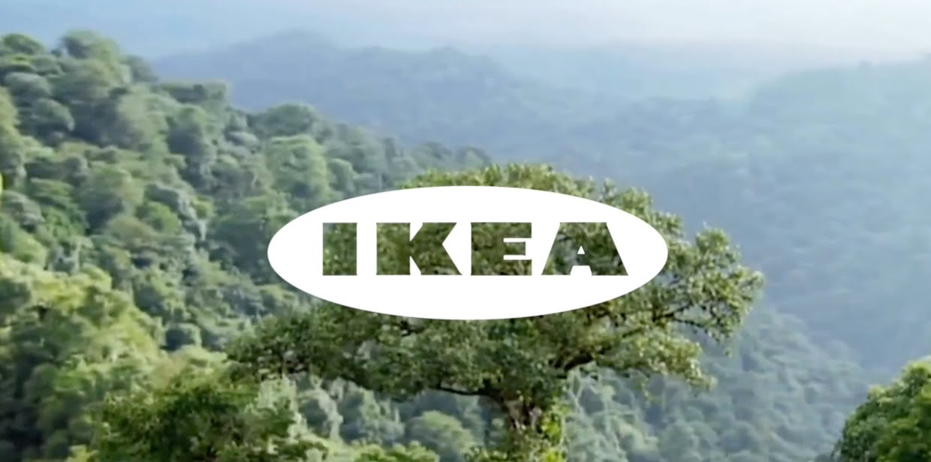

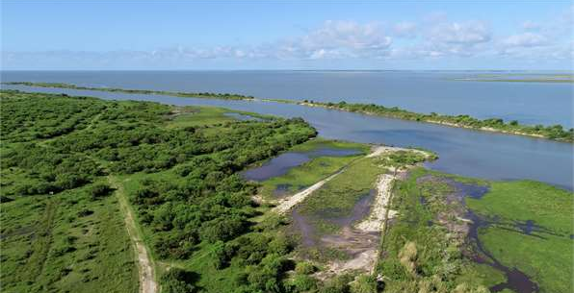

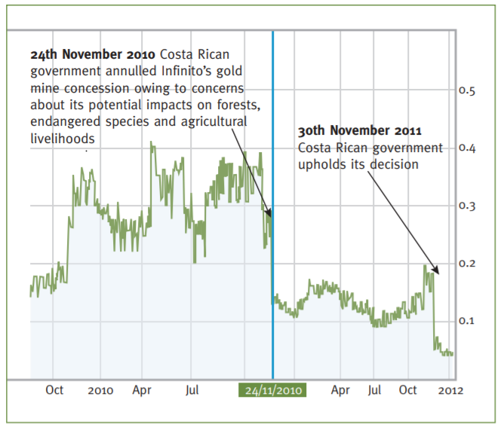
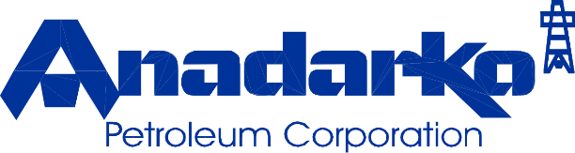



Operational Opportunity
Reputation Risk
Operational Risk
Reputation Opportunity
Risks & Opportunities for business
Financial Opportunity
Legal Opportunity
Financial Risk
Legal Risk
Financial Risk
Notes:
Take opportunity of this slide to mention COSO framework!
Through your different examples, we can highlight key types or categories of risks.
In years gone by, sustainability issues have sometimes taken business by surprise and companies have paid the cost. Companies are increasingly being impacted by the changing risk landscape discussed earlier.
Operational risk – Vale damn collapse
Reputation risk – increased public & consumer awareness of environmental and social damages + consumers are increasingly demanding assurance that the products they buy are produced in way that protect our environment and respect human rights – provide Volkswagen example here – link with SOCIETAL risks – health impacts on local communities, social license to operate
Legal risk – giant Texas oil company, Anadarko Petroleum, has agreed to pay $5.1 billion for a vast environmental cleanup - aimed at restoring thousands of sites polluted by toxins and compensating thousands of people with personal injury claims. https://www.nytimes.com/2014/04/04/business/energy-environment/anadarko-petroleum-to-pay-5-1-billion-to-settle-pollution-case.html
Financial risk – Underlying all of these risks & opportunities are financial ones! As we have seen, these risks imply important financial costs. Canadian gold mining company, Infinito Gold, lost over 50% of its share value as a result of the withdrawal of a mining concession in Costa Rica due to concerns about the potential impacts on agriculture, endangered species and forests. This led to a reference in the audit accounts to material uncertainties regarding the company’s ability to continue as a going concern
Source: KPMG, Flora and Fauna International, Acca, Is natural capital a material issue? (2012)
But good news is that, where there is risk, there is opportunity to:
Secure natural resources
Save costs
Manage future risks
Engage stakeholders
Operational opportunity – EDF rainwater harvesting to manage water scarcity risks leading to reduction in water consumption, economical & energy savings https://www.wbcsd.org/Programs/Food-Land-Water/Water/Circular-water-management/Resources/Case-studies/Rainwater-harvesting-for-water-reduction
Reputation opportunity – IKEA to use only renewable and recycled materials by 2030 https://www.reuters.com/article/us-ikea-sustainability/ikea-to-use-only-renewable-and-recycled-materials-by-2030-idUSKCN1J31CD
Legal opportunity – Union Carbide Corporation, subsidiary of The Dow Chemical Company: Seadrift, TX Wetlands for Wastewater Treatment Project description: 110-acre engineered wetland in lieu of an industrial wastewater treatment plant In 1995, the Seadrift water treatment facility was seeking a solution to consistently meet regulatory requirements for water discharge. An innovative GI solution consisting of a constructed wetland was installed and has been successfully operating upon startup and for the last 15 years. https://www.naturalinfrastructureforbusiness.org/wp-content/uploads/2015/11/DowUCC_NI4BizCaseStudy_ConstructedWetlands.pdf
Financial opportunity – But when these risks are taken into account, we saw how it can also lead to reduced financial costs, or improve access to finance. Companies like those you can see here have managed to secure substantial billion dollar loan facilities where the interest rate of repayments is linked to ESG performance. That is to say if the company has string environmental and social performance they pay back less on the loan.

Slide 17
Operational Opportunity
Reputation Opportunity
Risks & Opportunities for business
Financial Opportunity
Legal Opportunity
Financial Risk
Notes:
But good news is that, where there is risk, there is opportunity to:
Secure natural resources
Save costs
Manage future risks
Engage stakeholders
Operational opportunity – EDF rainwater harvesting to manage water scarcity risks leading to reduction in water consumption, economical & energy savings https://www.wbcsd.org/Programs/Food-Land-Water/Water/Circular-water-management/Resources/Case-studies/Rainwater-harvesting-for-water-reduction
Reputation opportunity – IKEA to use only renewable and recycled materials by 2030 https://www.reuters.com/article/us-ikea-sustainability/ikea-to-use-only-renewable-and-recycled-materials-by-2030-idUSKCN1J31CD
Legal opportunity – Union Carbide Corporation, subsidiary of The Dow Chemical Company: Seadrift, TX Wetlands for Wastewater Treatment Project description: 110-acre engineered wetland in lieu of an industrial wastewater treatment plant In 1995, the Seadrift water treatment facility was seeking a solution to consistently meet regulatory requirements for water discharge. An innovative GI solution consisting of a constructed wetland was installed and has been successfully operating upon startup and for the last 15 years. https://www.naturalinfrastructureforbusiness.org/wp-content/uploads/2015/11/DowUCC_NI4BizCaseStudy_ConstructedWetlands.pdf
Financial opportunity – But when these risks are taken into account, we saw how it can also lead to reduced financial costs, or improve access to finance. Companies like those you can see here have managed to secure substantial billion dollar loan facilities where the interest rate of repayments is linked to ESG performance. That is to say if the company has string environmental and social performance they pay back less on the loan.

Slide 18

What are the risks & opportunities for your business?
Use the blank spaces in your handbook p. 8 and refer to pp. 47-48 of the NCP
Individually reflect in what ways do you think your own company impacts and depends on nature
Write down 3 risks & 3 opportunities you think your company could be facing in the next 10 years
Notes:
Give participants 5’ to reflect individually on both questions
For Q. 1: In the workbook, will have a prepared blank list - one for them to list impacts and one for them to list dependencies. Give also list of examples from NCP they can use – reference to pp. 47-48 and explanation of close link between impacts & dependencies. Include Nadine’s landscape image as additional support.
Mention that it will be important for them to do this part as another exercise will then link to this.
Business impacts and dependencies are closely linked. For example, a company may depend on water, while the quality of its water management practices will affect the scale of impacts generated through its use of water.

Slide 19

Why should business assess its impacts & dependencies on nature?
Many natural capital risks and opportunities are becoming increasingly visible, and business needs a way to understand and manage these.
Understand relationships with nature in a structured way
Challenge your business model
Mitigate risks
Increased competitive advantage
Create opportunities
Inform decisions that are really important to your business
Access to finance
Recruitment & retention of staff
Notes:
There are evidently a lot of pertinent risks around nature and the environment facing businesses today. Where does natural capital come into this - how can it help you manage these risks?
To assess natural capital is to assess your company’s impacts and dependencies on nature.
It provides information that will help you to understand your relationship with nature. By focusing on impacts and dependencies, natural capital provides structure to this understanding.
Once you have a better understanding of your relationship with nature, you can use this to challenge your business model, mitigate risks and create opportunities. Natural capital can also be a valuable tool for broadening the conversation to include all parts of your business, including the finance team.

Slide 20


Objectives
At the end of the training, you will be able to understand:
What is natural capital and its linkages with business,
Why it is important for business decision-making and risk management,
How business can start applying a natural capital approach to support decision-making.
Notes:
The objectives for today are …
Emphasize that this training is particularly targeted at businesses in the early stages of their natural capital journey wanting to understand where to get started / organizations that want to help businesses get started.

Slide 21

How can business apply natural capital?
Notes:
Now we hope we’ve whetted your appetite

Slide 22


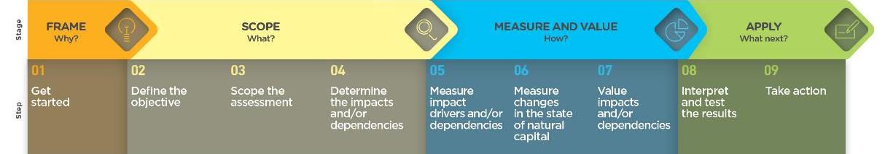
The Natural Capital Protocol
The Natural Capital Protocol is a standardized framework for businesses to identify, measure and value their direct and indirect impacts and dependencies on natural capital.
Notes:
The Natural Capital Protocol has been produced by the Natural Capital Coalition (a network of more than 300 organisations across research, science, academia, accountancy, reporting and many others…) in order to harmonize approaches to natural capital and help businesses get to grips with a crowded and confusing landscape.
The NCP build upon many approaches and seeks to present a standardized, harmonized, global approach to applying natural capital and ultimately, supporting better and more informed decisions.
STRUCTURE of the Protocol:
4 overarching stages of frame (why), scope (what), measure and value (how) and apply (so what) and 09 logical steps. It should be easy to follow and should be suitable for any business across any sector or geography. The stages and steps are iterative so expect that you may need to revisit a previous step.
The NCP is a framework – it lays out the steps, helps to structure your thinking and your research. However, in order to actually assess natural capital in your business, you will need to make use of specific methodologies or tools. The Protocol does not recommend any specific tools, because this is highly dependent on your particular business context and what you want to get out of your assessment. What the protocol does do is help you realise your business context, to frame your assessment and prepare you to select the right tools for your assessment. NCC also provides a toolkit, which we will share the link for after this presentation, which collates a few of these useful resources and tools in one place.

Slide 23
Business applications
Refer to p. 10-11 of your handbook & p. 20 of the Natural Capital Protocol
Natural capital information can be used in plenty of ways. You need to decide what information you need and how it will be used.
Potential Business Applications
Assess risks and opportunities
Compare options
Assess impacts on stakeholders
Estimate total value and/or net impact
Communicate internally or externally
Notes:
A natural capital assessment provides information. Whilst this can be valuable in its own right, this means there are also numerous ways to use this information for further purposes.
The NCP focuses on using natural capital for decision-making, measurement and valuation, but it can also be used for disclosure and communication, or to help formulate strategy.
The best way for your company to use natural capital information is highly individual – think back to the challenges and risks you identified earlier in the training and consider how exactly how more information could help you meet these challenges.

Slide 24
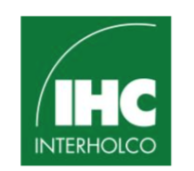

Business example –
Check the NCC’s website or WBCSD’s website for more case studies
What was assessed: a comparison of the effects of sustainable forest management vs pristine conservation and palm oil production.
How this was used: Results were communicated with internal and external stakeholders
  Sustainable forest management by IHC allowed the preservation of integrity of forest and associated values (provision of economic and social benefits)
Going forward: The assessment will guide future monitoring indicators to be integrated into business decision-making.
Compare options
Source: https://naturalcapitalcoalition.org/forest-products-sector-guide-case-study-for-interholco/
Communicate internally or externally
Notes:
https://naturalcapitalcoalition.org/forest-products-sector-guide-case-study-for-interholco/
Interholco (IHC) specializes in forest management and wood production and is one of the largest producers of African tropical hardwood
IHC undertook a study comparing the effects on the forest of undertaking sustainable forest management in the Congo basin vs pristine conservation and palm oil production.
They found that SFM provided more economic value and comparable natural value as conservation. Palm oil theoretically provides 700x economic value than conservation and 40x more than SFM, but this is outweighed by significant co2 emissions associated with deforestation for palm oil and irreversible loss of ecosystem (showing benefit of taking NC approach).
Going forward: the assessment will be used to provide insight on impacts and dependencies, and guide future monitoring indicators to be integrated into business decision making. IHC may in future undertake specific NC assessment for new business development scenarios.

Slide 25
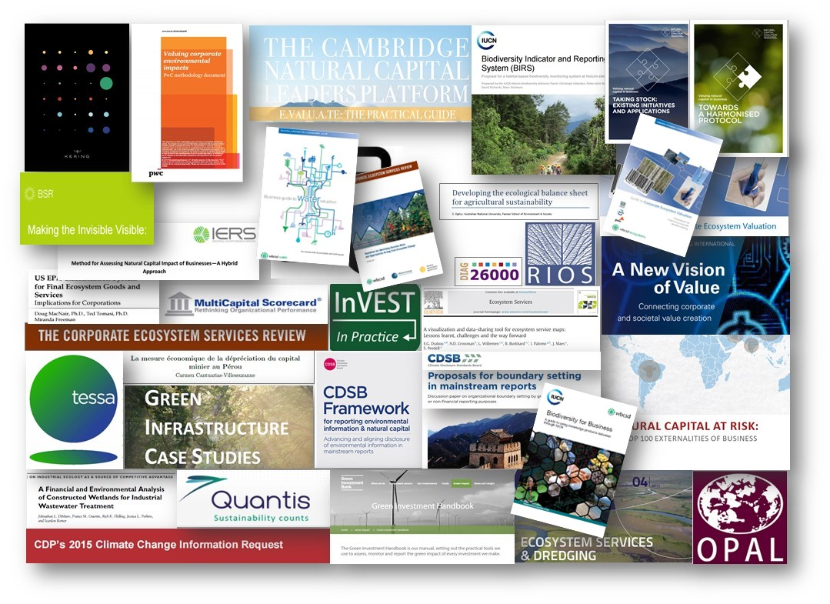
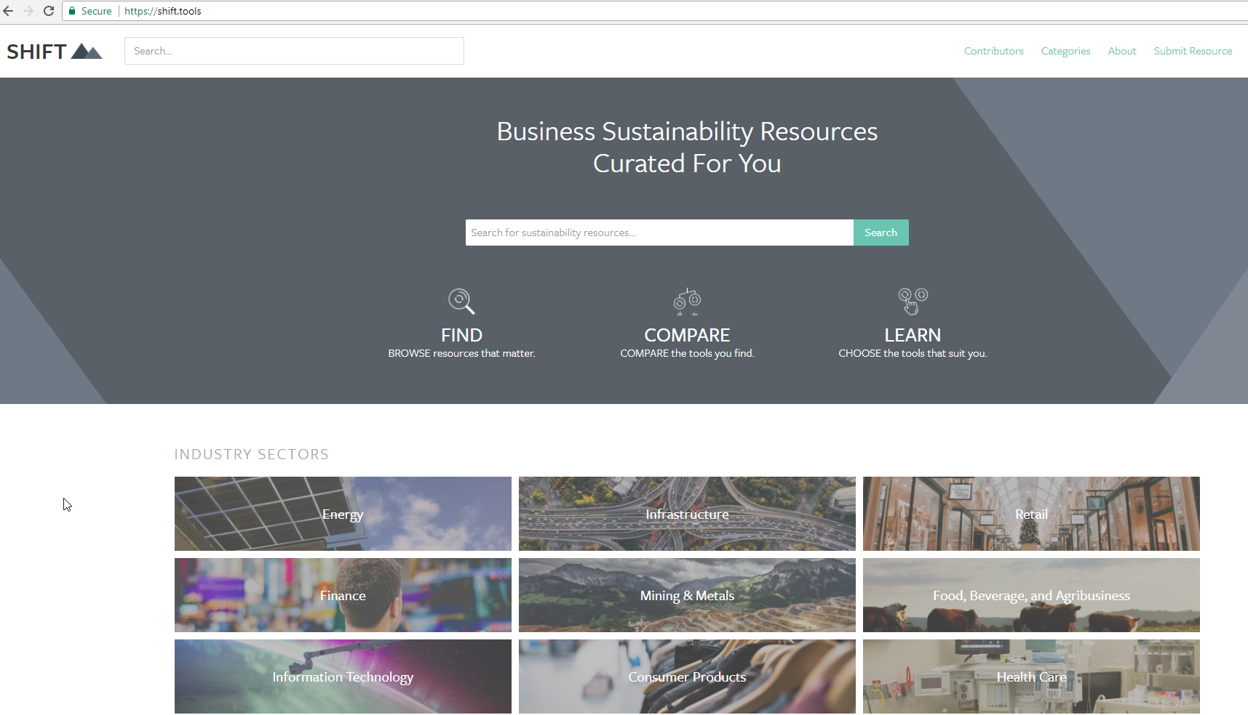
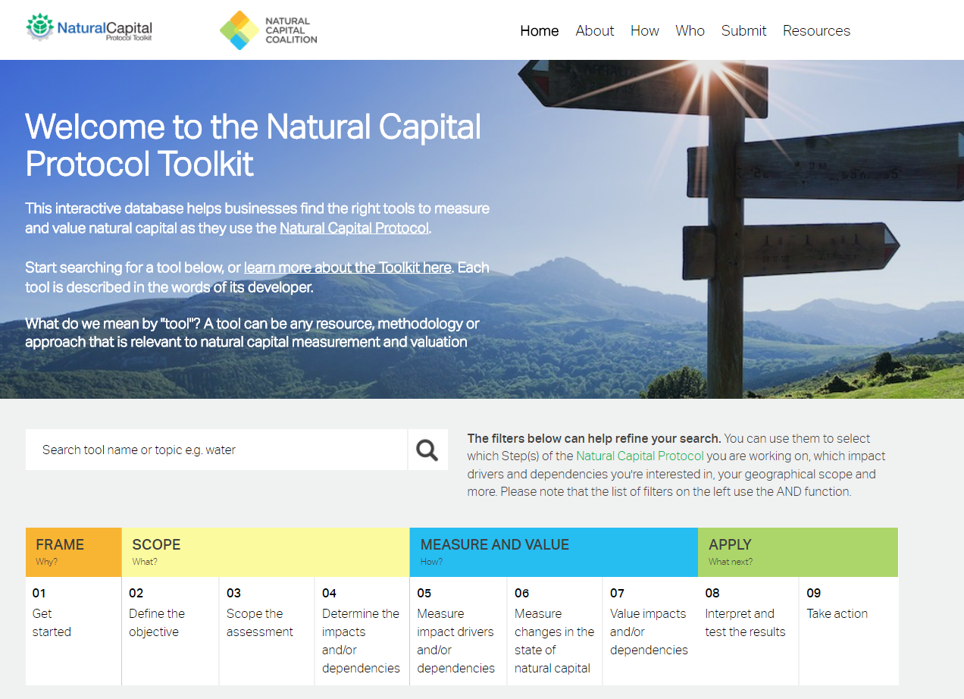

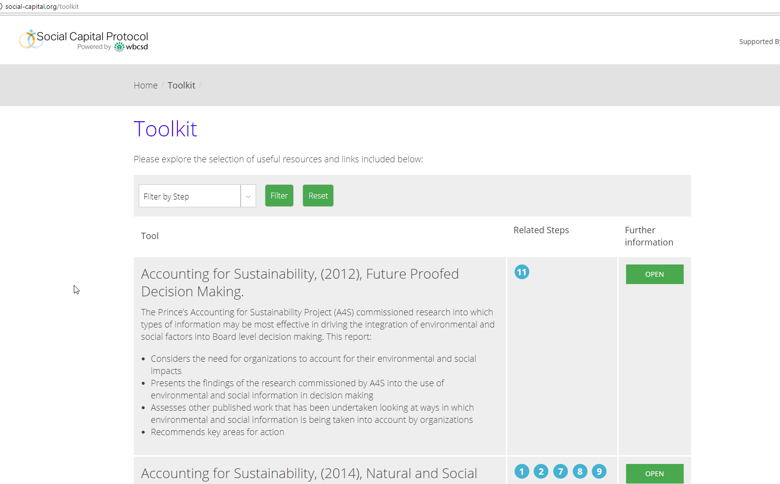
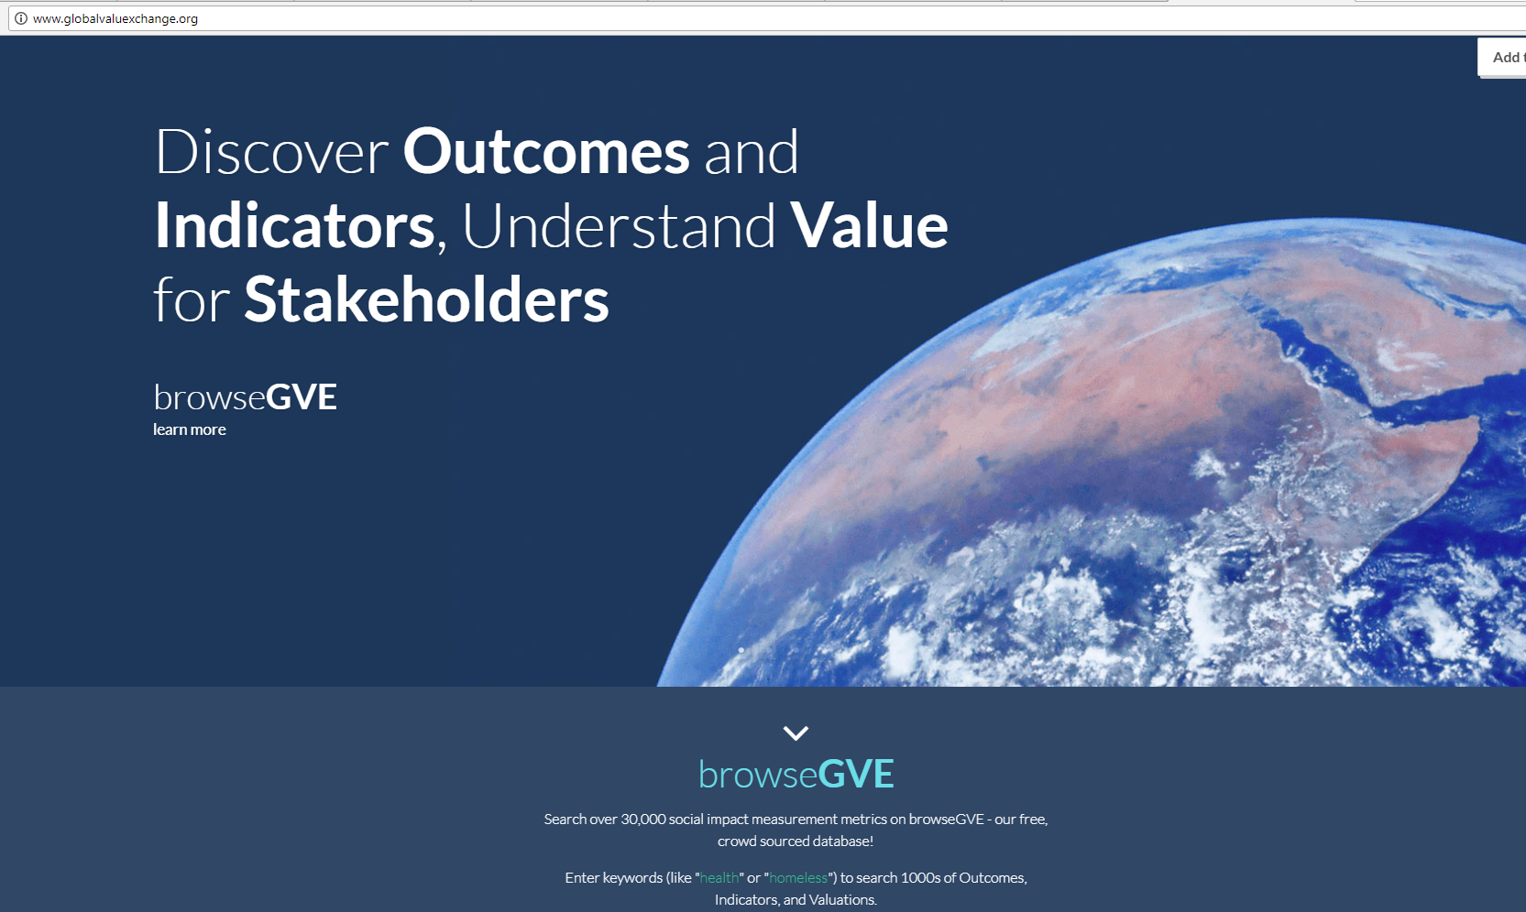
Notes:
We can see from this slide, the wealth of intellectual content, tools and approaches that already exist in the natural capital field.
This certainly highlights the need for standardization, and a process into which all of these existing resources can input. As we have seen, the Natural Capital Protocol does NOT aim to recreate or invent any new methodologies – instead leverages what we already have.
This also shows that while there are many tools, methodologies and resources out there, this can add to the confusion hence the importance to have a good understanding of what it is you are trying to achieve, what kind of information you are trying to collect or decision you are trying to inform in order to chose the most appropriate tool / resource.

Slide 26


Group exercise: exploring tools and resources
In pairs:
Go to The Natural Capital Toolkit on the SHIFT platform: https://shift.tools/nct
Imagine that you work for a mining company. Your senior management team has asked you to explore ways to conduct a company-wide assessment on its use of water.
3. Using the toolkit, determine which tool(s) could help you conduct such an assessment.
Notes:
Now, we thought what better way to have you familiarize yourself with these tools by doing an exercise that will have you explore some of them.
For this exercise, you will need your laptops. You’ll be using SHIFT, which is an extensive repository of tools and resources on how to undertake a natural capital assessment and valuation. Because it’s so huge, we’ve picked the natural capital toolkit to help narrow your search a bit. This was developed by the natural capital coalition and WBCSD.
This is a nice exercise to have them realize that there are many tools available and that the one they will choose will depend on many aspects.

Slide 27
Use p.12 in the handbook
Debrief discussion
What tool(s) have you chosen?
What are the advantages and disadvantages of the chosen tool?
What kind of information did you look for when navigating on the Natural Capital Toolkit?
What factors did you consider to help make the choice of the tool?
In what way(s) could the Natural Capital Toolkit and SHIFT be helpful to you?
What did you learn from this activity?
Notes:
Conclusion of this exercise is that:
There are no perfect answers!
The choice of tool will depend on various factors:
What is the objective / what are you trying to achieve? / What decision are you trying to inform? – Is it to inform business strategy? Business management? Or operating decision?
What is the scope? Are you looking at product, corporate level?
What perspective are you looking at? Business? Societal? Both?
How much resources do you have available to conduct the assessment?
How much information / data do you already have?
Will you need external help?
Etc.

Slide 28



Assessments: Measure & Value
To measure ≠ to value
To measure: determine the amounts, extent and condition in physical terms, e.g. m3, tons, number of injuries, number of jobs
To value: estimate the relative importance, worth, or usefulness of natural / social / human capital to people (or to a business), in a particular context.
Can be qualitative, quantitative and monetary
Costs and benefits to the business, and to society
Notes:
There are different ways of valuing – could be qualitative, quantitative and monetary
Important to note that monetary values without any context (i.e. accompanying quantification) are less meaningful!
The method you chose depends on which natural capital impact drivers or dependencies you wish to assess, the chosen value perspective (e.g. business, societal, or both), the ultimate objective of your assessment, and the time and resources available.
Monetary valuation: some find it difficult to accept or interpret monetary valuation of certain benefits (e.g. spiritual values). In such situations, special efforts may be required to explain the advantages and also to acknowledge the limitations of monetary valuation.
Advocates of natural capital are sometimes accused of ‘putting a price on nature’ or ‘pricing the priceless’, but in fact our core assertion is that prices have failed to reflect the true value of the natural world, and that the economic systems that we are using are broken.
We use the common definitions of price and value: Where price is ‘the quantity of one thing that is exchanged or demanded in barter or sale for another/the amount of money given or set as consideration for the sale of a specified thing’ and value as ‘The regard that something is held to deserve; the importance, worth, or usefulness of something i.e. “your support is of great value”. If something is not for sale, we do not describe it as having a ‘price’, but we may nevertheless recognise the value that it holds, and make decisions on this basis.

Slide 29

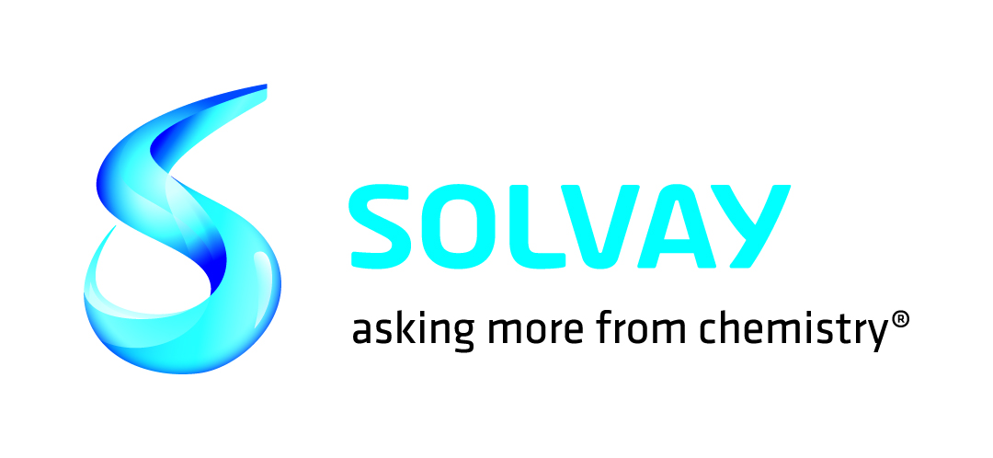

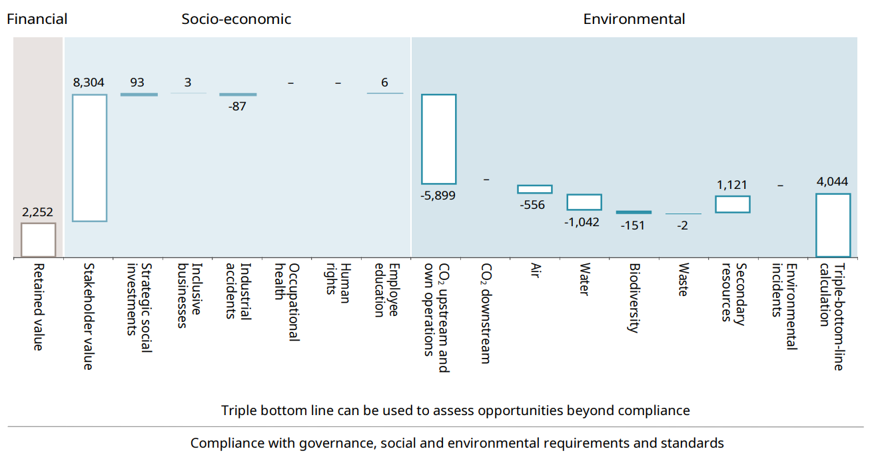
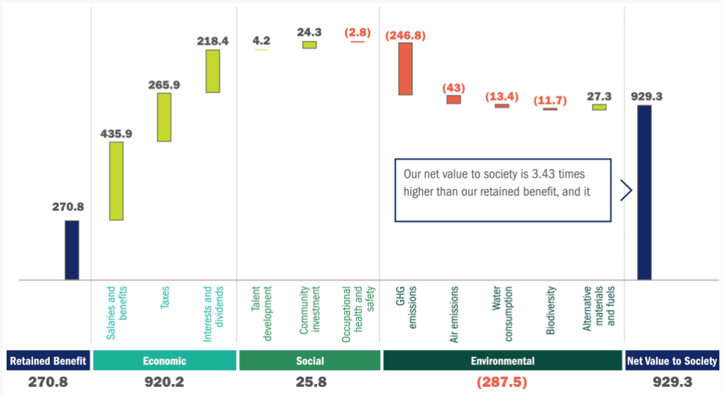
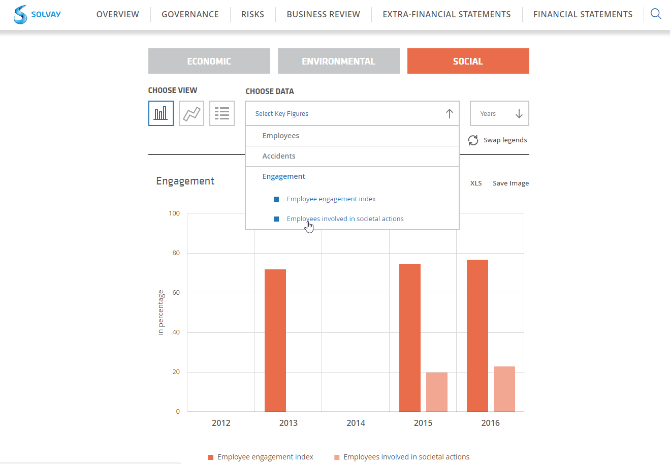

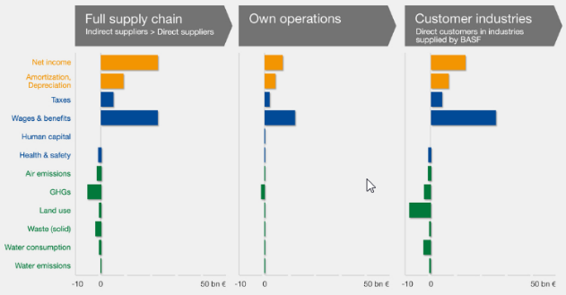

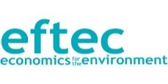
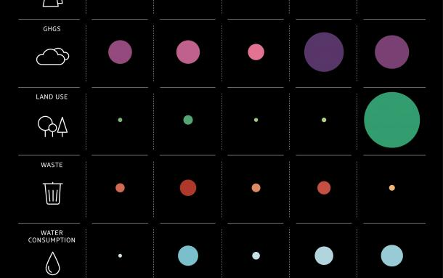


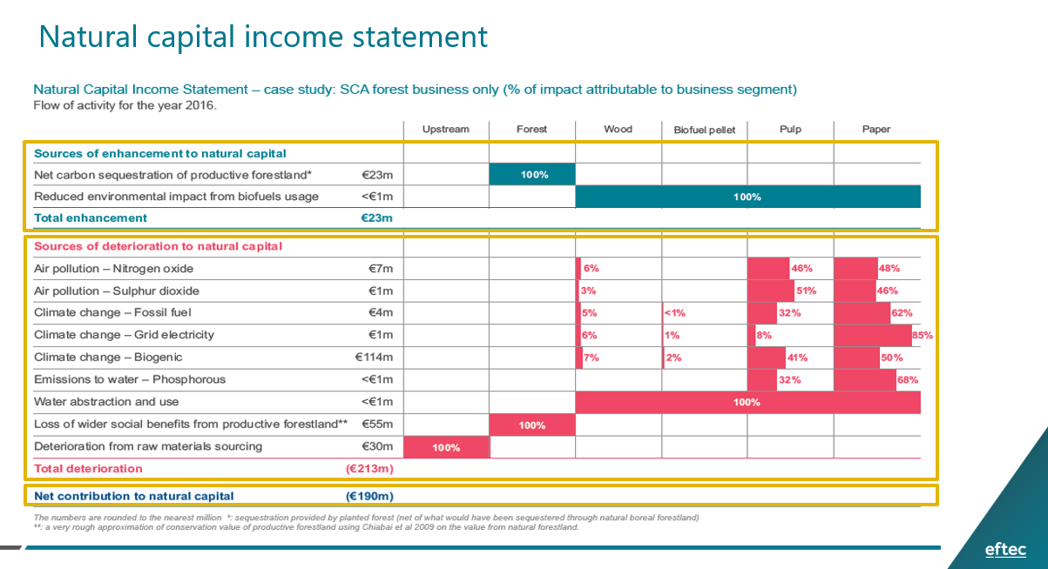
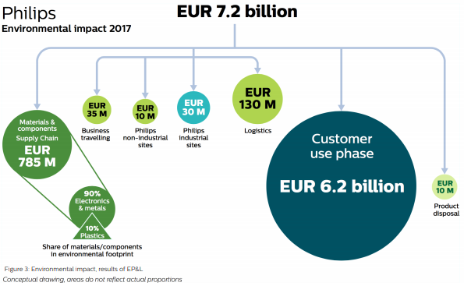
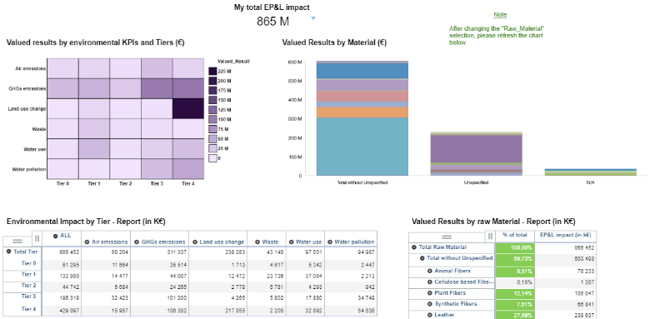
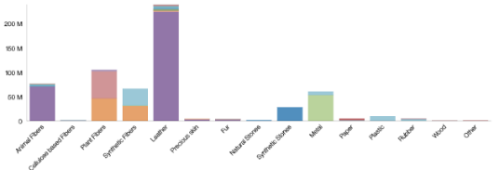
Companies are Experimenting & Sharing
≠
Notes:
ATTENTION should talk through at least one of these with some information as to the use of the data and what it has helped the company to achieve!
Can ask after explaining this slide, what are participants’ corporate culture when it comes to this? What would their senior management team prefer?
SCA/eftec: natural capital balance sheet showing value to business, value to society, total value, and how much of this is reported in financial accounts. Total assets in financial accounts reported as 3250mn euros, whilst total natural capital assets value at 12,369mn euros.
Used as internal risk management tool, in internal & external communications and in government/regulatory relations. Production required an element of learning as SCA was a first-mover in this space.
Solvay: extra-financial statements which show economic, environmental and social indicators in similar form to a standard financial statement, with different units of measurement (i.e. not all monetary).
LafargeHolcim: Integrated profit & loss statement, estimation of total value LH provides for society. Considers socio-economic and environmental factors alongside financial. The statement is the result of cross-functional collaboration. Used in LT strategy to help LH building value for shareholders, people and planet. To help shape the mindset of decision makers in LH and enhance decision making process by looking at things from the bottom-up.
Argos: (will be explained by Cristina)
BASF: Value to society approach, considers impact categories along the entire supply chain and provides an absolute value of contribution in monetary terms. Can compare results between years since 2013. This approach in particular allows comparison between financial and non-financial impacts and maps impacts along different stages of the value chain, as well as providing a better understanding of interdependencies between economic, social and environmental issues.
Phillips: EP&L providing an environmental footprint for the whole value chain in monetary terms, using LCA methodology. However only looks at hidden environmental costs to society, not benefits.
Kering: EP&L (next slide)
Natura EP&L: in 2013, results have been used for carbon neutrality programme.

Slide 30
Case study

Slide 31
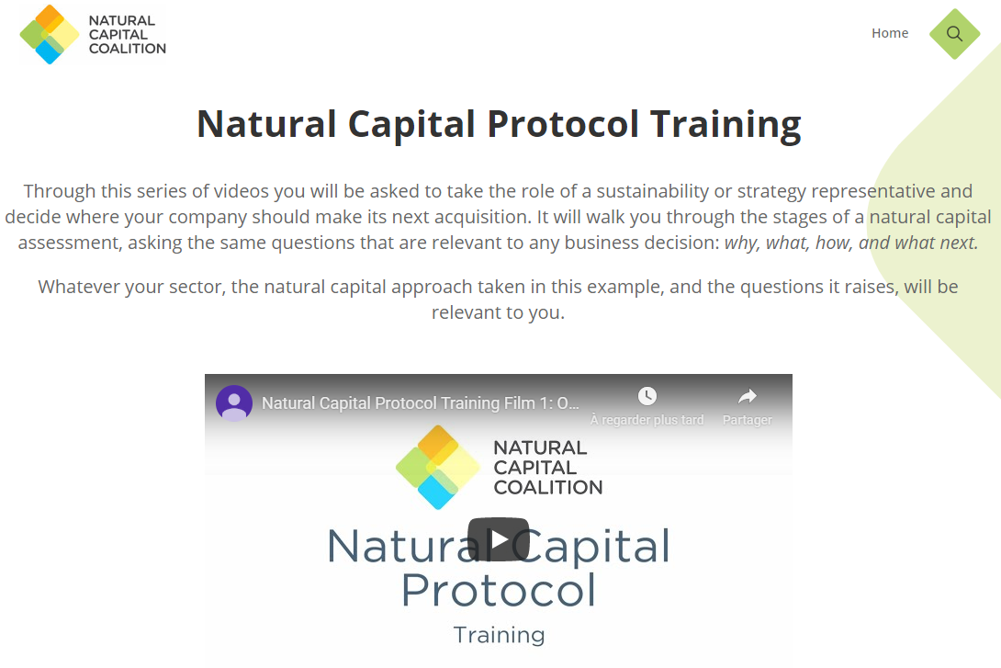
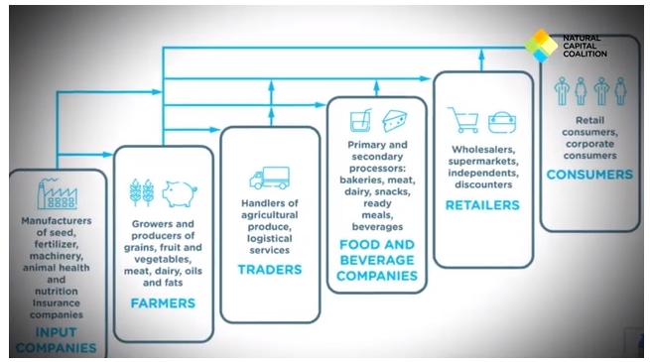
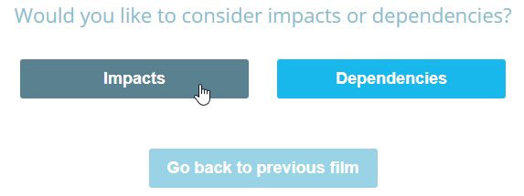
Eager to get started?
Check out NCC’s interactive training videos
Notes:
The Natural Capital Coalition has recently launched a set of training videos that will guide you in an interactive way through a light natural capital assessment to explore just how much can be achieved with limited resources. Interested to learn more? Check out these videos here.

Slide 32

Objectives
At the end of the training, you will be able to understand:
What is natural capital and its linkages with business,
Why it is important for business decision-making and risk management,
How business can start applying a natural capital approach to support decision-making.
Notes:
The objectives for today are …
Emphasize that this training is particularly targeted at businesses in the early stages of their natural capital journey wanting to understand where to get started / organizations that want to help businesses get started.

Slide 33
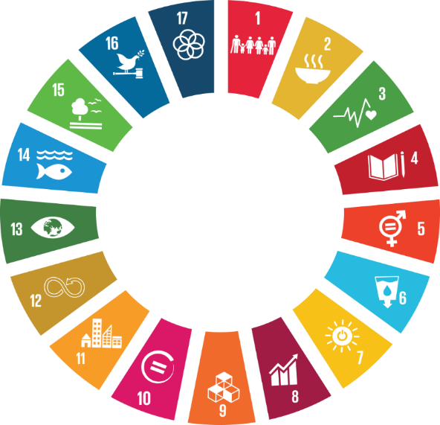




2020 and a New Deal for Nature and People
5 years since…
2020 is gearing up to a “super year for nature”
COP15 | 19-31 Oct | Kunming, China
“Ecological Civilisation – building a shared future for all life on Earth”
Notes:
Not assume that everyone will know these initiatives so also make sure to explain these and why business should care about them / keep an eye out.
While the IPBES Global assessment report warns that nature is declining globally at rates unprecedented in human history, it also tells us that it is not too late to make a difference, but only if we start now at every level from local to global, and through transformative change, that is, system-wide reorganization across technological, economic and social factors, including paradigms, goals and values.
2020 is set to be a ‘super year’ for nature, there is a strong call for a global agenda for action on nature and biodiversity with several crucial political decision milestones in 2020, providing key opportunities to address the frightening loss of nature.
SDGs & Paris Agreement: World leaders are expected to review the progress made on the UN Sustainable Development Goals and the Paris Agreement
15th Convention on Biological Diversity (CBD) COP meeting in Kunming, China in 2020: - This is a very important conference, as targets for nature for the decade 2020 to 2030 are to be agreed
Unified business voice through Business for Nature coalition: B4N is a global coalition hosted by WBCS that will champion radical collaboration to unite the vast network of business initiatives for nature in a somewhat similar way to the We Mean Business coalition did/does for climate. It will complement and drive business momentum for the Nature Action Agenda. A diverse, and powerful group of stakeholders including WBCSD, We Mean Business, the Consumer Goods Forum, the World Economic Forum, the Natural Capital Coalition and WWF have come together to initiate this coalition.
IUCN World Congress: Held once every four years, the IUCN World Conservation Congress brings together several thousand leaders and decision-makers from government, civil society, indigenous peoples, business, and academia, with the goal of conserving the environment and harnessing the solutions nature offers to global challenges
Capitals Coalition: As natural capital thinking and the Coalition continue to flourish, it is becoming impossible to ignore the fact that natural, social, human and economic issues are fundamentally interconnected, and that they must be addressed together. For this reason, the Natural Capital Coalition and the Social & Human Capital Coalition now unite as the ‘Capitals Coalition’. This integrated approach and initiative will be key if we are to reach the required goals in 2020.

Slide 34

Key takeaways / Closing word
See p. 17 in your handbook
Business impacts and depends on nature
Applying a natural capital approach helps make better & more informed decisions
There are many existing tools & resources
Companies can start to conduct an assessment themselves
Buy-in must extend beyond the sustainability team
Notes:
Business impacts and depends on nature – the NCP provides the framework to identify and assess impacts and dependencies,
Understanding, measuring and valuing natural capital (i.e. taking into account) will help business make better decisions,
There are many existing tools & resources to measure and value impacts and dependencies. The one you chose depends on the information you are aiming to get or the decision you are trying to inform,
Companies can start to conduct an assessment themselves by getting the project going, scoping the assessment and integrating natural capital considerations into internal processes,
For natural capital to become strategically important, buy-in must extend beyond the sustainability team.
ADDITIONAL BACKGROUND INFORMATION
How much will an assessment cost?
Some of the Protocol pilot testers - like our members Nestlé and Roche - estimated they spent about USD $50,000 on consulting services for their assessments over a six-month period. Some companies spend less, others spend more.
Dow, Kering and Natura have invested significantly more over a longer term, for in-depth assessments that contribute to their multi-year strategic ambitions
The Protocol can help companies navigate these kinds of situations by making sure the services required align with the assessment's objective.
Skills & data needed:
It's usually much more efficient to build on existing data that's readily available in-house, and the Protocol provides guidance on gathering and using that data too.
For example, many companies have data on their own GHG emissions, water, waste, and some also have results of product Life Cycle Assessments - this existing information can provide a really good starting point for a natural capital assessment. How applicable it is will depend on the objectives and scope of the assessment though, so it's important to find the balance between getting perfect data (e.g. from monitoring in the field) and using proxies that are not as accurate but can be more practical and still lead to better decisions.
Internal buy-in:
In many cases, natural capital assessments can be a bottom-up effort. Trying to drive natural capital assessments from sustainability, environment or health and safety departments is sometimes difficult, but nevertheless, the Protocol provides guidance on integrating the assessment into the business itself.
One way to facilitate engagement internally can be to show that "many companies are already doing natural capital assessments; they're just using different terminology and steps.
To support this engagement, it is important to look beyond those benefits that can be valued through the natural capital assessment itself, and acknowledge how a natural capital approach can motivate organizational change in support of broader business goals." This means that there will be more leadership from the top to better measure, value and then integrate natural capital into business.
The bottom line is that although carrying out a natural capital assessment is technical, it's also achievable. Not every assessment has to be a huge undertaking, so companies should start off with a scope that makes most sense to their situation. The Protocol will help you do this.
Finally, we must make sure the information obtained from the assessment is included in core business decision-making. This will ensure you have the best possible impact on your business, and on the environment.

Slide 35

Wrap-up
Use p. 16 in your handbook
On post-its, take note of:
1 key learnings that were most useful to you today,
1 concrete next step / activity you could take to move your company / member companies forward in the natural capital journey?
Notes:
5’ for participants to write these down – can place their post-its on flipchart as they exist room (to save time).
ATTENTION not forget to then ask participants fill out training survey (google sheet form)!!

Slide 36



We are here to help!
Join us tomorrow 15:00-17:00
Deep-dive webinars
Virtual office hour/
Q&A
In-person training
Helpdesk calls
Online training
Train-the-trainer
We want to learn too – how have we helped?
What else? Tell us what other support you need: Survey
Keep in touch & sign-up: wevaluenature.eu
Email: bonga@wbcsd.org
Notes:
WHAT ELSE would you need? What support would you need?
Sign-up for in-person day training, t-t-t
If want support, need to fill out survey (Google form survey)
Refining training further, keen to know how have used this training and catch-up via call (if don’t want to, let us know)

Slide 37
